Slide 1
Von den Atomkernen in den Mikro- und Makrokosmos
Aus den Ruinen zum KIT-CETA
Herwig Schopper
Talk in German, slides in English

Slide 2
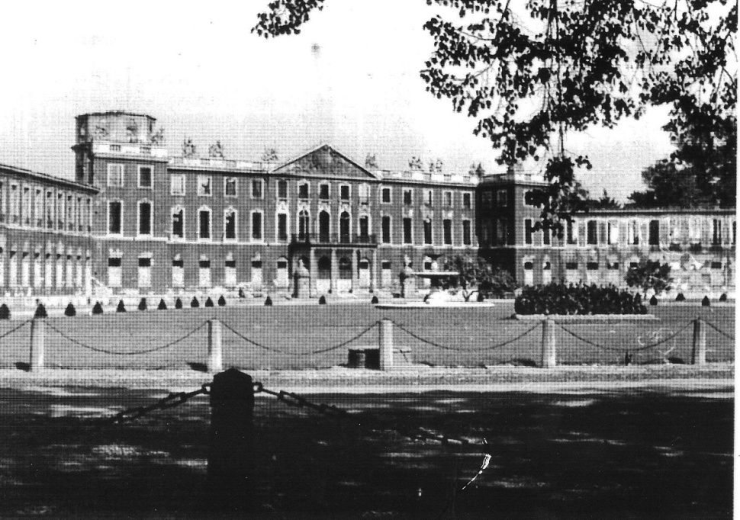
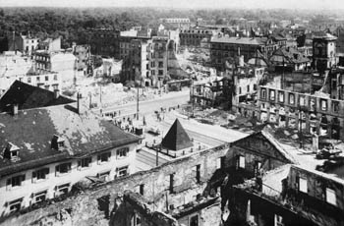
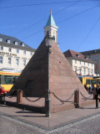
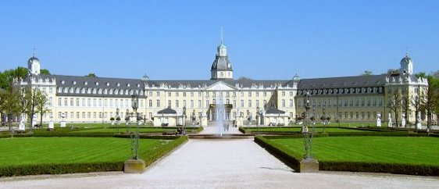
1945 Karlsruhe in ruins (town and physics)
Castle
Market place
Now reborn, town and physics

Slide 3
Looking back 50 years I am deeply impressed by the incredible development of
Nuclear and Particle Physics
(experimental and theoretical) at Karlsruhe
I cannot cover all events of past 50 years,
in 30 min - impossible
Just some highlights
Apologies for omissions
Thanks to all who have provided material for this talk:
H.Appel, B.Jenschke, W.Kluge, H.Koch, W.Eichelberger,
L.Schänzler, H.-M.Staudenmeier et al

Slide 4
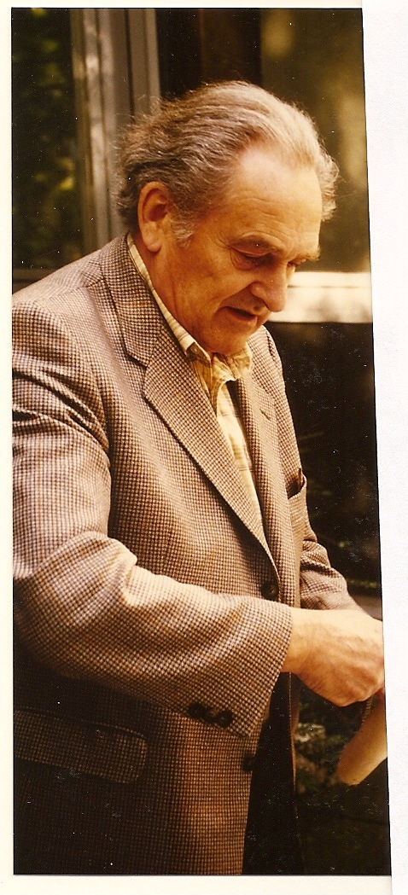
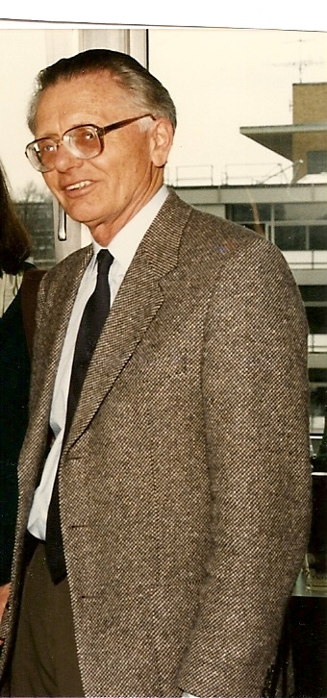
New beginning of physics with (big) bang
Several chairs at TH Karlsruhe were filled
within a few months in 1960
1960 Werner Buckel, Festkörperphysik (Nachfolger Gerthsen), Stöckmann, Falk
19.7.1960 Gerhard Höhler,
Theoretische Kern- und Teilchen Physik
22.8. 1960 Herwig Schopper,
Experimentelle Kern- und Teilchenphysik
HS appointed as Director of two Instituts for Experimentelle Kernphysik IEKP
one at Research Center Karlsruhe FZK
the other at University
Höhler
Buckel
My condition: unification of the two instituts
‚formale Zweiteilung des Instituts (TH und KFZ) soll im wissenschaftlichen Bereich nicht in Erscheinung treten‘

Slide 5
Reasons for Unification of two Institutes
Advantages for both, university and research center
University offers:
- free environment necessary for creative research,
no ‚directed‘ research (Auftragsforschung)
contact with students, decisive to find excellent collaborators
Research centre offers:
technical infrastructure and financial planning necessary for large projects of nuclear and particle physics
basic research contributes to stability of research centre,
since independent of technical and economic fashions

Slide 6
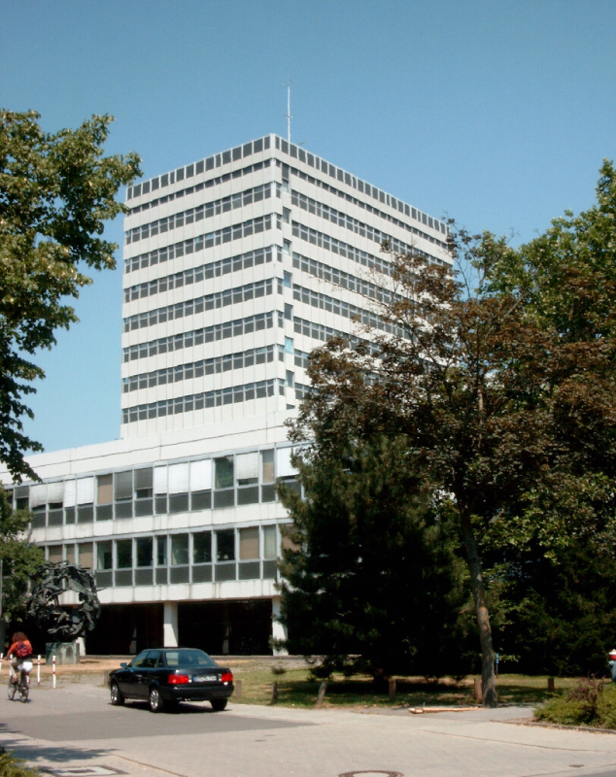
First tasks at University in 1960 ff
New Buildings were desparately needed:
new Highrise, lecture halls
A new and modern curriculum had to be agreed upon and lectures organised (balance between nuclear-particle physics and condensed matter physics)
Hochhaus ready 1967

Slide 7
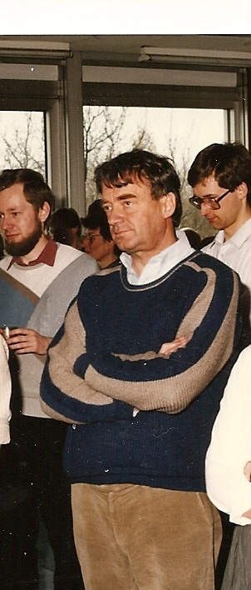
Institut Theoretische Kernphysik establised at University
Gerhard Höhler: World expert for Pion-Nucleon interaction
(has written a ‚bible‘ in Landoldt-Börnstein)
Pilkuhn: mesic, antiprotonic atoms
Genz: Symmetries, several popular books
H.-M.Staudenmaier : decay processes, symmetries
Julius Wess: Father of Supersymmetry Theories (with Zumino)
5.10.1990, Johann Kühn successor of Höhler, Particle-Phenomenology
New name of Instituts:
Institut für Theoretische Teilchenphysik TTP
Wess

Slide 8
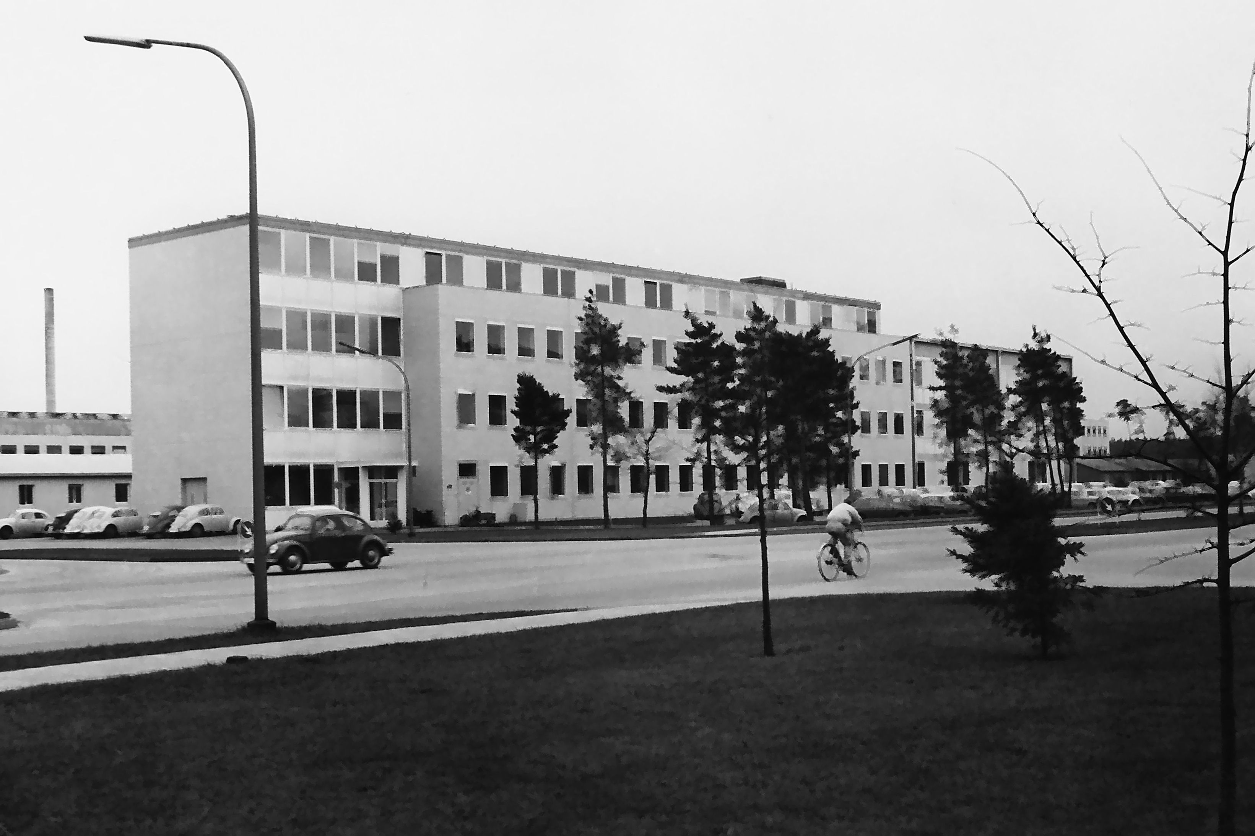
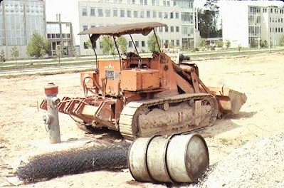
First tasks at Research Centre FZK
get a building, preliminary at Erwin Becker‘s institute
Design and construction of ‚double‘ IEKP
How it started
Soon we could move in!

Slide 9
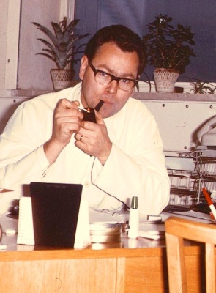
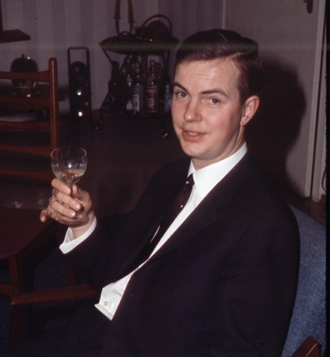
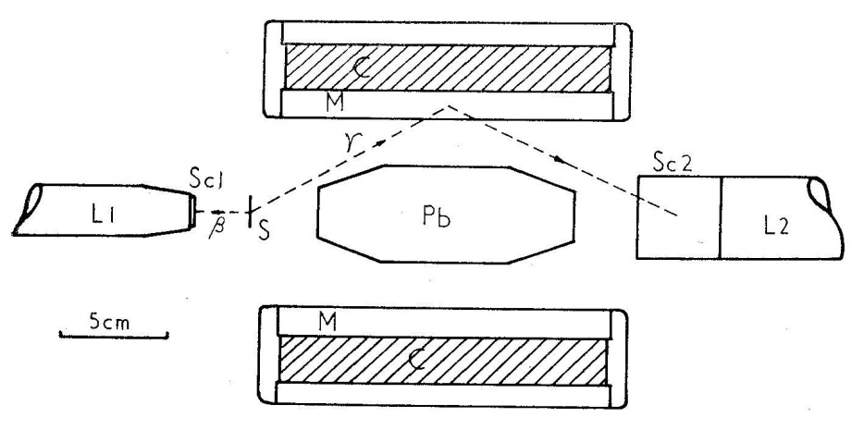
1. Phase of IEKP (unified)
1960 – 1973
Start with Nuclear physics
First modest possibilities to do research with equipment brought along and with colleagues following from Erlangen and Mainz
H.Appel, H.Behrens, Galster, Hartwig, H.Müller
Parity violation experiment 1957 (Cambridge,UK)
β - γ circular porlarisation corelation
Thought impossible by Lee and Yang
γ circular polarisation scattering from
magnetised iron
Exploited in many ways (many thesis):
e.g. nuclear spectroscopy
matrix elements of beta transitions

Slide 10
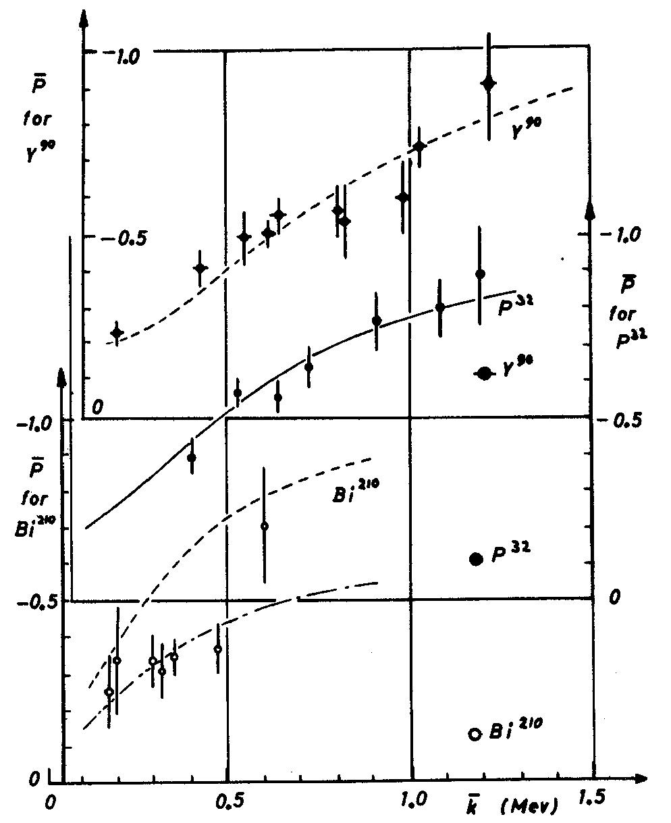
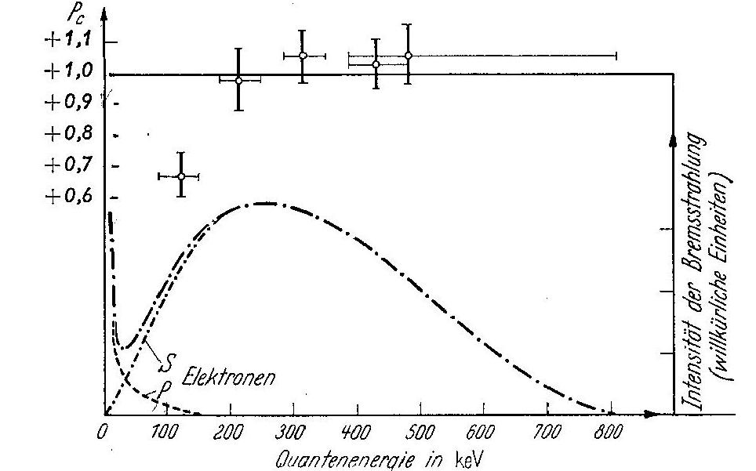
Circular polarisation of Internal Bremsstrahlung
following
  beta decay
  K capture
100 % polarised
Many publications

Slide 11
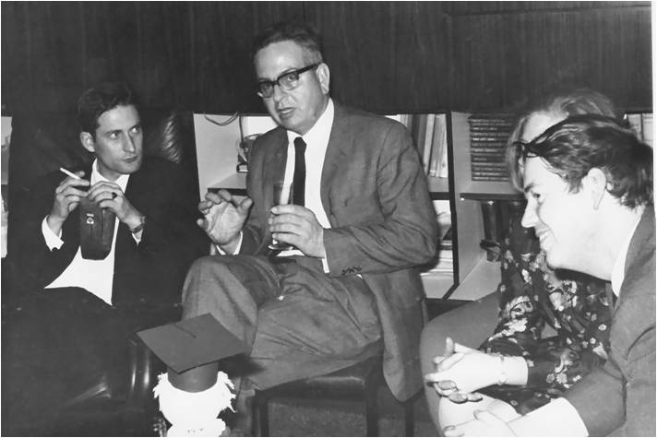
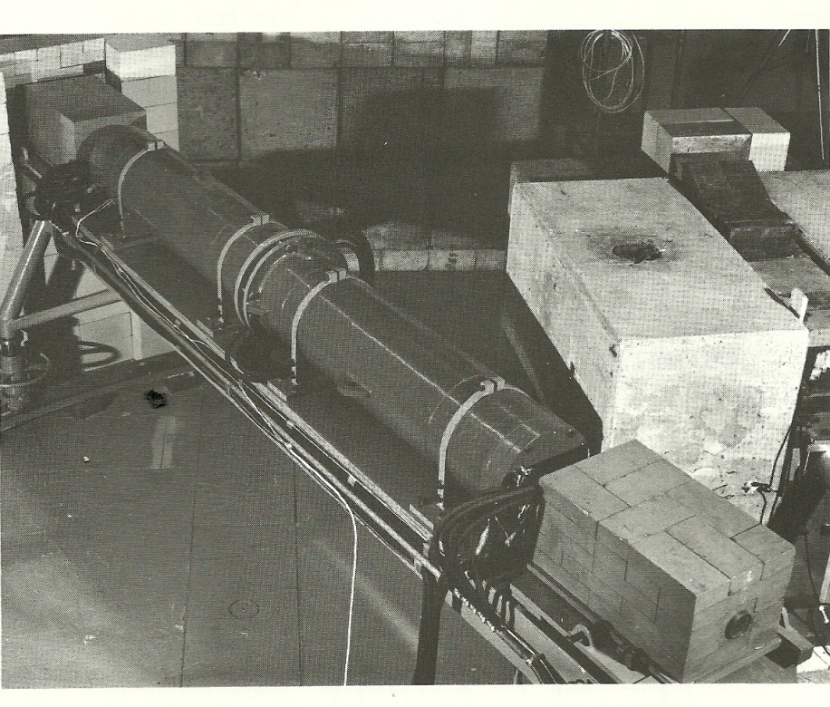
Other activities in nuclear physics
Nuclear reactions using KA Cyclotron
Polarized particles
Source for Polarized Protons
Polarized Neutrons
E.Boschiz, H.Brückmann, W.Kluge, L.Schänzler, H.Ullrich, Ch.Weddingen
Magnet to rotate neutron spin

Slide 12
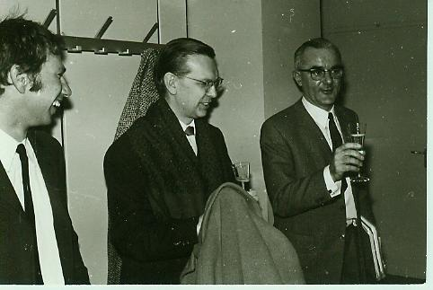
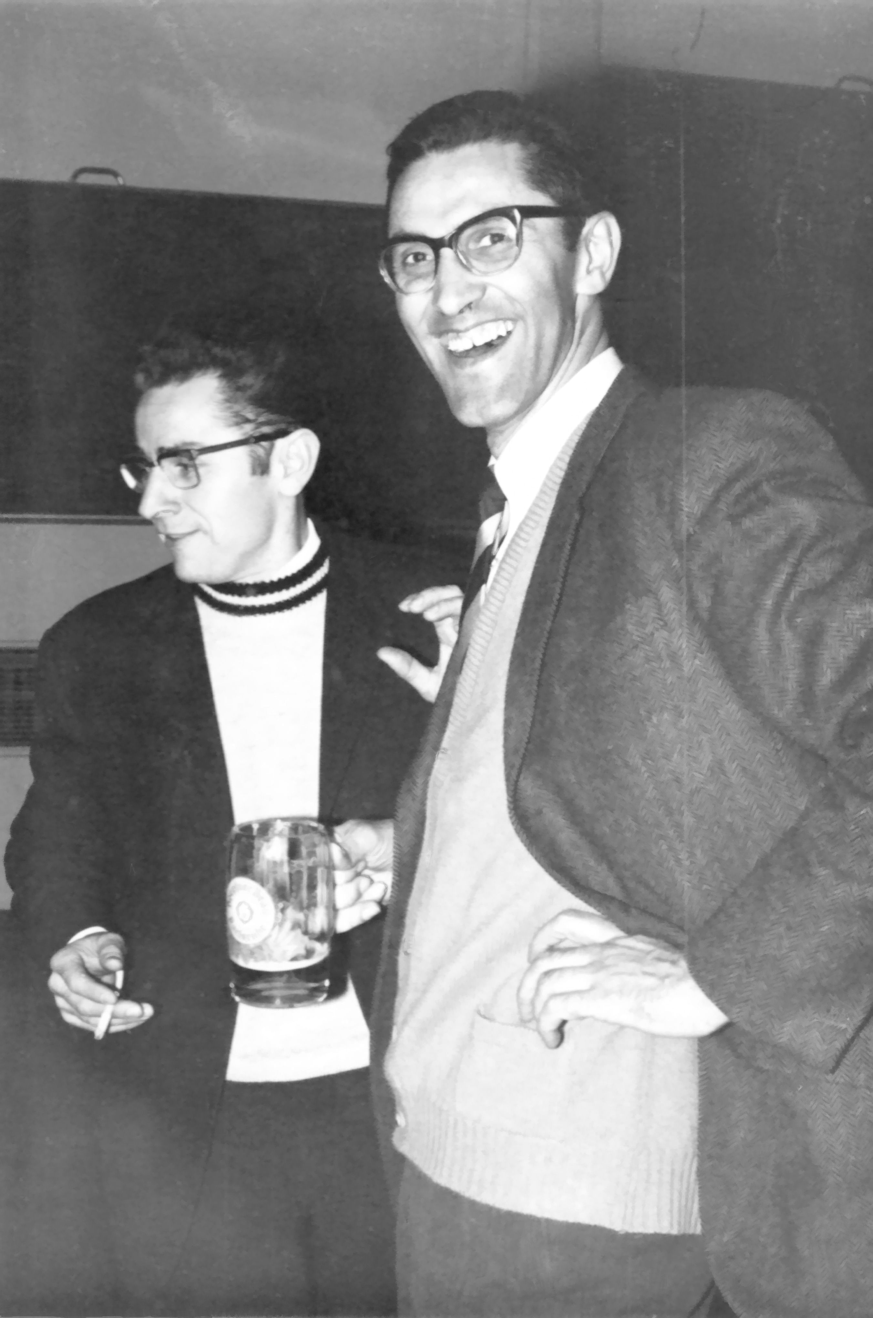
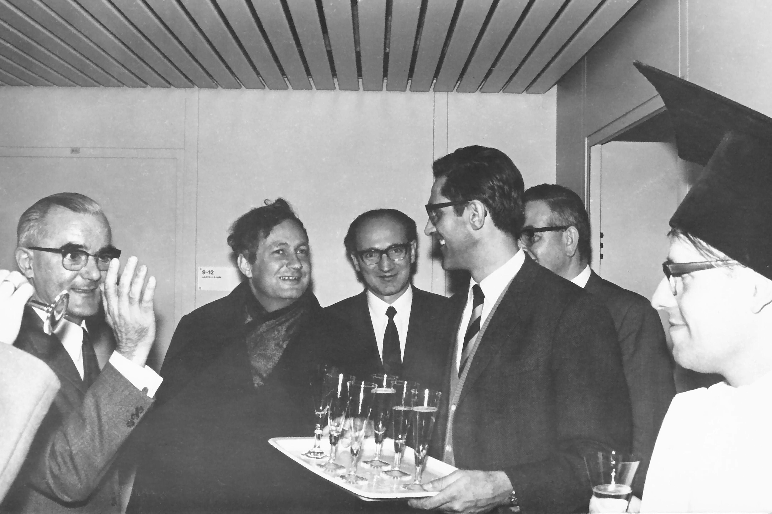
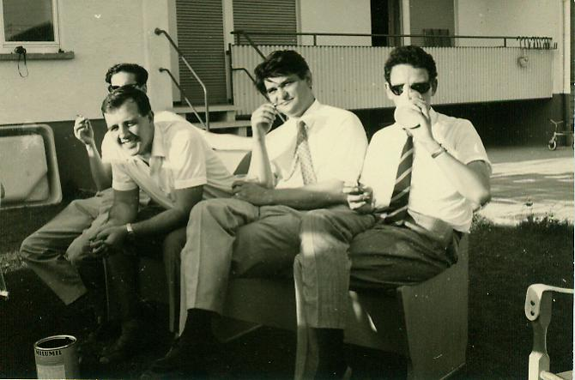
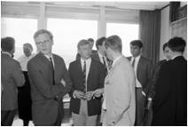
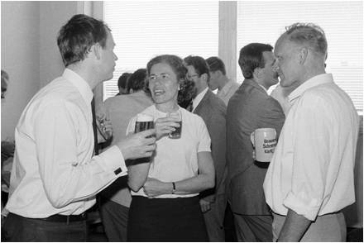
Institutsfeste

Slide 13
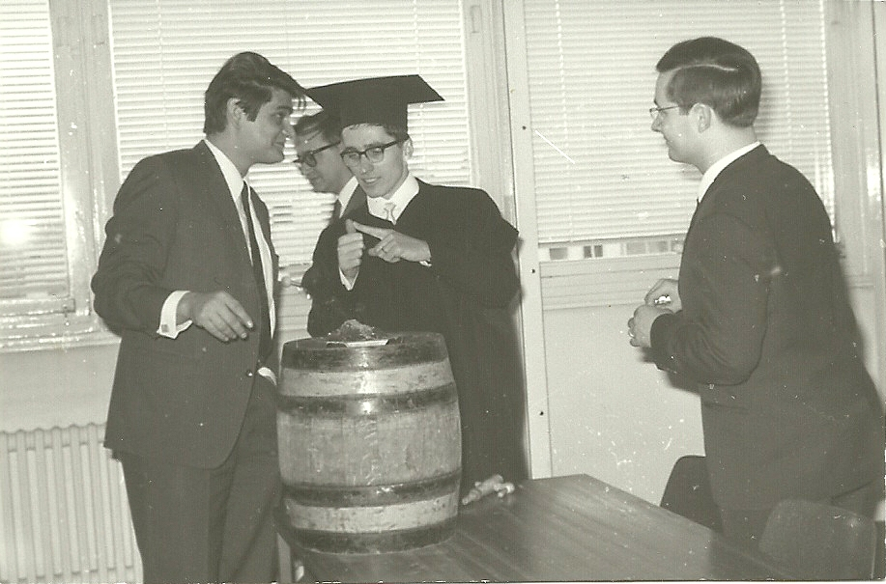
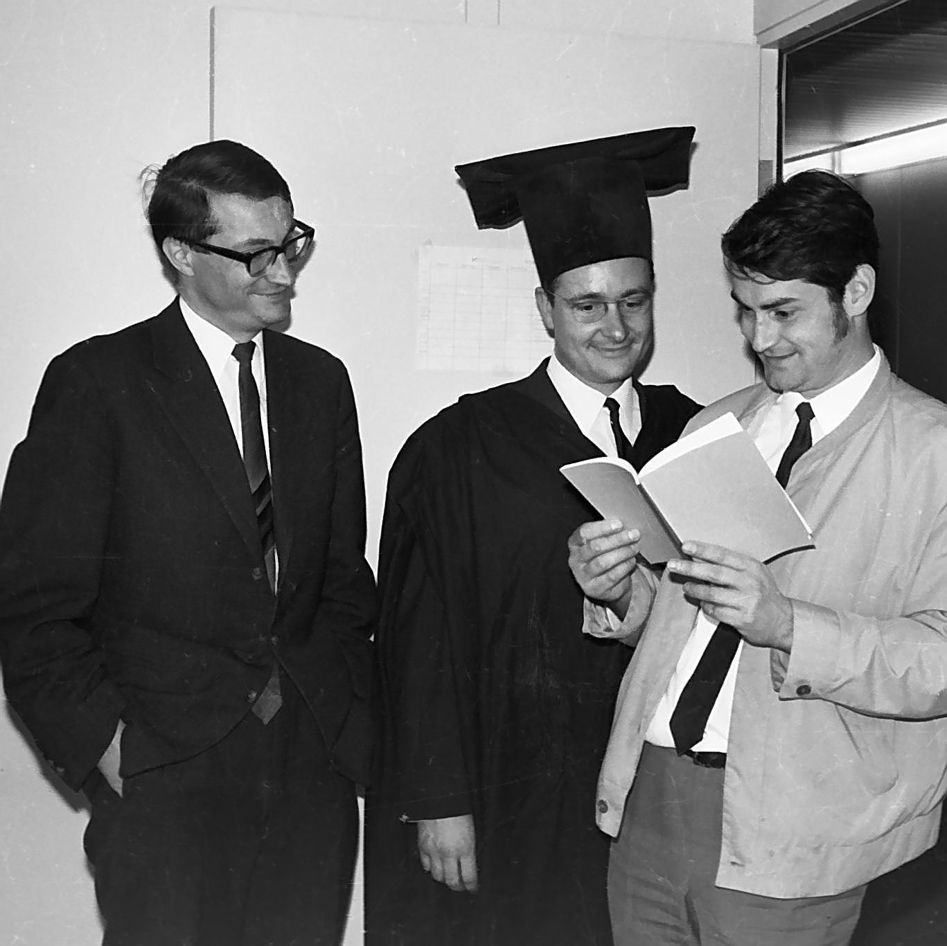
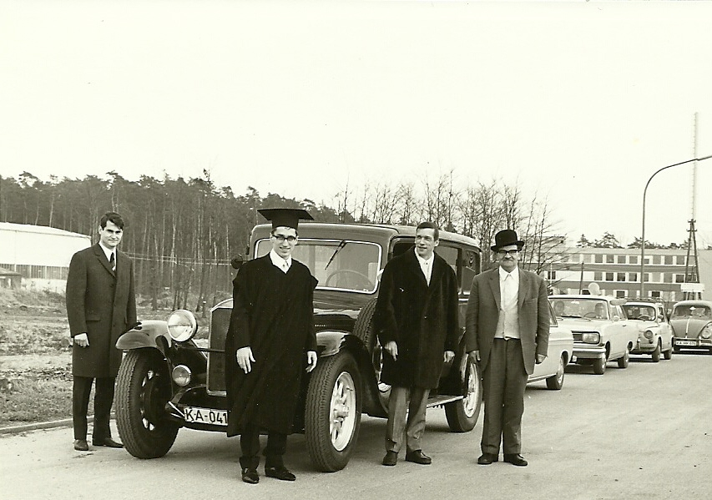
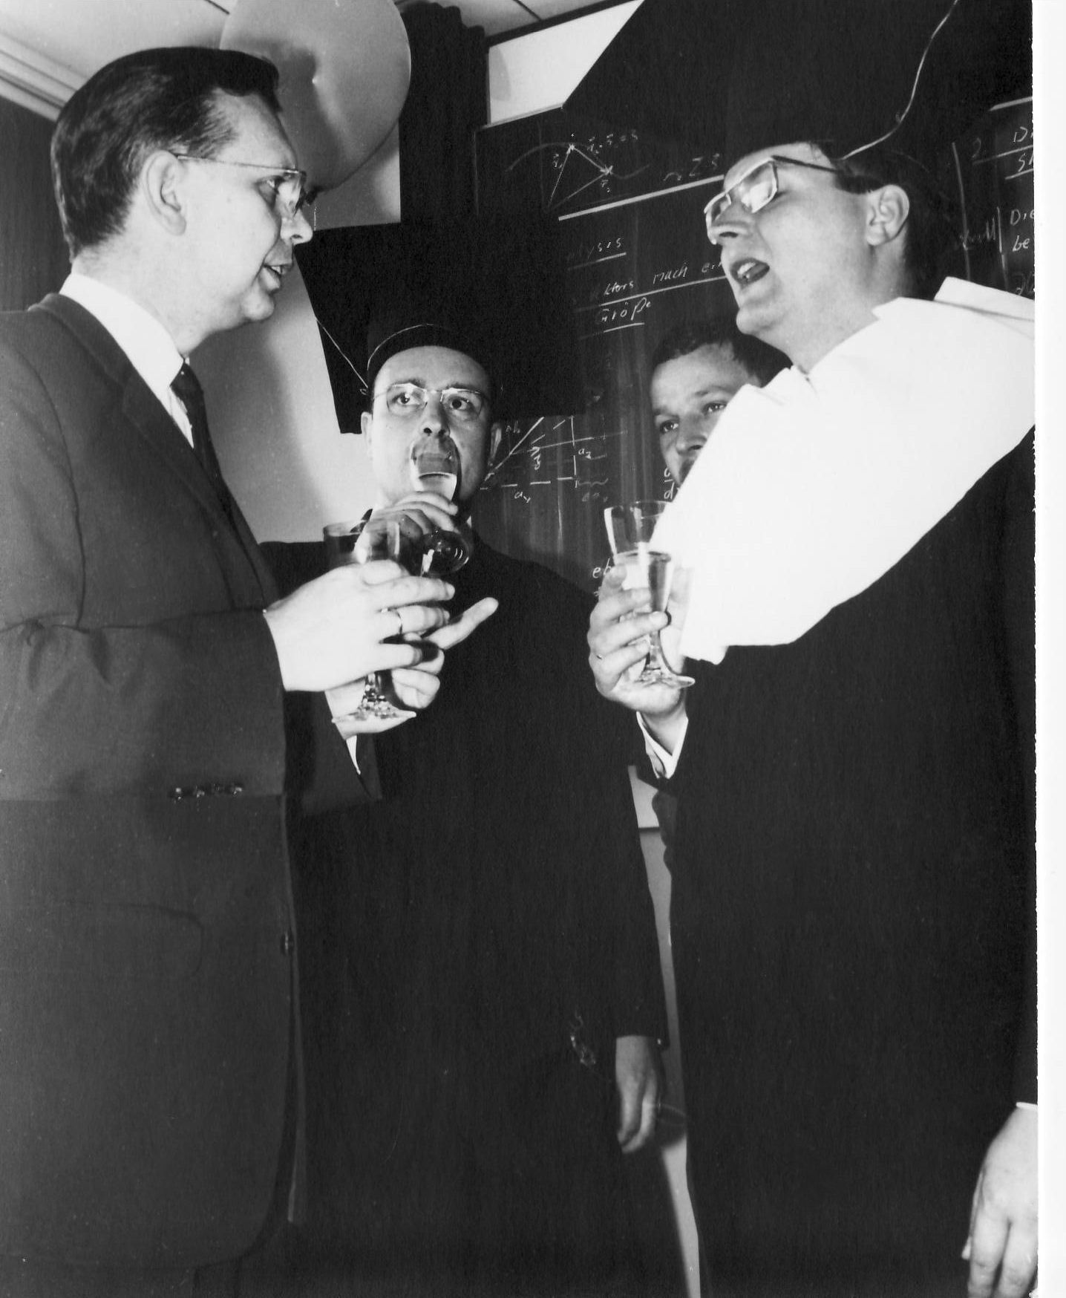
New Doctors are produced and celebrated

Slide 14
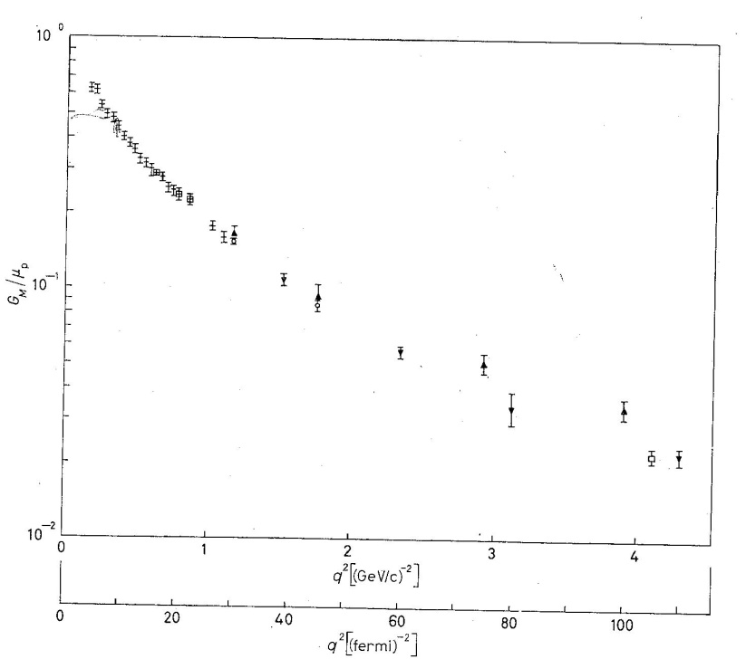
Transition to Elementary particle physics
1. Electron – Nucleon Scattering at DESY, Hamburg
I had learned e-N scattering at Cornell (R.R.Wilson) 1960
first experiment at DESY from 1963
by Karlsruhe group
Elastic electron scattering
on Proton and Neutron,
internal target
(D.Wegener, D.Fries, et al)
G_{M}
Electromagnetic Formfactors to higher q-values
Finer details of Nucleon Structure

Slide 15
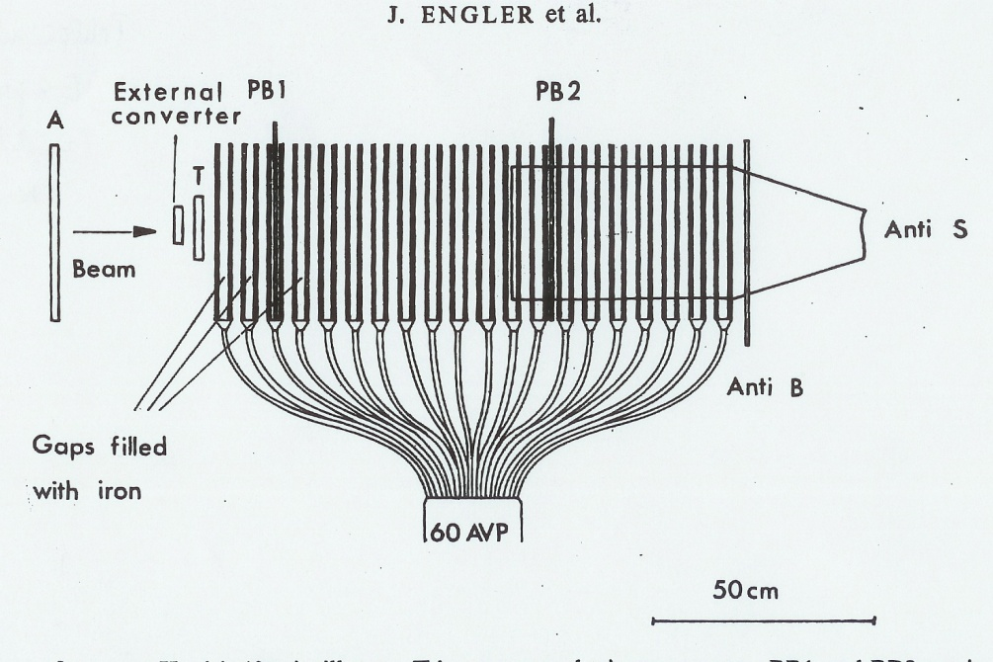
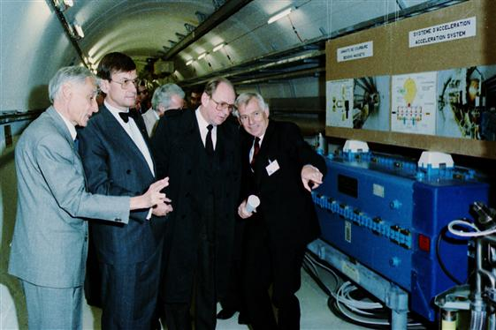
Invention of Hadron-Calorimeter 1967
Sampling Total Absorption Counter name „STAC“ not popular
J.Engler, K.Runge, H.Müller et al
2. Neutron –Scattering at CERN und Serpuchov UdSSR
First strike on Soviet Territory by students from Karlsruhe
Smiled at by all experts:
not competitive with magnetic spectrometer,
now in every collider experiment
First optimisation of a detector by simulation (Monte Carlo)
(meters of Punch Cards for IBM Computer)
Minister Riesenhuber at CERN
First at CERN PS, ISR
from 1970 at Serpuchov

Slide 16
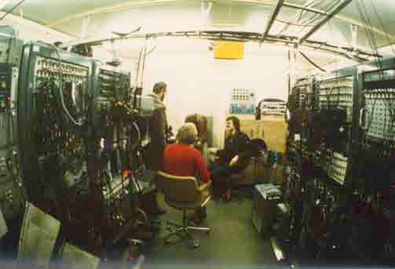
Exotic Middle Energy Physics
Investigation of mesonic atoms
at SC and PS at CERN
Discovery of antiprotonic atoms
Citron, Backenstoss, Koch, Tauscher,…
Measuring hut at CERN
Meson spectroscopy
with Crystal Barrel Detector
at antiproton ring LEAR at CERN
Cierjacks, Koch, Kunze, Matthäy, Weddigen,...
Crystal Ball
More than 100 Publikationen
Candidat for Glueball-Grundstate (f0(1500)
Initiated antiprotonic part
of FAIR-Project at GSI

Slide 17
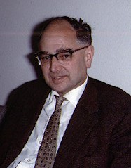
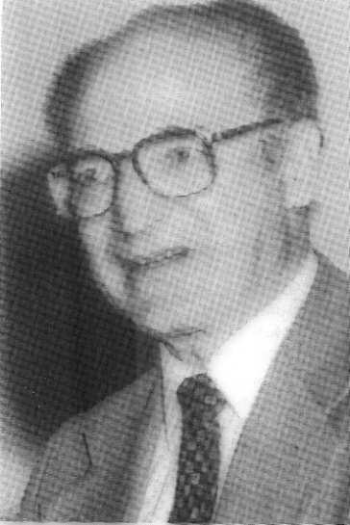
High energy Proton accelerator at KA?
KFZ seemed to offer excellent conditions for construction of accelerator,
cooperation with France
Proposal Proton Synchrotron 40 GeV,
complementary to DESY and CERN
Look for reinforcement:
Anselm Citron, 6.4.1965
Elementary particle physics
Arnold Schoch, 1965 to 23.7.1967 (deceased),
accelerator expert
Werner Heinz, 1969 bis 31.12.1984 (deceased),
succesor Schoch

Slide 18
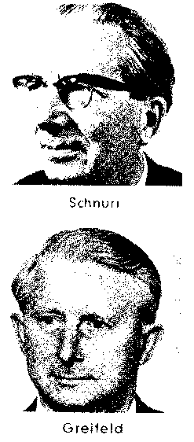
National accelerator project abandoned:
- CERN proposes 300 GeV Super Proton Synchrotron 1970
(Germany: either SPS or national project)
- Resistance in FZK
(emphysis on ‚reactor station‘, fast breader)
Basic Research at Research Centre??
Schnurr
Scientific Director of FZK
Greiffeld
Administrative Director of FZK
Foundation of Arbeitsgemeinschaft der Grossforschungszentren
Now Helmholtz Association

Slide 19
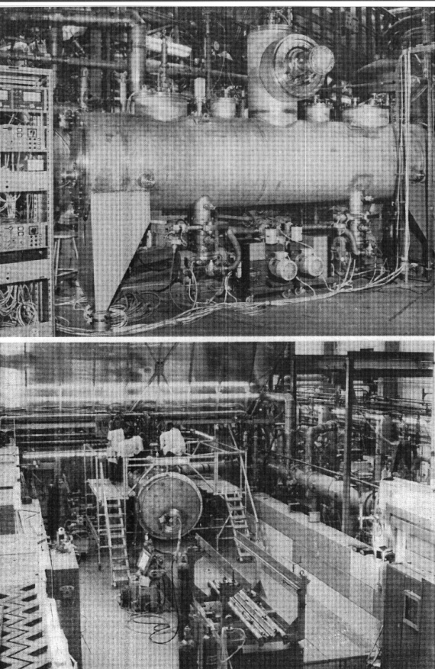
Technological developments
Accelerators and detectors:
First European studies of Supraconducting RF Cavities
first application for particle separators at CERN and Serpuchov
knowhow to CERN (LEP) and many accelerators
Proton SC Linac Prototyp at IEKP (2 cooling plants at 3⁰ K)
first cryogenic at FZK
Supraconducting Magnets
W.Heinz, J.Halbritter (origine of ITP)
Use of computers (in particle physics experiments)
Basic research has introduced new technologies at FZK which became basis for new applications
e.g. SL magnest for fusion TOSCA
SC proton linac

Slide 20
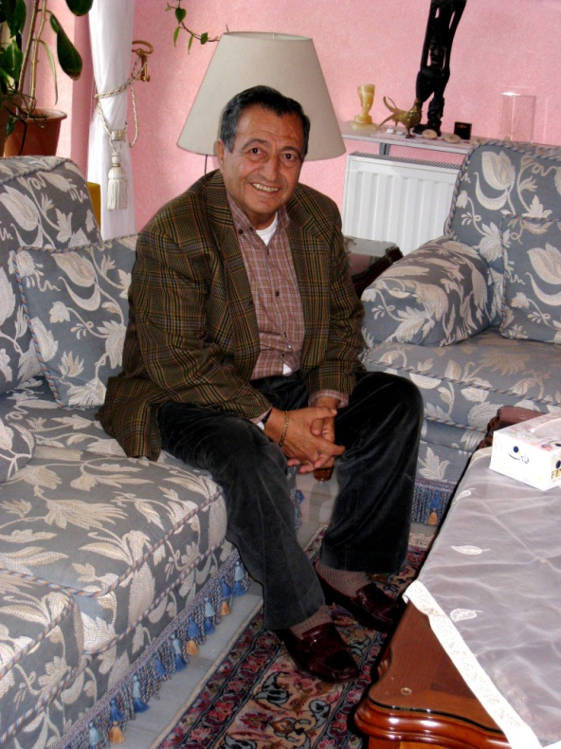
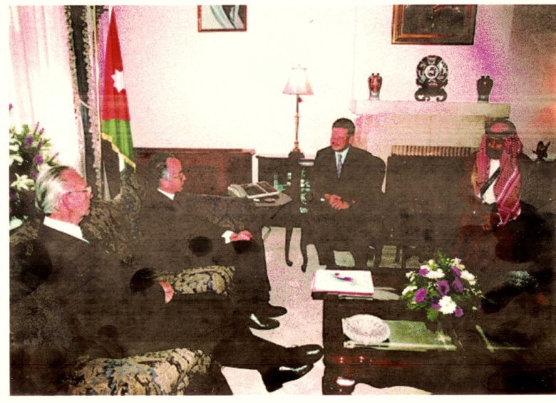
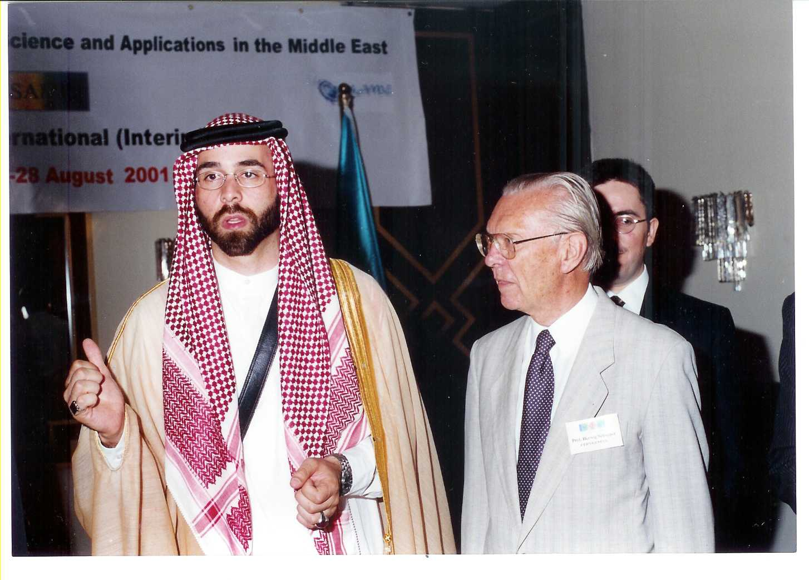
No time to discuss importance of teaching and role of students
One example (Allow me small diversion!):
Isa Khubeis from Jordan,
Diplom Mainz, PHD in KA, Prof. Uni. of Jordan
(German degrees very appreciated in Middle East) MSc??
Vice-Präsident Al Balqa Univeristy
Help to establish SESAME Synchrotron Radiation Lab in Jordan (2000)
(under umbrella of UNESCO like CERN)
By establishing contacts with King
Isa Khubeis
Prince Ghazi
Schopper, ADG UNESCO, King Abdullah, Prince Ghazi

Slide 21
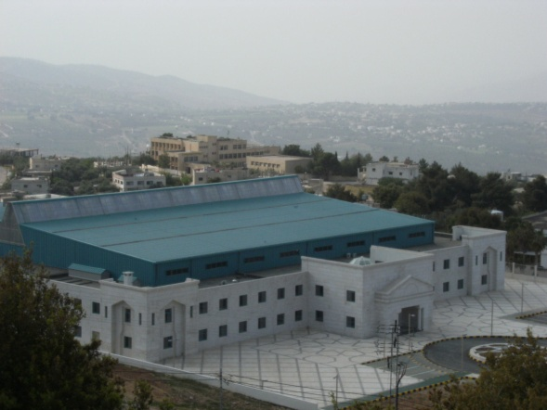
FZK (Manfred Popp) provided help for birth of SESAME
SESAME Building (Near Amman) is copy of ANKA
SESAME International Organisation (like CERN)
Only two institutions with objective: science for peace
Member States: Bahrein, Cyprus, Egypt, Iran, Israel,
Jordan, Pakistan, Palestine, Turkey

Slide 22
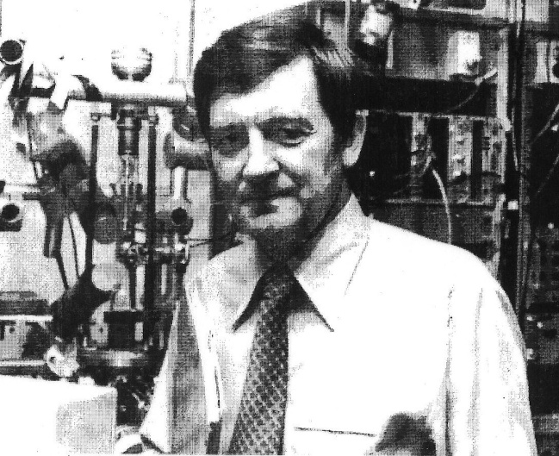
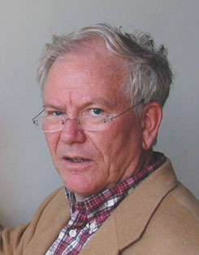
2. Phase IEKP
Schopper disappears in April 1973 to Hamburg (DESY and Uni),
difficulties in appointing successors (took more than 5 years!)
End of unification , IEKP dissected into 4 institutes:
Nuclear and elementary particle physics I at FZK
Bernhard Zeitnitz 1978!to 1997(retirement)
Hans Blümer 1999 until now
(Neutrinos, Cosmic Showers)
Nuclear Physics II at FZK
Anselm Citron until 1991 (Retirement)
Medium energy physics,(Disolved at retirement)
Technical Physics at FZK, Supraconductivity
W.Heinz 1969 bis 1984
P.Komarek 1985
Nuclear and particle physics at Uni
Klaus Schubert 1988 bis 1993
(Chair at Dresden)
Thomas Müller 1996 until now

Slide 23
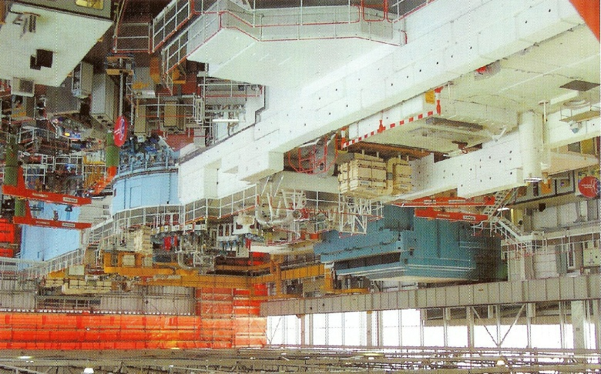
KARMEN
KArlsruhe-Rutherford-Middle-Energy-Neutrinos
Neutrinophysics at Rutherfordlab‘s spallation source ISIS
also strong source for neutrinos
Zeitnitz et al
Many interesting results:
Limits for ν-oscillations (appearence) v_{µ} -> v_{e}
interesting situation:
result of LSND wrong ?
or antisymmetry between neutrinos and antineutrinos?
(new FNAL-Minos resutls)
ISIS at Rutherford Lab

Slide 24
‚Great Unification‘ 2009 concerns:
3. Phase: towards KIT- CETA
University with Research Centre
Theory with Experiments
Supersymmetry, Non-relativistic quantum chromo dynamics
Perturbative quantum field theory, Collider phenomenology
Technology with Physics
Computing and Networking, Cryogenic technology
Including Cooperation with Associated Institutes:
Institut for Technical Physics (ITeP),
Institut for Processdata analysis and Elektronics (IPE)
Steinbuch Centre for Computing (SCC).

Slide 25
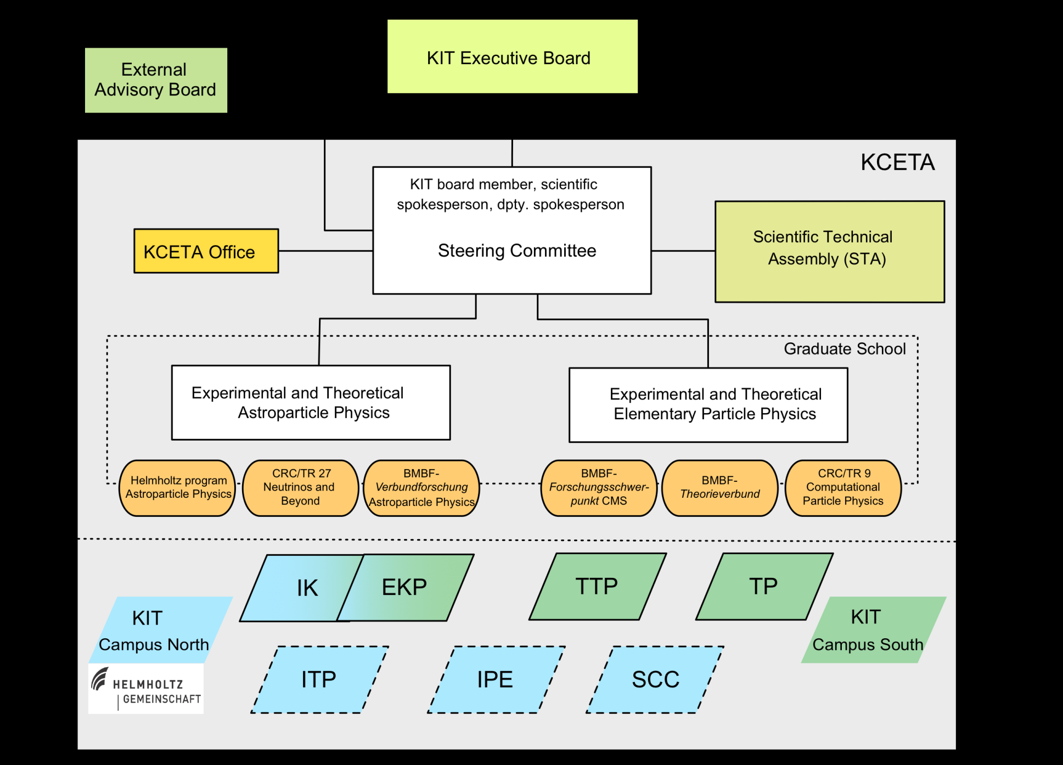
Center for Elementary - and AstroParticle- Physics KCETA
One of the largest concentration for this domain of physics in the world has been created
Competitive on worldwide scale

Slide 26
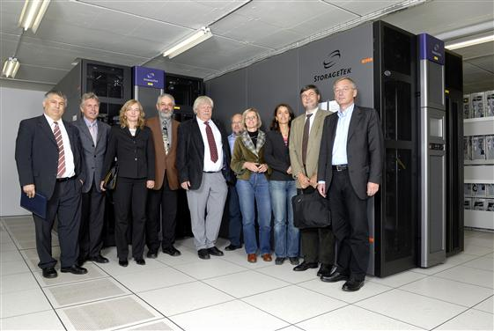
Unification became basis for recognition
of ‚University of Excellence‘
Visit Senate UNI KA at CERN 6. Oktober 2006
( E.Umbach, H.Hippler

Slide 27
KCETA has not only impressive past, but also bright future
Some very short remarks concerning
highlights of ongoing and future activities
to complete picture
These are logical continuation of earlier activities
More information by following speakers

Slide 28
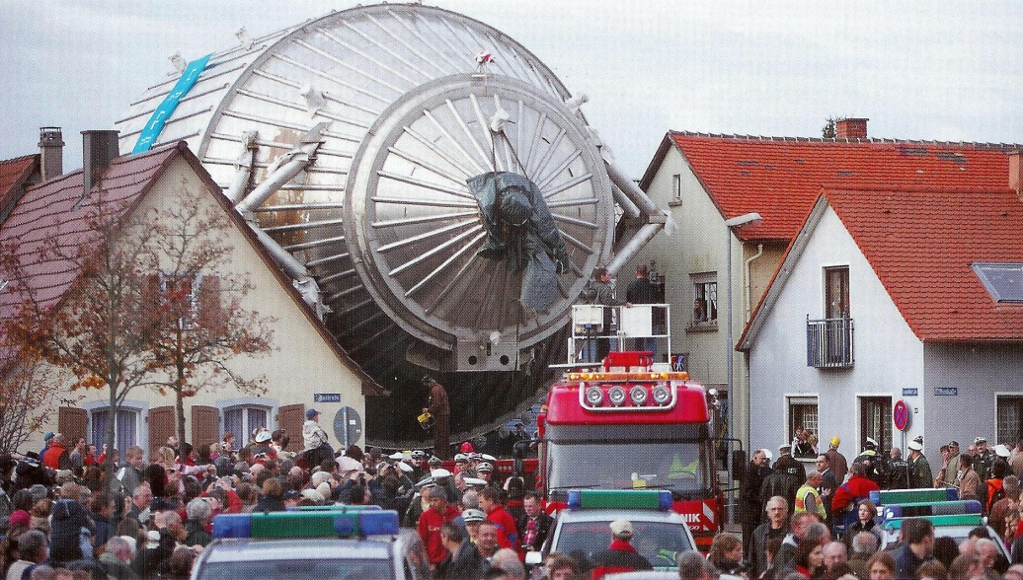
KATRIN
Measurement of neurino mass
from betadecay of tritium
Can only be performed at FZK:
Tritium technology,
Large equipment
Neutrino mass different from 0
How big?
Great mystery !
Only experiment in the world of this kind
Electron-Neutrino-Mass:
Best present limit <2.2 eV,
KATRIN 0.3 eV
International collaboration G.Drexlin et al

Slide 29
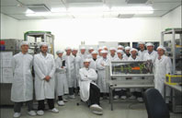
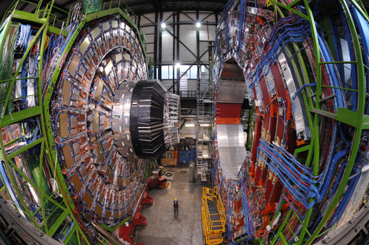
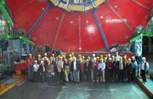
CMS at LHC CERN
One of the 3 big experiments
KCETA involved in CMS since 1995, R/D for silicon strip detectors and Micro strip gas detectors, radiation hardness studies at the cyclotron of FZK
construction of large scale prototypes for feasibility tests.
The Karlsruhe (Campus South): about 35 physicists and technicians
Th.Müller, W.de Boer, M.Feindt

Slide 30
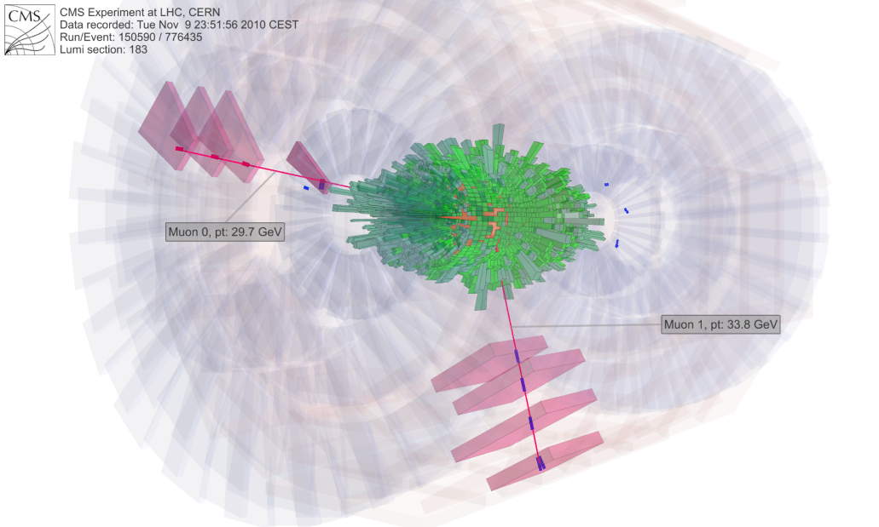
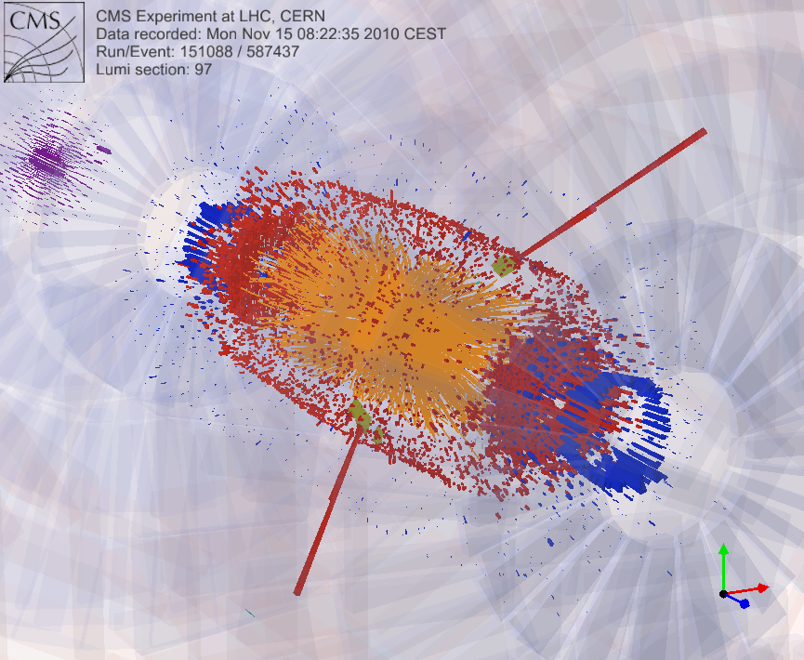
CMS at LHC
LHC running for p-p at 3.5+3.5 TeV most of time in 2010
Results will be report by Joachim Mnich
Not only machine works very well, but also experiments
Beginning of November until 6 December Pb + Pb
CMS works even for Lead !
First observation in Pb-Pb, 9. November 2010
Z-> µ+µ- and Z-> e+ e-

Slide 31


Jet quenching in
quark-gluon matter
First observation
and study
CMS
Pb-Pb collisions
Normal jet pair
back-to-back, equal energies
Hottest nuclear matter
(Cosmic primary matter)
Normal hadrons play no role
Quarks and gluons
One jet quenchend

Slide 32
Worldwide LHC Computing Grid successor of World Wide Web
WLCG serves a community of more than 8,000 physicists around the world with near real-time access to LHC data, and the power to process it. store, distribute and
analyse the 15 Petabytes (15 million Gigabytes) of data annually
more than 140 computing centres in 34 countries
Layers:
Tier 0 CERN
Tier 1 in the world 11, one at KIT
Tier 2 at large universities and labs
Tier 3
Grid KA plays essential role:
interface for all universities and labs in Germany
Günter Quast et al., many partners at KIT

Slide 33

11 Tier 1 nodes
KIT

Slide 34


Cosmics rays from Kaskade to Auger
Kaskade (Grande) im FZK
B.Zeitnitz, H.Kampert,H.Ullrich
Large detector array at FZK
To investigate cosmic air showers
252+37 Detektorstationen
Now also used for LOPES (Radioantennen)
What is origin of extremely energetic cosmic showers?
What is their energy distribution and
nuclear composition?

Slide 35



Pierre Auger - Observatorium
J.Blümer,K.-H.Kampert, H.O.Klages
Extension of KASKADE to higher energies
In Argentinian pampas
1600 Water tanks combined with
4 Air Fluorescence Light detectors
KCETA biggest single group in collaboration

Slide 36

Cosmic ray energy spectrum
Main results: Form of spectrum due to different mass components
Cut-off at high energies exists!

Slide 37




Suche nach dunkler Materie
EDELWEISS in Frejus tunnel W.de Boer et al
Recoil energy of Weak Interacting Massive Particle detected with Bolometers
Only 4% of matter in cosmos is ‚normal‘
23 % Dark matter, what is it?
320 g Germanium at 0.017⁰ K
Data taking started 2007, some results (exclusions)
More bolometers being added

Slide 38



AMS Antimatter Spectroscopy
Only magnetic spectrometer in space (on Space Station)
Search for antimatter and dark matter
W.de Boer et al
Transport from CERN to Cap Canaveral

Slide 39
Conclusions
During last 50 years excellent results (experiments and theory)
Research of highst quality at forefront of nuclear and particle physics and fully competitive
Full integration into international collaborations
Success based on competence and enthusiasm of collaborators, old and young
Cooperation between FZK and Uni was essential
I am very happy about ‚great unification‘ in KIT_CEAT
All conditions for an equally successful future are there
Best wishes for the next 50 years

