Slide 1
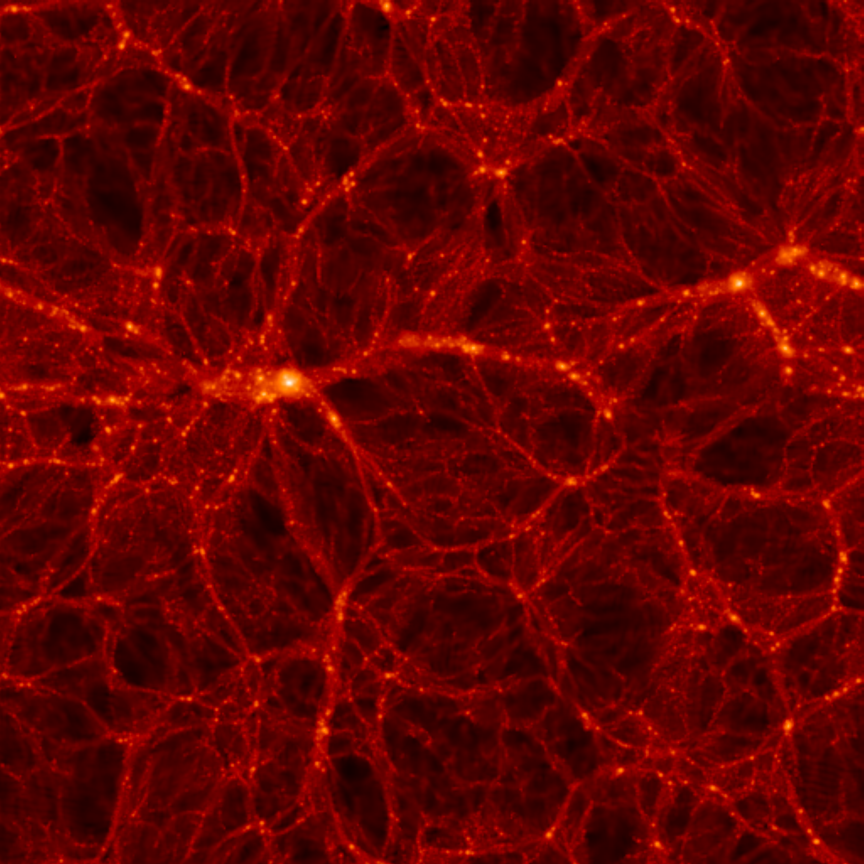
NEUTRINOS IN
COSMOLOGY AND IN THE LAB
ν_{e} ν_{μ}
ν_{τ}
STEEN HANNESTAD
KIT, 14 DECEMBER 2010

Slide 2
Fermion Mass Spectrum
Q = −1/3
d
s
b
Q = +2/3
u
c
t
Charged Leptons
e
μ
τ
All flavors
Neutrinos
ν₃
1
10
100
1
10
100
1
10
100
1
10
100
1
10
100
1
meV
eV
keV
MeV
GeV
TeV

Slide 3
FLAVOUR STATES
PROPAGATION STATES
MIXING MATRIX (UNITARY)
COSMOLOGY IS SENSITIVE TO THE
MASS STATES, NOT THE FLAVOUR STATES

Slide 4
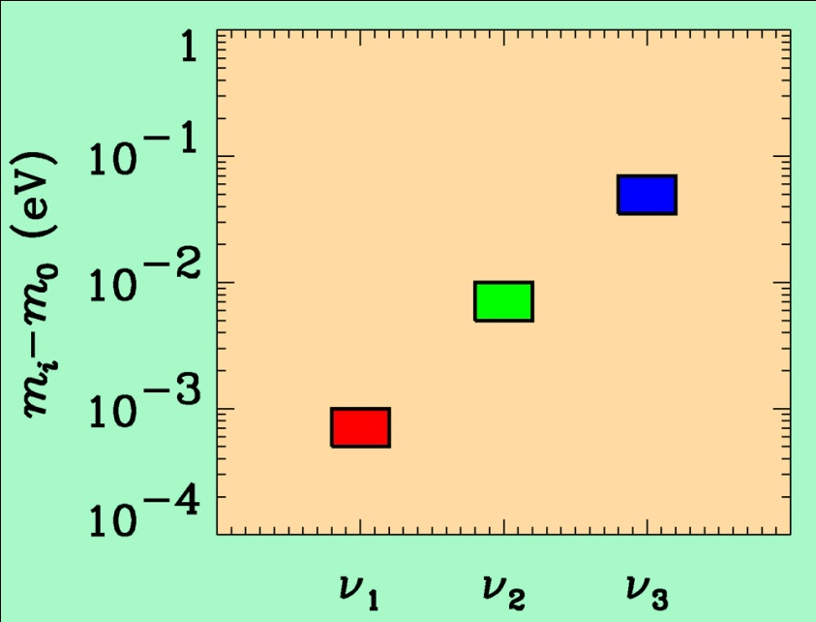
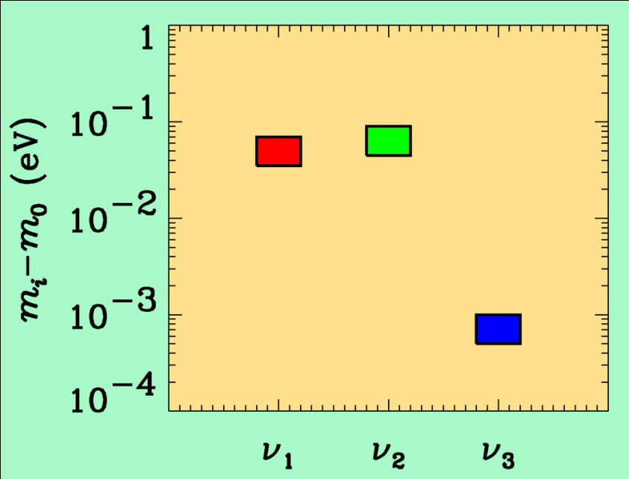
If neutrino masses are hierarchical then oscillation experiments
do not give information on the absolute value of neutrino masses
ATMO. ν
K2K
MINOS
SOLAR ν
KAMLAND
Normal hierarchy
Inverted hierarchy
However, if neutrino masses are degenerate
no information can be gained from such experiments.
Experiments which rely on either the kinematics of neutrino mass
or the spin-flip in neutrinoless double beta decay are the most
efficient for measuring m₀

Slide 5
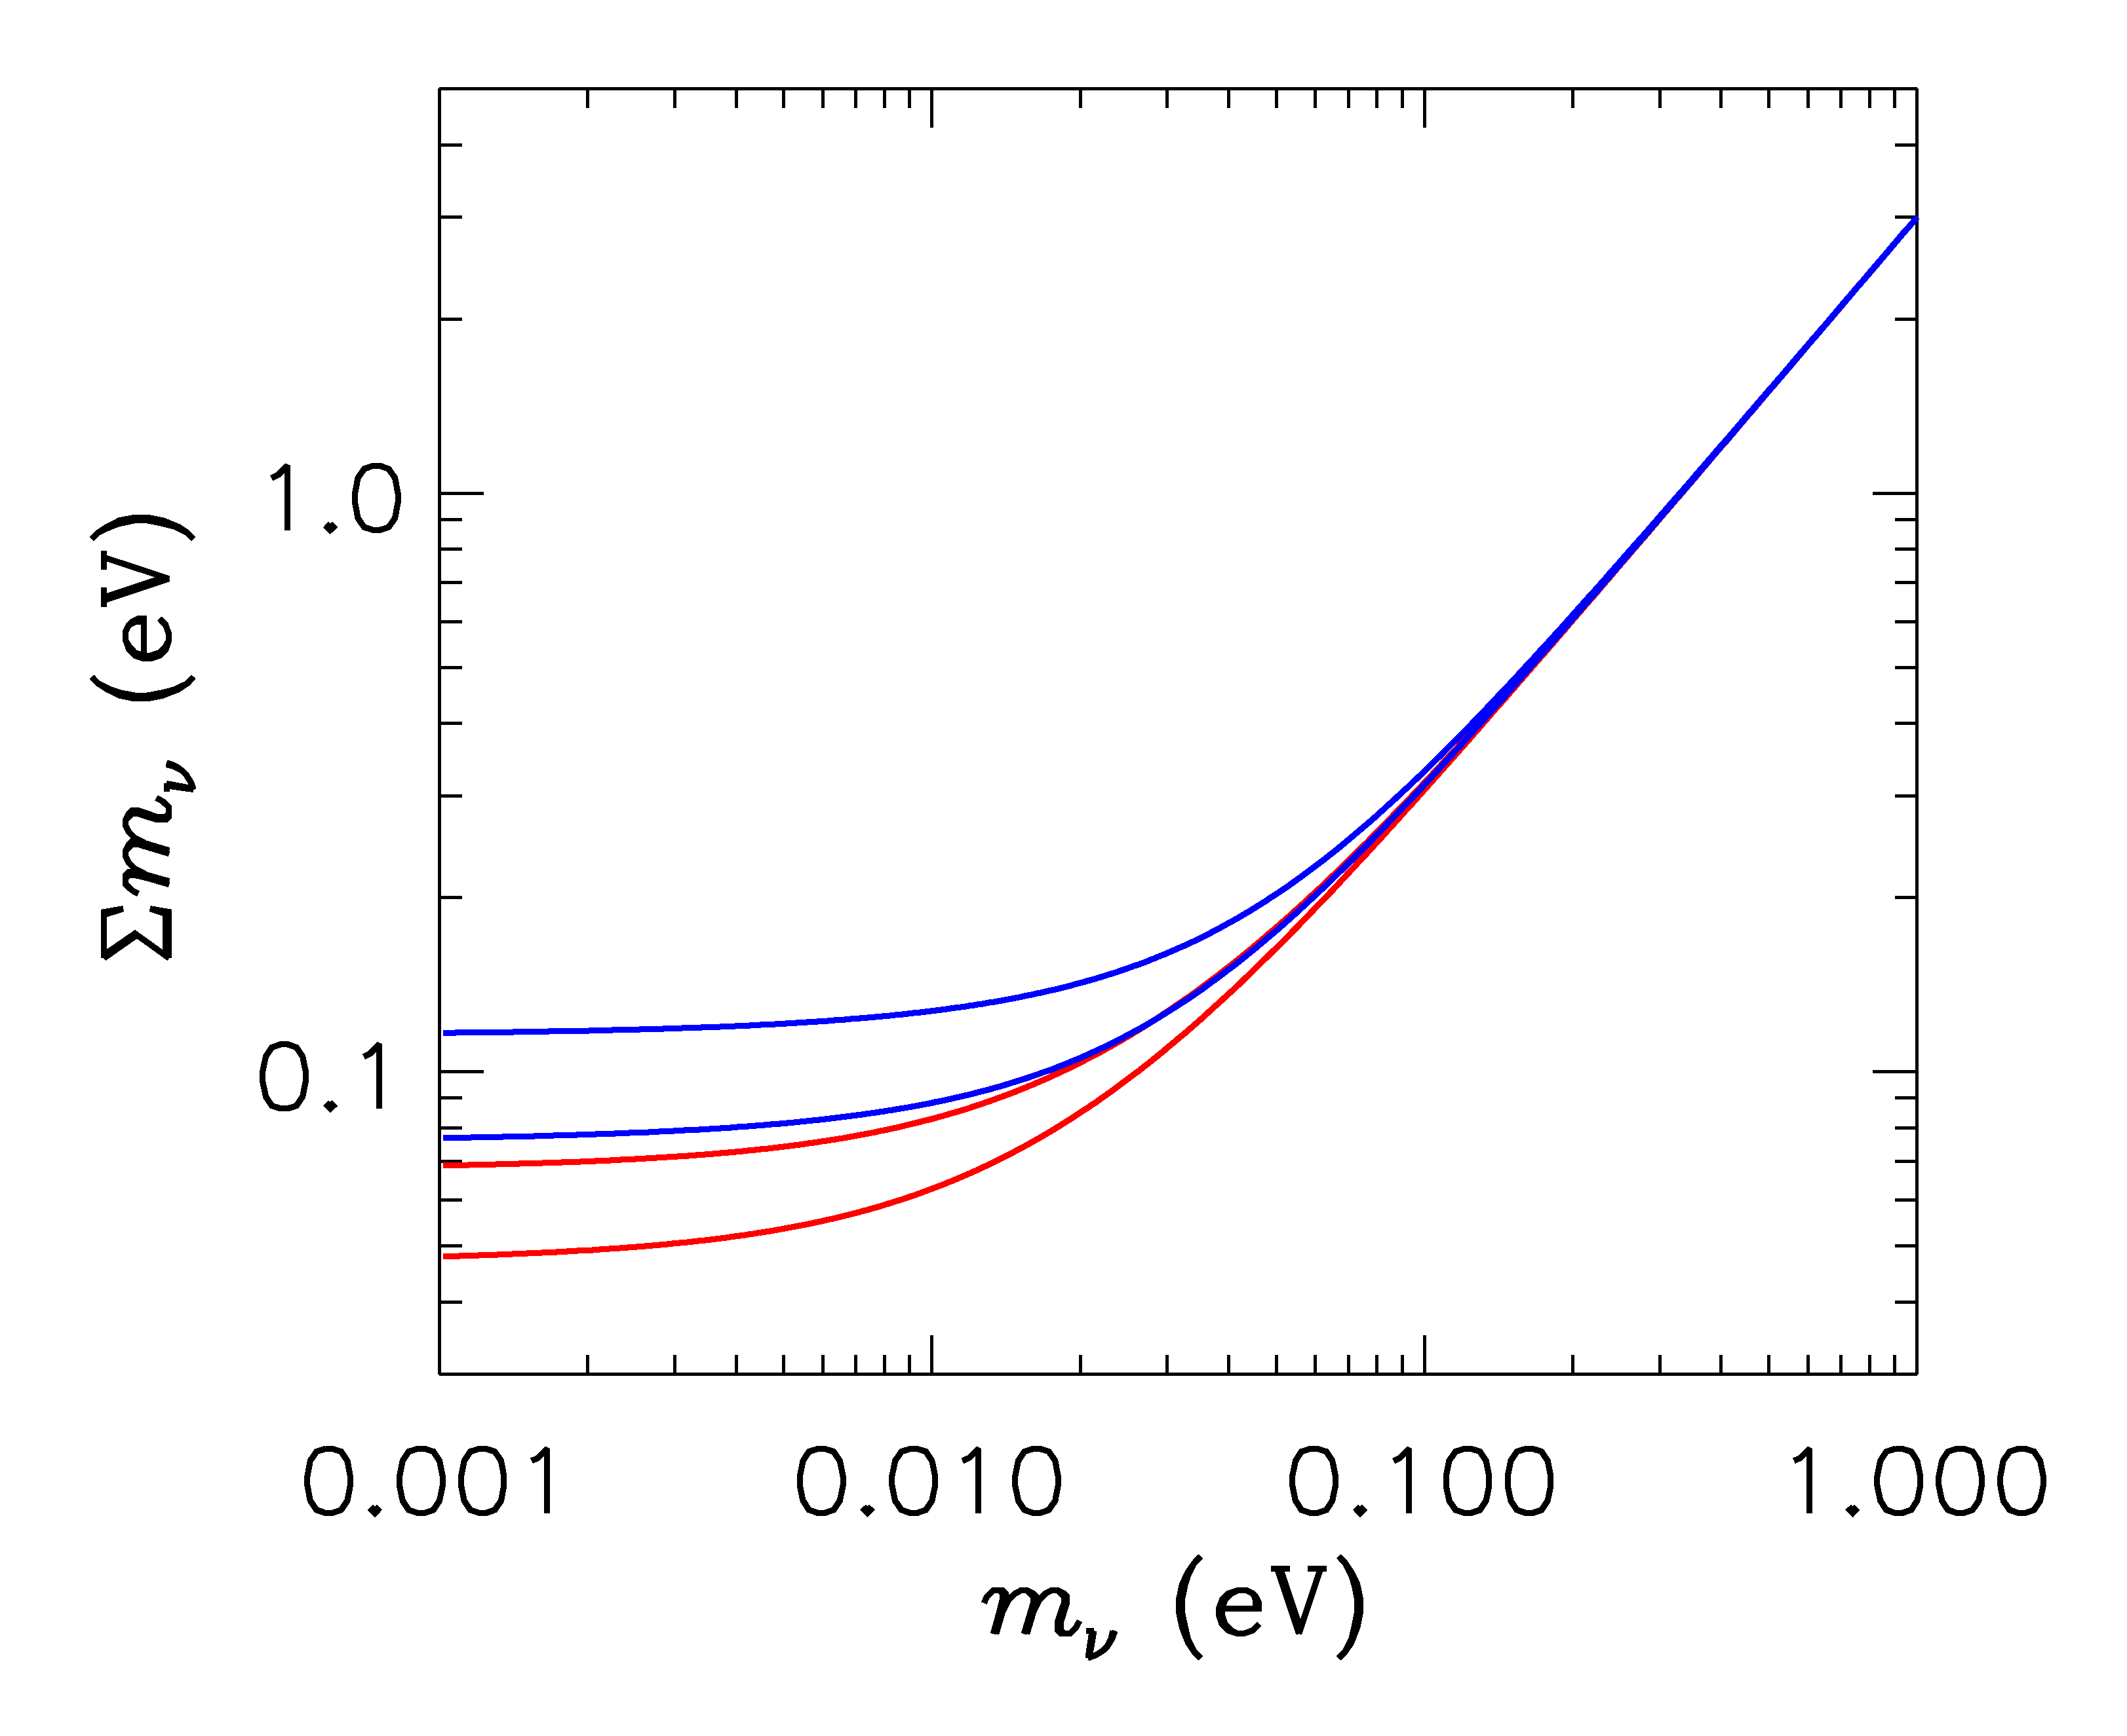
HIERARCHICAL
DEGENERATE
INVERTED
NORMAL
LIGHTEST

Slide 6
ß-decay and neutrino mass
model independent neutrino mass from ß-decay kinematics
only assumption: relativistic energy-momentum relation
experimental observable is m_{ν}²
T₂:
E₀ = 18.6 keV
T_{1/2} = 12.3 y

Slide 7
Tritium decay endpoint measurements have provided limits
on the electron neutrino mass
Mainz experiment, final analysis (Kraus et al.)
This translates into a limit on the sum of the three mass
eigenstates

Slide 8
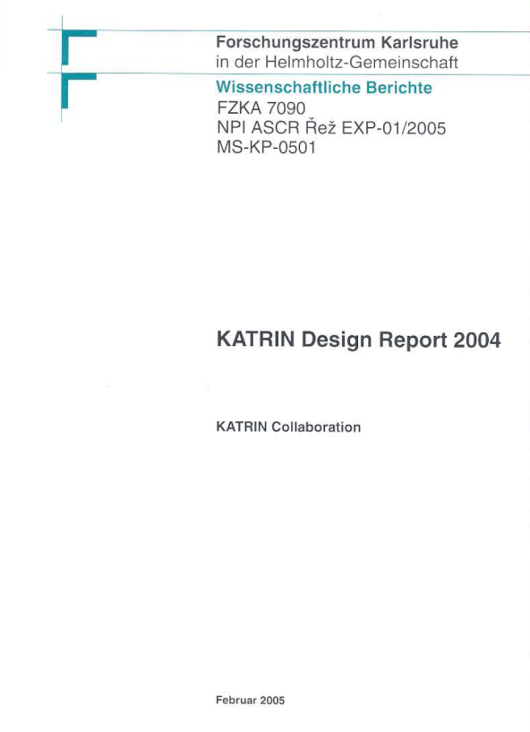
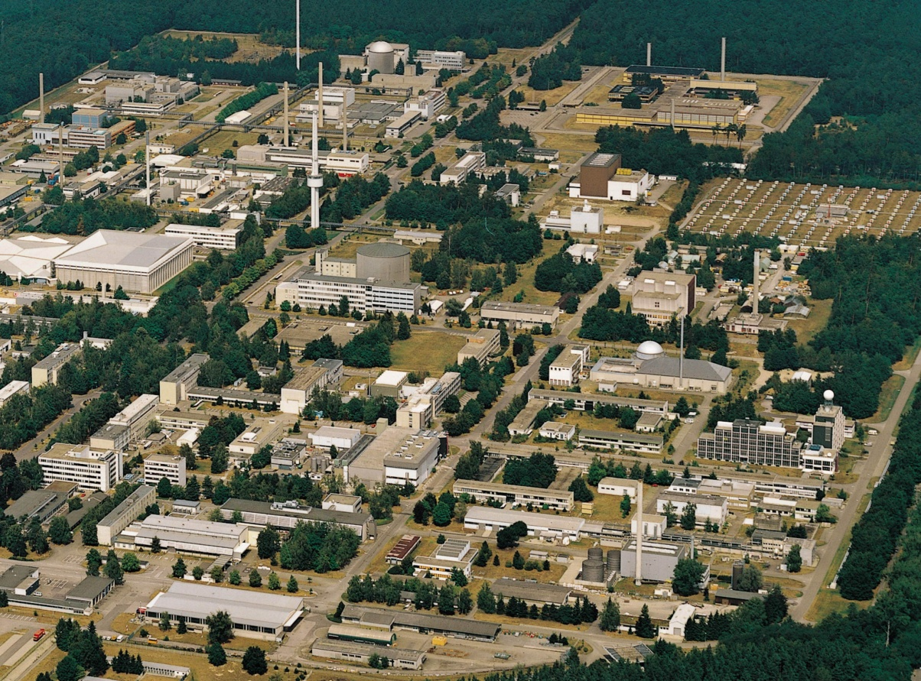
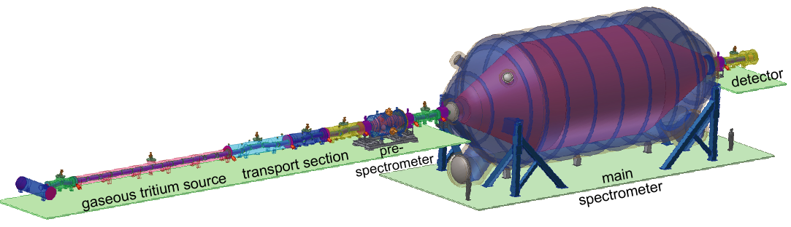
KATRIN experiment
Karlsruhe Tritium Neutrino
Experiment at KIT
Data taking starting 2012
TLK
25 m

Slide 9
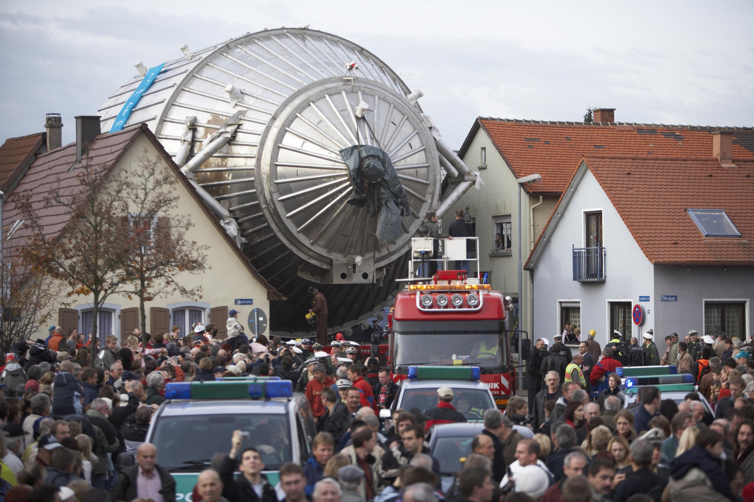

Slide 10
THE ABSOLUTE VALUES OF NEUTRINO MASSES
FROM COSMOLOGY
NEUTRINOS AFFECT STRUCTURE FORMATION
BECAUSE THEY ARE A SOURCE OF DARK MATTER
(n ~ 100 cm⁻³)
FROM
HOWEVER, eV NEUTRINOS ARE DIFFERENT FROM CDM
BECAUSE THEY FREE STREAM
SCALES SMALLER THAN d_{FS} DAMPED AWAY, LEADS TO
SUPPRESSION OF POWER ON SMALL SCALES

Slide 11
N-BODY SIMULATIONS OF ΛCDM WITH AND WITHOUT
NEUTRINO MASS (768 Mpc³) – GADGET 2
256
Mpc
T Haugboelle, University of Aarhus

Slide 12
AVAILABLE COSMOLOGICAL DATA

Slide 13
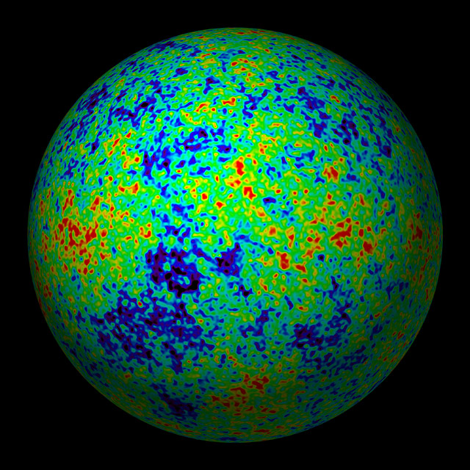
THE COSMIC MICROWAVE BACKGROUND
WMAP TEMPERATURE MAP

Slide 14
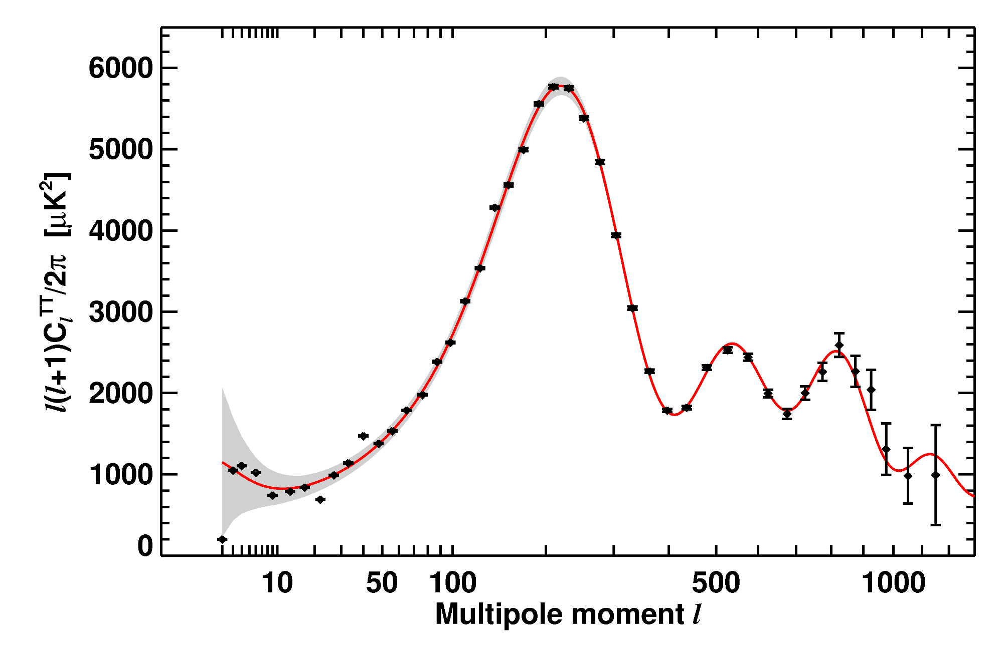
WMAP-7 TEMPERATURE POWER SPECTRUM
LARSON ET AL, ARXIV 1001.4635

Slide 15
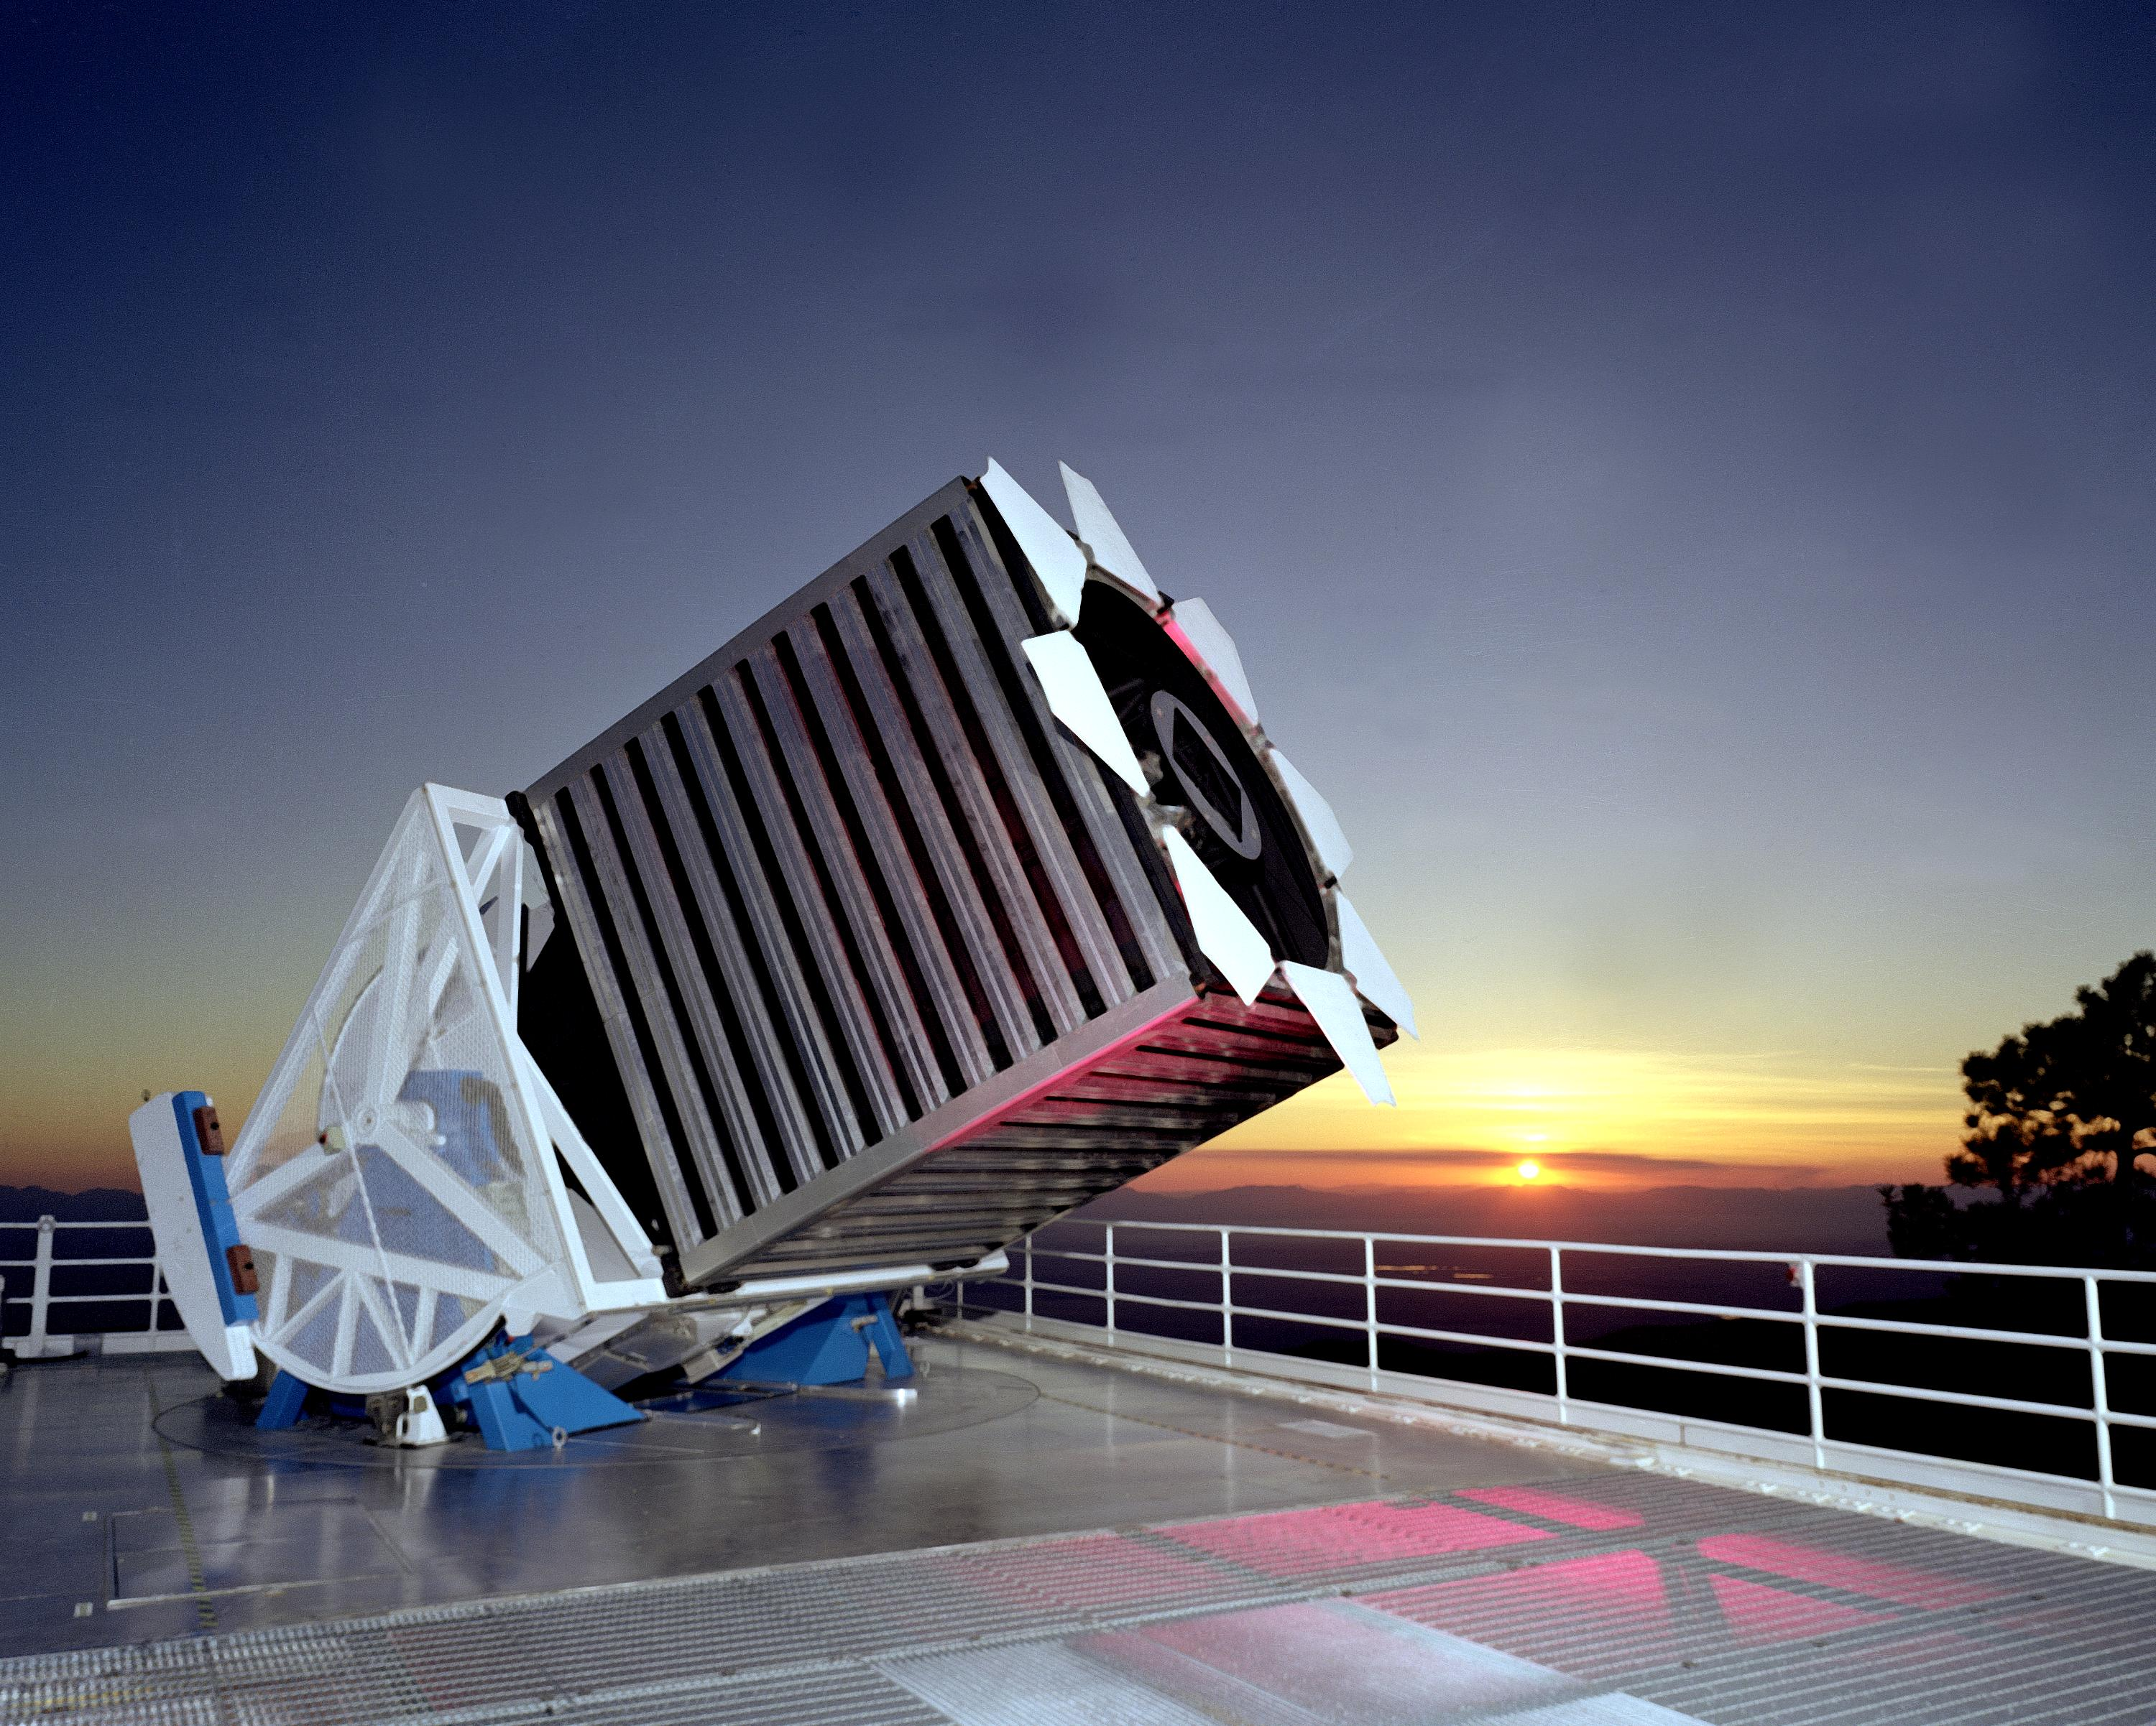
LARGE SCALE STRUCTURE
SDSS SURVEY (1,000,000 galaxies)

Slide 16
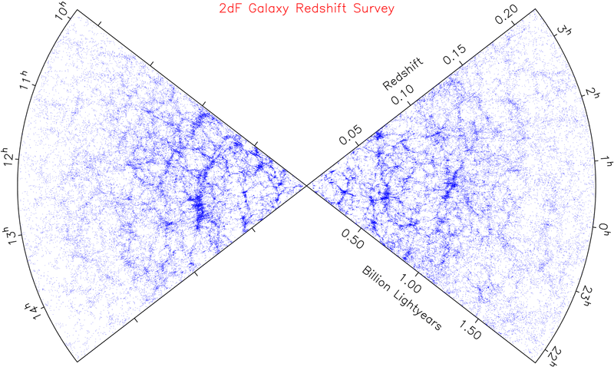
LARGE SCALE STRUCTURE SURVEYS - 2dF AND SDSS

Slide 18
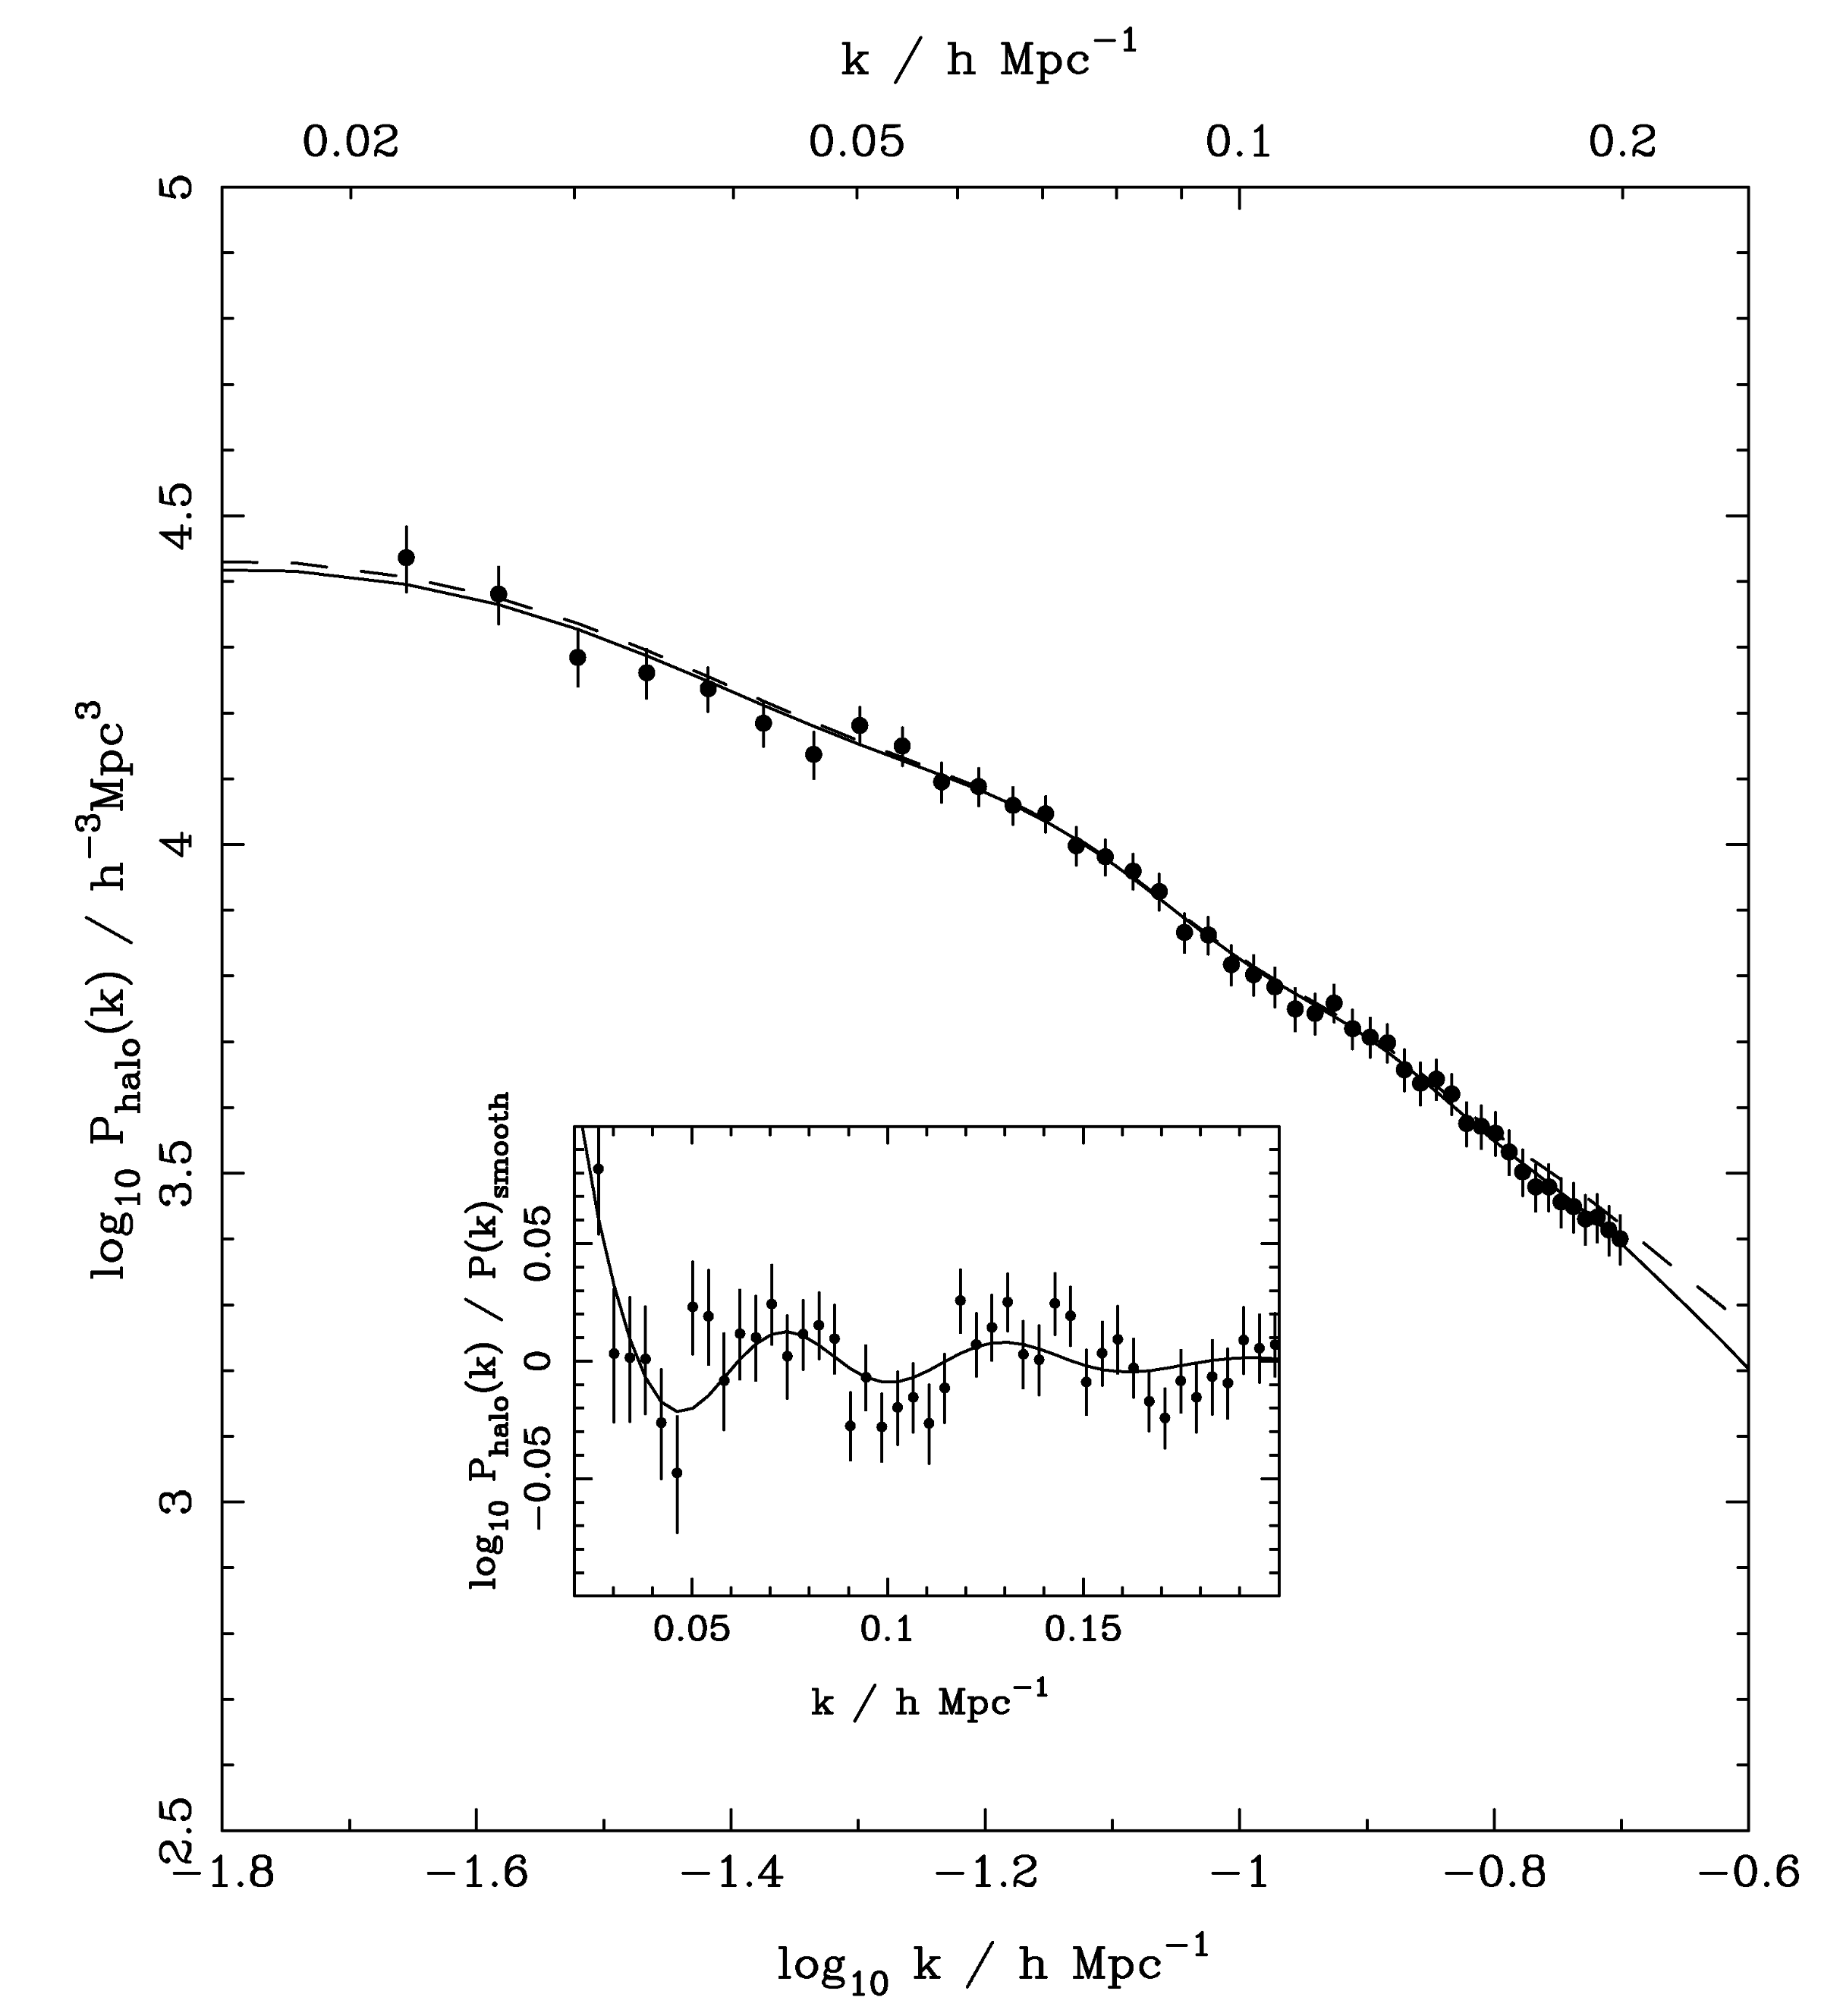
SDSS DR-7
LRG SPECTRUM
(Reid et al ’09)

Slide 19
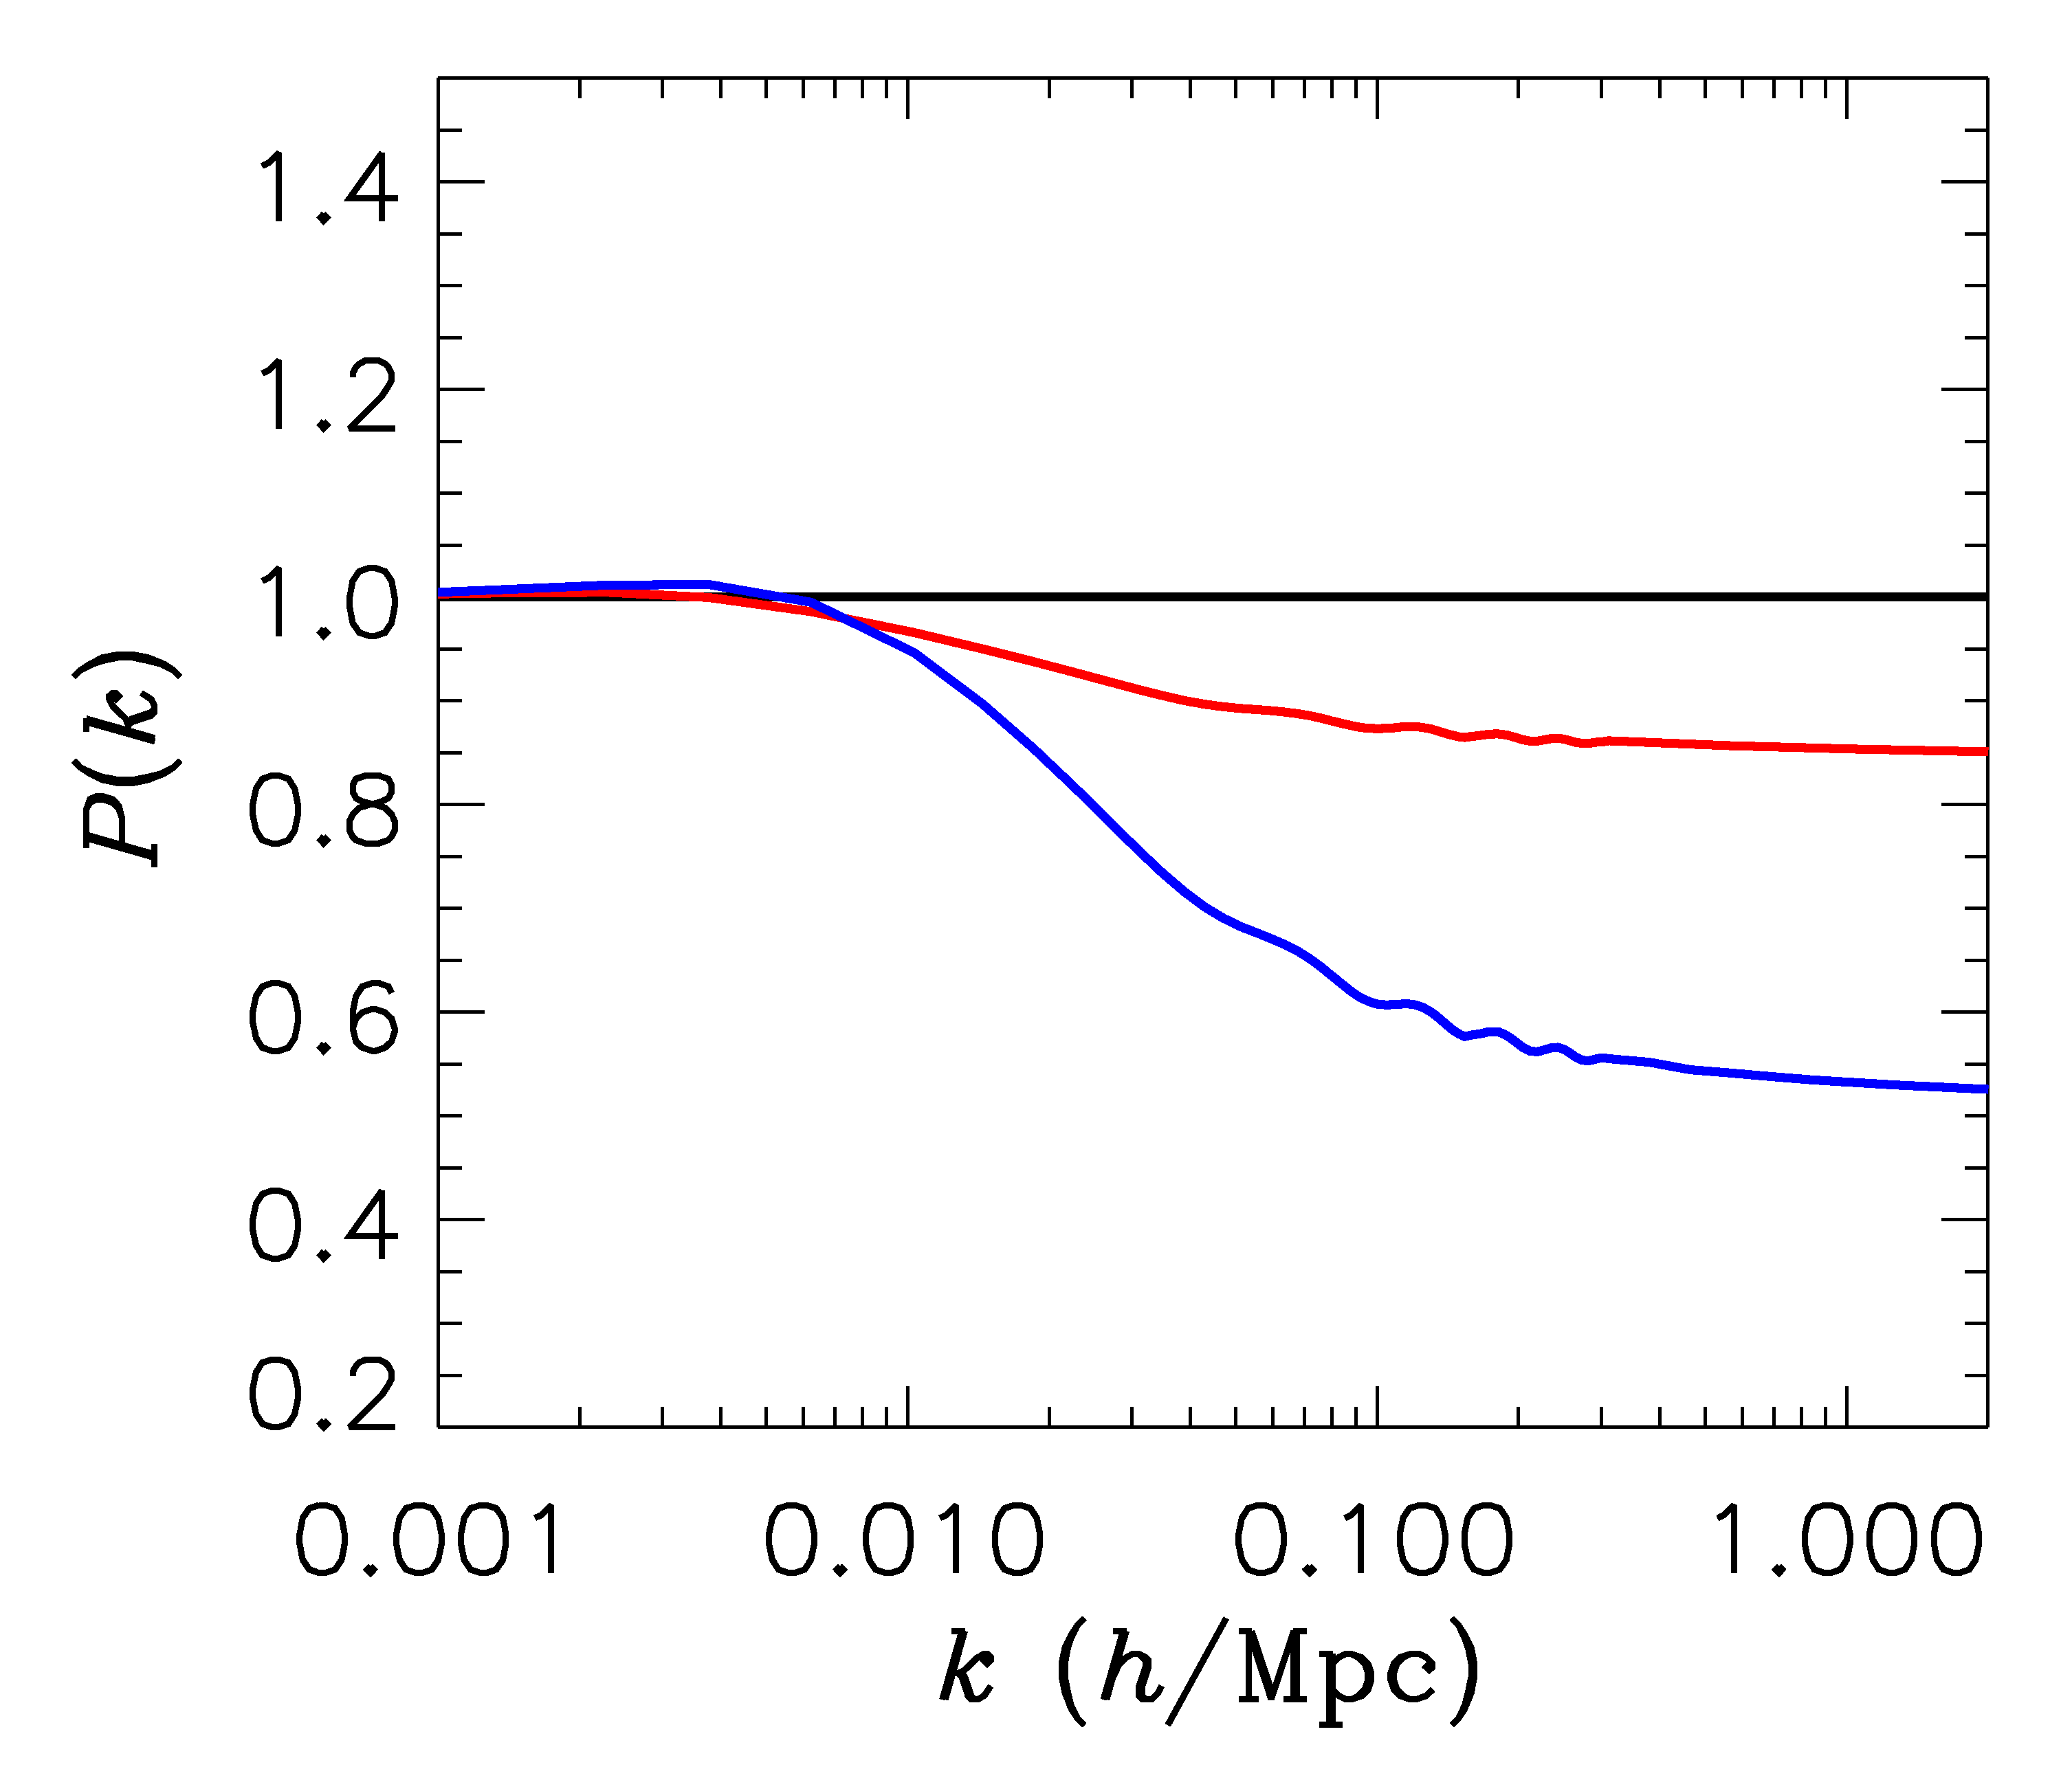
FINITE NEUTRINO MASSES SUPPRESS THE MATTER POWER
SPECTRUM ON SCALES SMALLER THAN THE FREE-STREAMING
LENGTH
Sm = 0 eV
P(k)/P(k,m_{ν}=0)
Sm = 0.3 eV
Sm = 1 eV

Slide 20
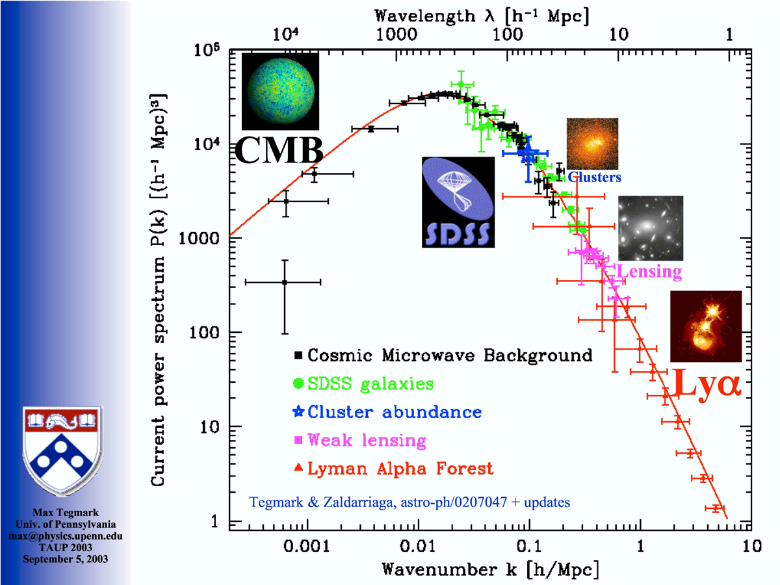
Power Spectrum of Cosmic Density Fluctuations
SDSS BAO
FROM MAX TEGMARK

Slide 21
NOW, WHAT ABOUT NEUTRINO
PHYSICS?

Slide 22
WHAT IS THE PRESENT BOUND ON THE NEUTRINO MASS?
DEPENDS ON DATA SETS USED AND ALLOWED PARAMETERS
THERE ARE MANY ANALYSES IN THE LITERATURE
USING THE MINIMAL COSMOLOGICAL
MODEL
STH, MIRIZZI, RAFFELT, WONG (arxiv:1004:0695)
HAMANN, STH, LESGOURGUES, RAMPF & WONG (arxiv:1003.3999)
JUST ONE EXAMPLE

Slide 23
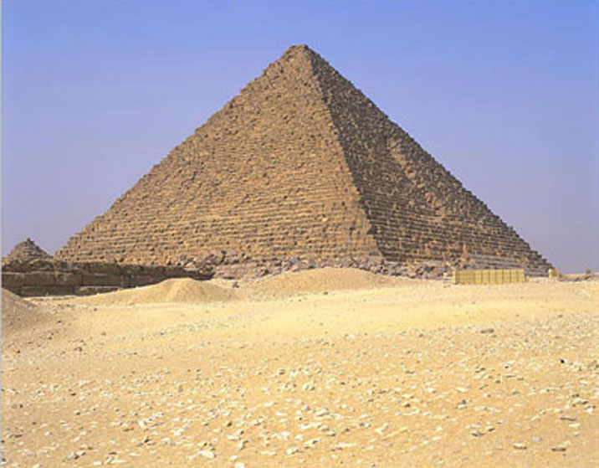
THE NEUTRINO MASS FROM COSMOLOGY PLOT
More data
+Ly-alpha
~ 0.2 eV
0.2-0.3 eV
0.2-0.3 eV
+ SNI-a
+WL
~ 0.5 eV
0.5-0.6 eV
0.5-0.6 eV
+ SDSS
0.6 eV
~ 1 eV
1-2 eV
CMB only
1.1 eV
~ 2 eV
2.? eV
??? eV
Minimal
ΛCDM
+N_{ν}
+w+……
Larger model
space

Slide 24
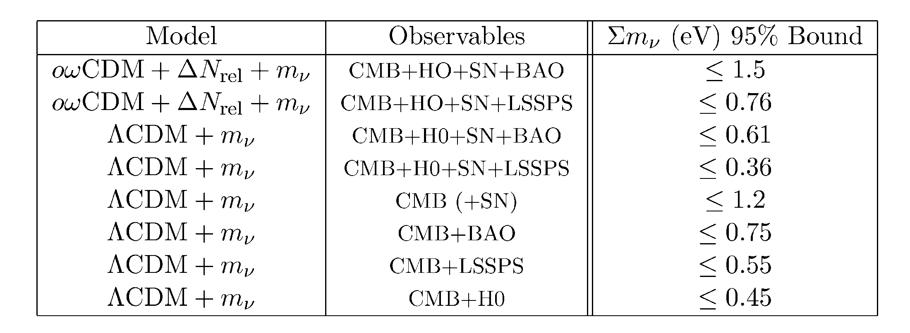
Gonzalez-Garcia et al., arxiv:1006.3795

Slide 25
WHAT IS N_{ν}?
A MEASURE OF THE ENERGY DENSITY IN NON-INTERACTING
RADIATION IN THE EARLY UNIVERSE
THE STANDARD MODEL PREDICTION IS
Mangano et al., hep-ph/0506164
BUT ADDITIONAL LIGHT PARTICLES (STERILE NEUTRINOS,
AXIONS, MAJORONS,…..) COULD MAKE IT HIGHER

Slide 26
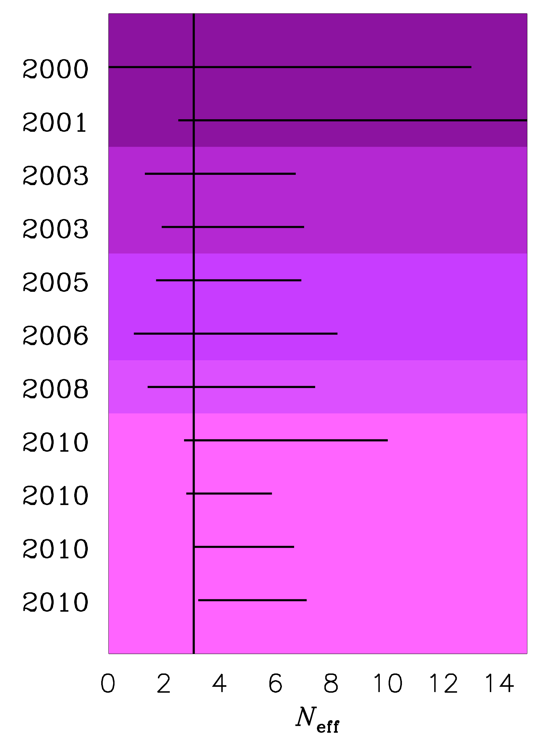
TIME EVOLUTION OF
THE 95% BOUND ON
N_{ν}
Pre-WMAP
WMAP-1
WMAP-3
WMAP-5
WMAP-7
ESTIMATED PLANCK
SENSITIVITY

Slide 27
A STERILE NEUTRINO IS PERHAPS THE MOST OBVIOUS CANDIDATE
FOR AN EXPLANATION OF THE EXTRA ENERGY DENSITY
ASSUMING A NUMBER OF ADDITIONAL STERILE STATES OF
APPROXIMATELY EQUAL MASS, TWO QUALITATIVELY DIFFERENT
HIERARCHIES EMERGE
ν_{s}
ν_{A}
ν_{A}
ν_{s}
3+N
N+3

Slide 28
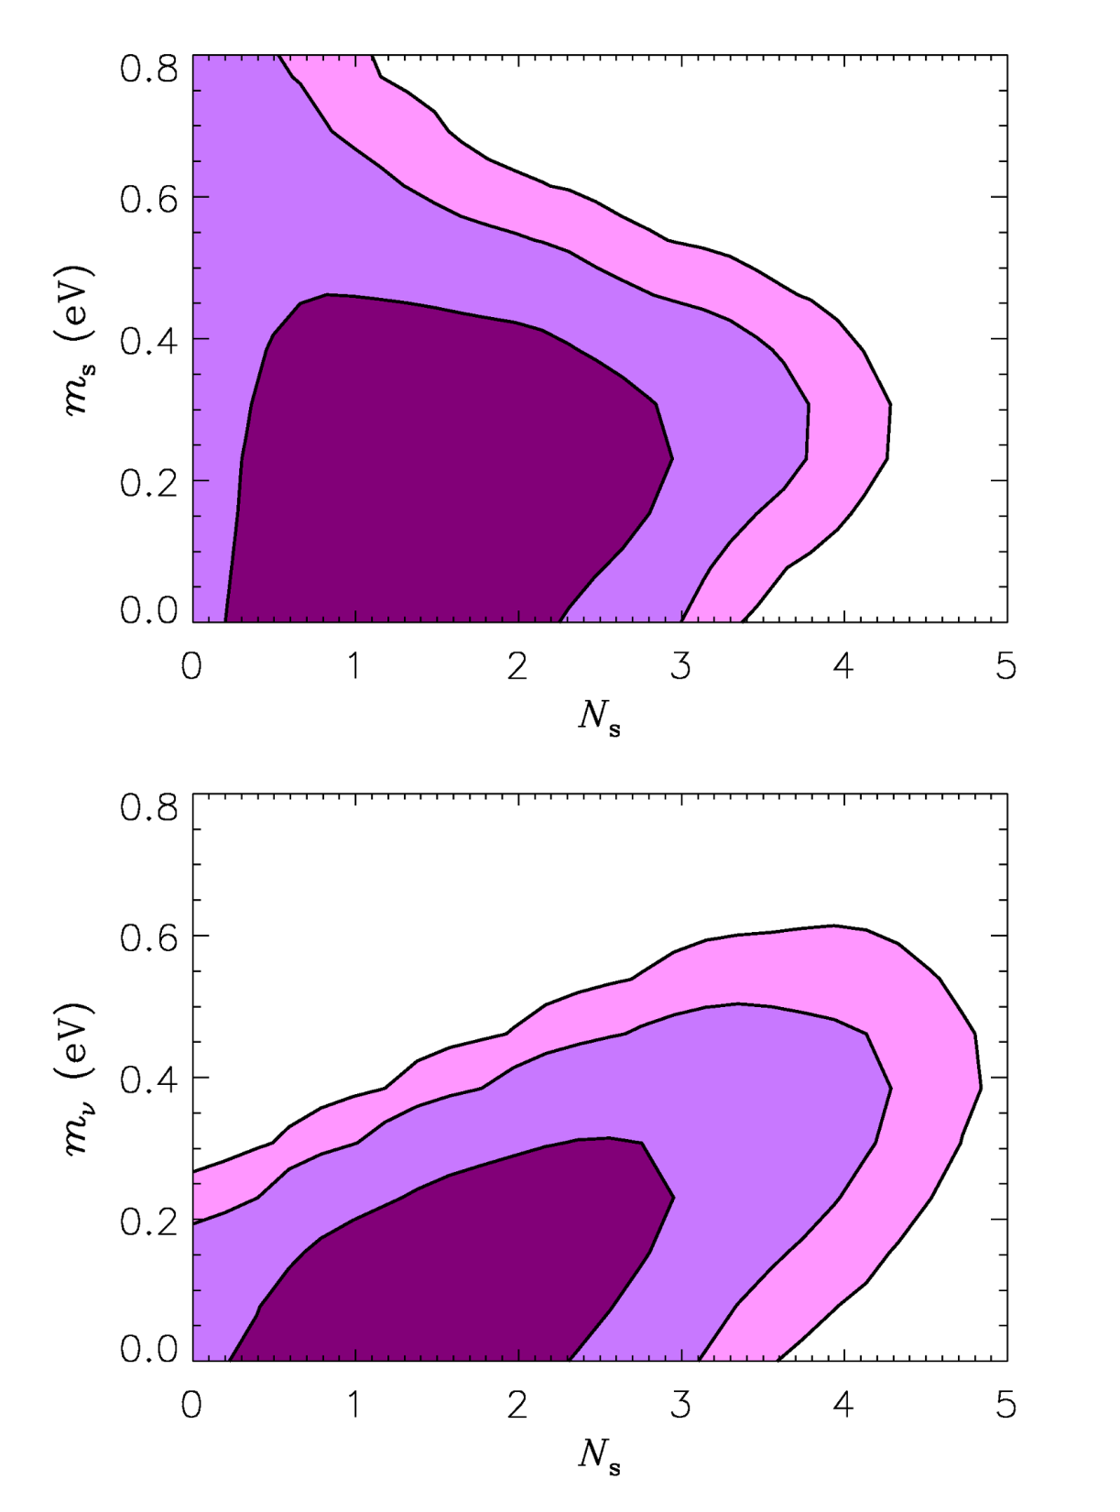
Hamann, STH, Raffelt, Tamborra,
Wong, arxiv:1006.5276 (PRL)
3+N
COSMOLOGY AT PRESENT
NOT ONLY MARGINALLY
PREFERS EXTRA ENERGY
DENSITY, BUT ALSO ALLOWS
FOR QUITE HIGH NEUTRINO
MASSES!
IF STERILE NEUTRINOS ARE THE
CAUSE, KATRIN MIGHT BE ABLE
TO DETECT THEM!
N+3
See also
Dodelson et al. 2006
Melchiorri et al. 2009
Acero & Lesgourgues 2009

Slide 29
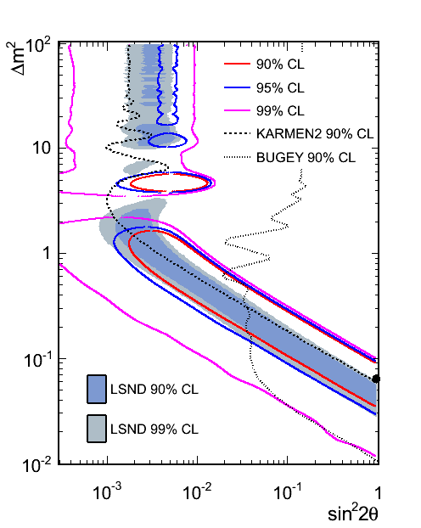
Updated Antineutrino mode MB results for E>475 MeV (official oscillation region)
Results for 5.66E20 POT
Maximum likelihood fit.
Null excluded at 99.4% with respect to the two neutrino oscillation fit.
Best Fit Point
(∆m², sin² 2θ) =
(0.064 eV², 0.96)
χ²/NDF= 16.4/12.6
P(χ²)= 20.5%
Results to be published.
E>475 MeV
Richard Van de Water, NEUTRINO 2010, June 14

Slide 30
WHAT IS IN STORE FOR THE FUTURE?
BETTER CMB TEMPERATURE AND POLARIZATION
MEASUREMENTS (PLANCK)
LARGE SCALE STRUCTURE SURVEYS AT HIGH
REDSHIFT
MEASUREMENTS OF WEAK GRAVITATIONAL LENSING
ON LARGE SCALES

Slide 31
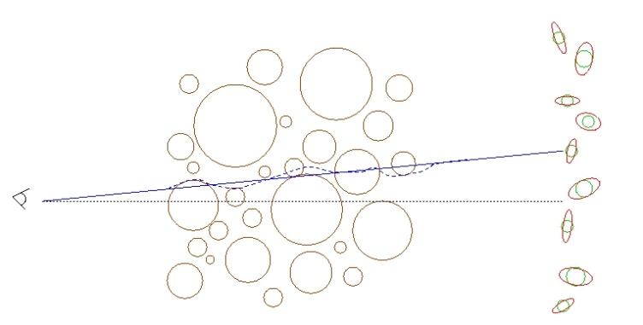
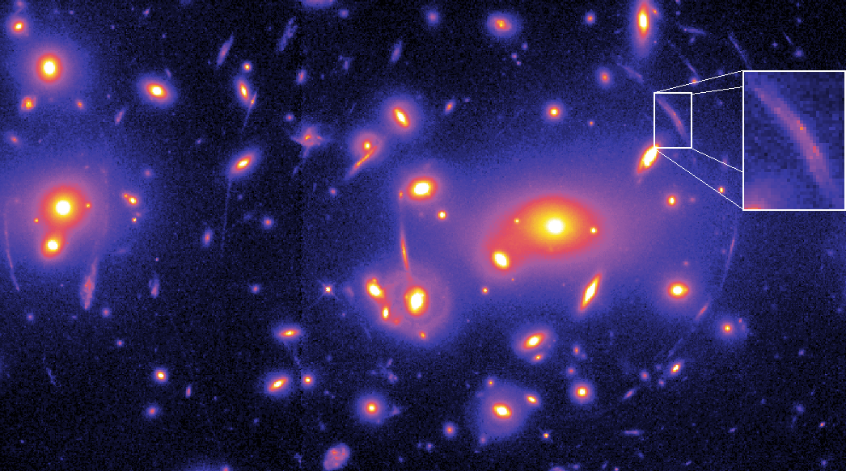
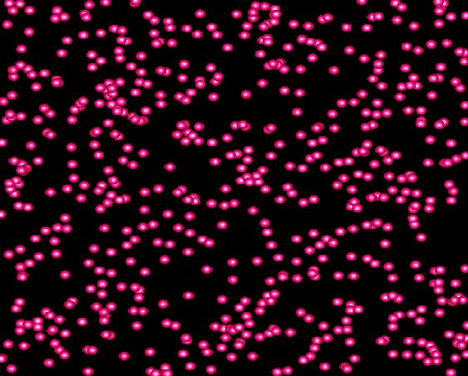
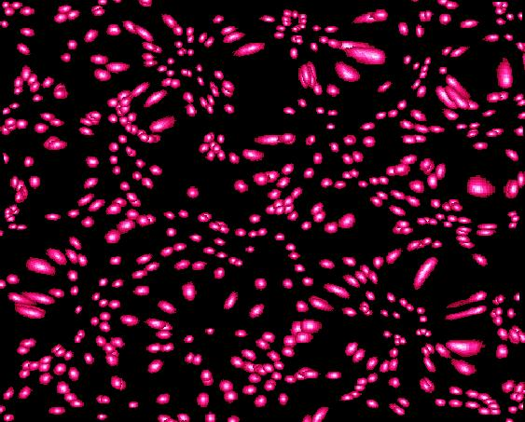
WEAK LENSING – A POWERFUL PROBE FOR THE FUTURE
Distortion of background images by foreground matter
Unlensed Lensed

Slide 32
FROM A WEAK LENSING SURVEY THE ANGULAR POWER SPECTRUM
CAN BE CONSTRUCTED, JUST LIKE IN THE CASE OF CMB
MATTER POWER SPECTRUM (NON-LINEAR)
WEIGHT FUNCTION
DESCRIBING LENSING
PROBABILITY
(SEE FOR INSTANCE JAIN & SELJAK ’96, ABAZAJIAN & DODELSON ’03,
SIMPSON & BRIDLE ’04)

Slide 33
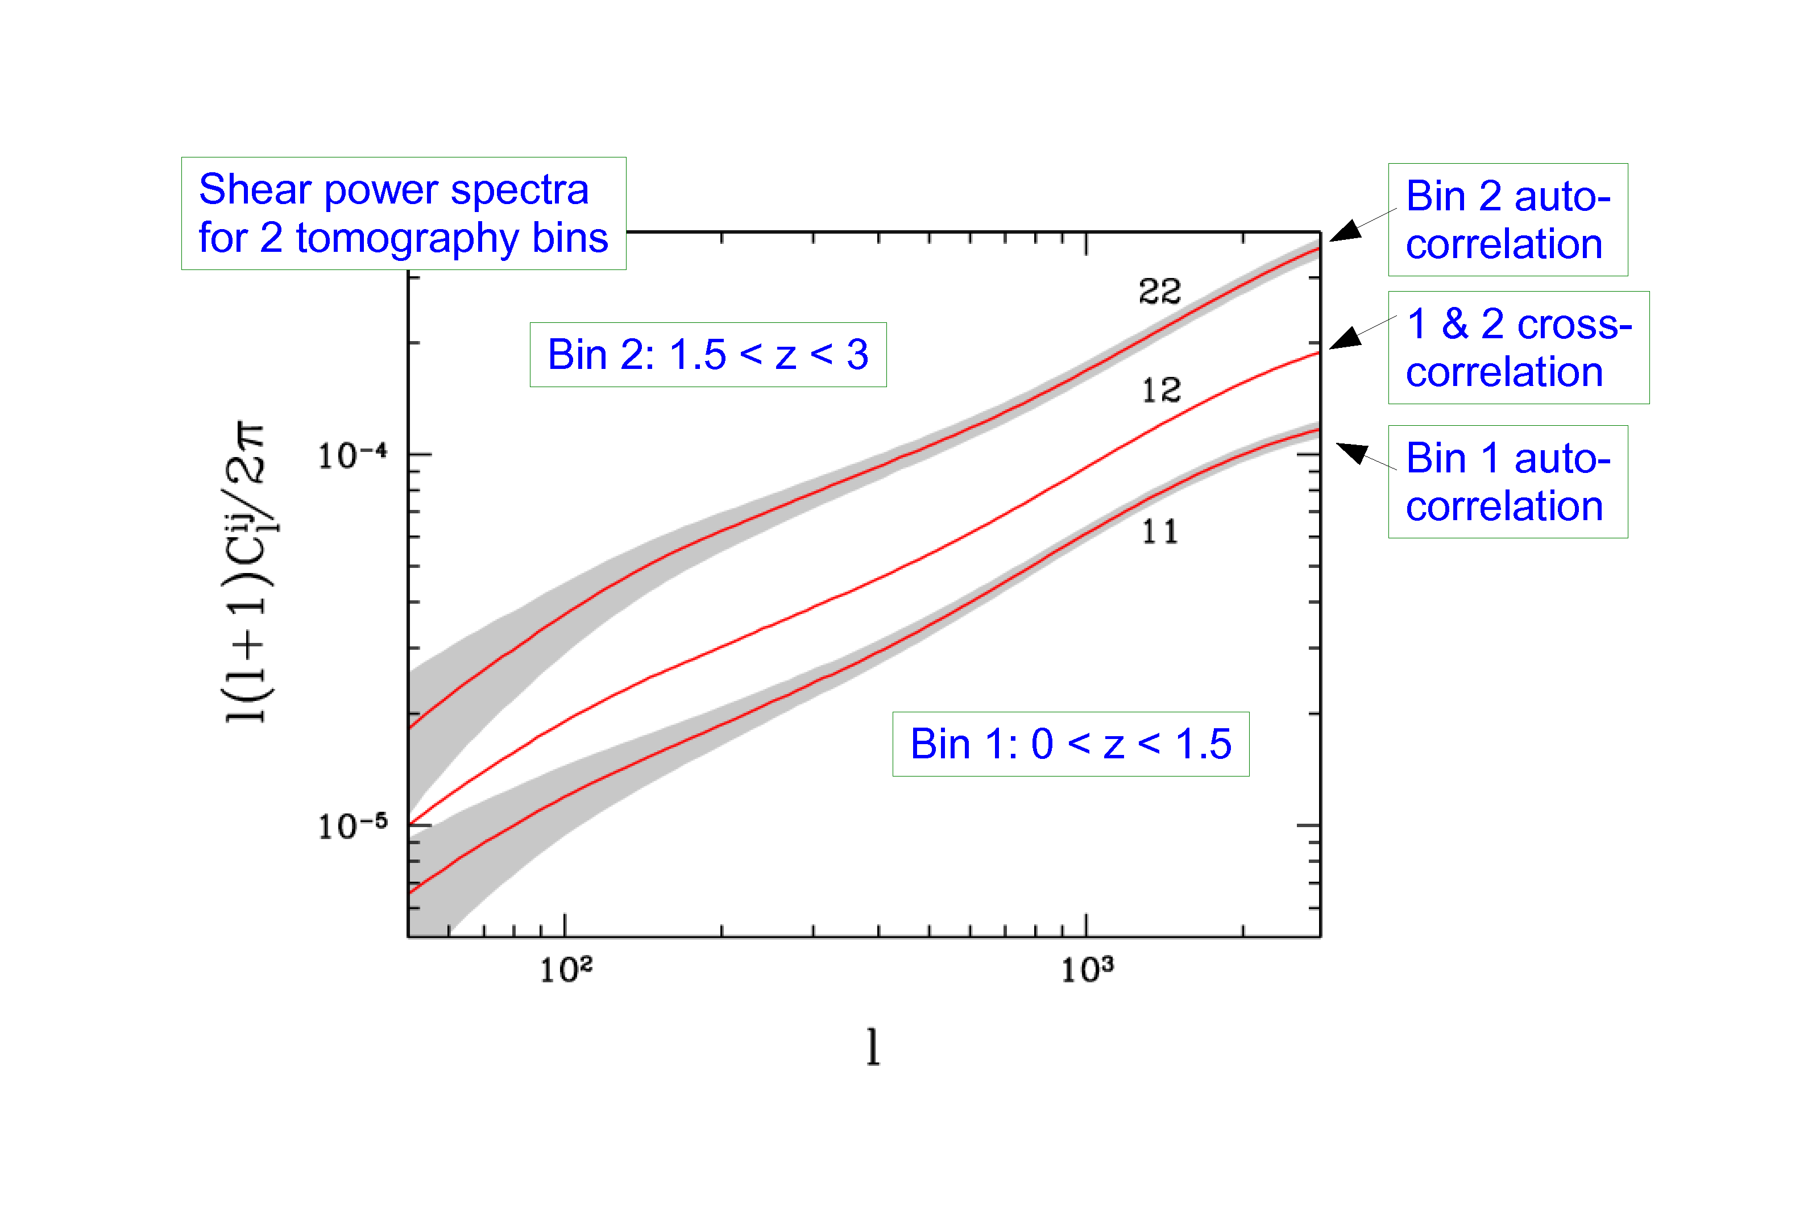
STH, TU, WONG 2006

Slide 35
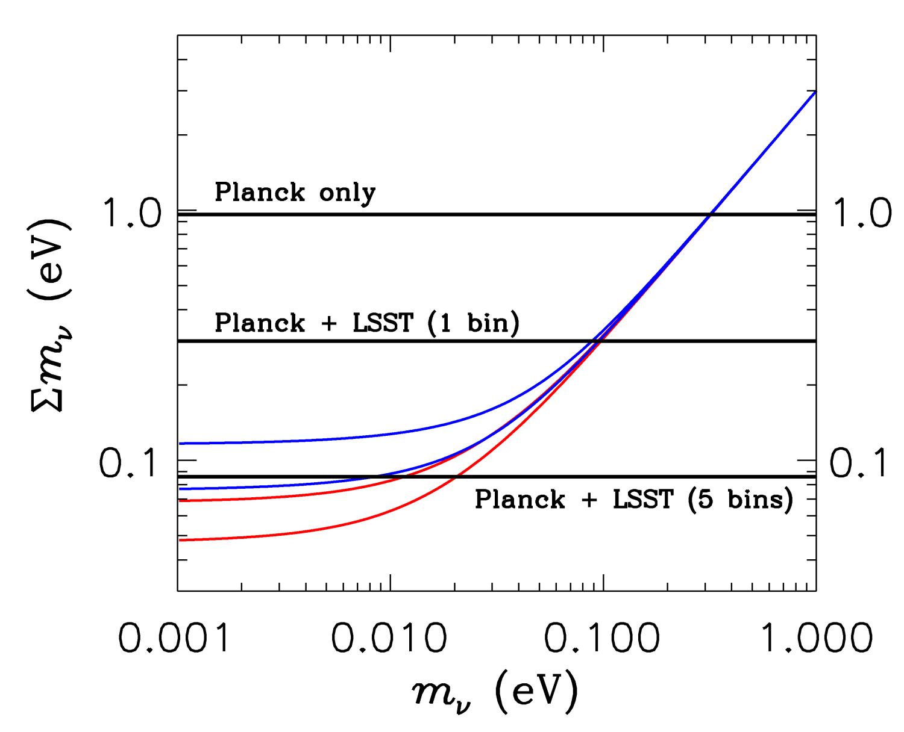
95% CL
STH, TU & WONG 2006

Slide 36
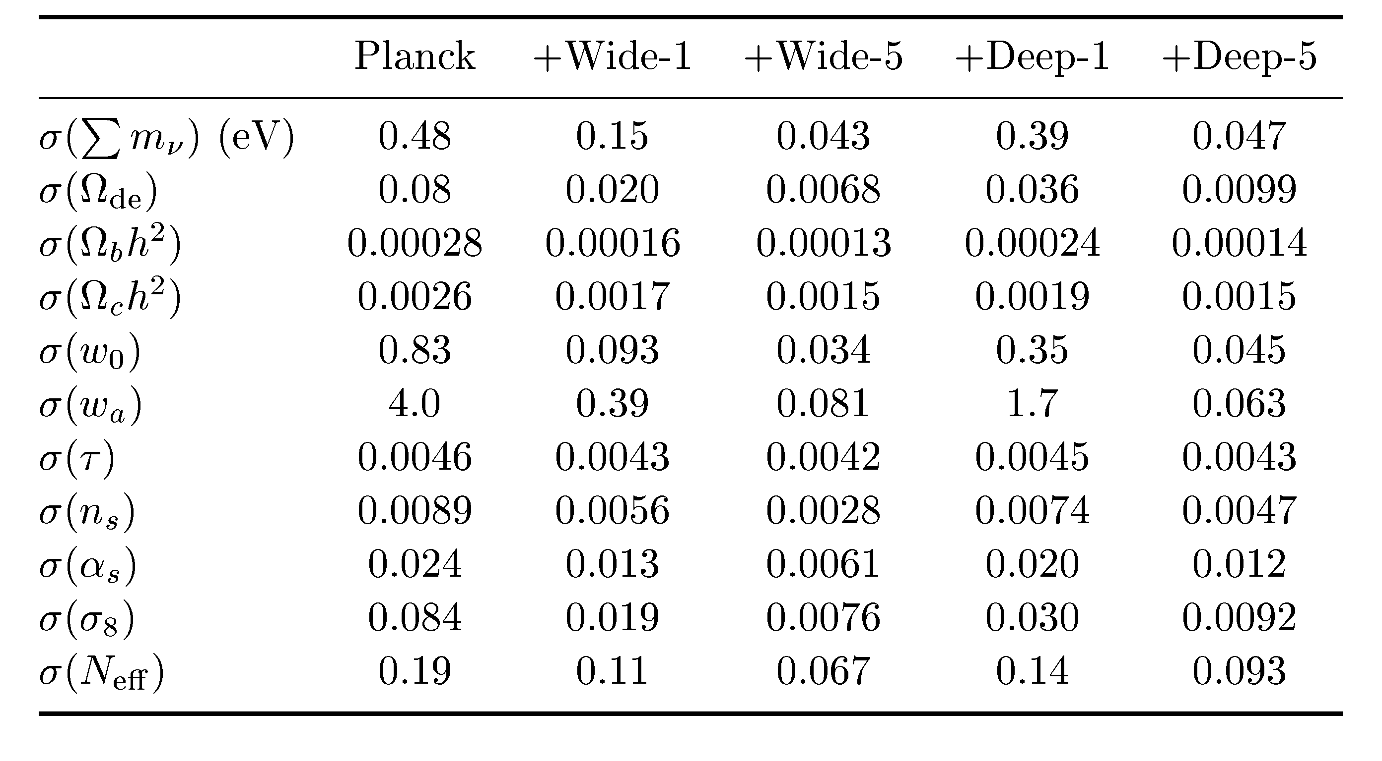
STH, TU & WONG 2006

Slide 37
THIS SOUNDS GREAT, BUT UNFORTUNATELY THE THEORETICIANS
CANNOT JUST LEAN BACK AND WAIT FOR FANTASTIC NEW DATA
TO ARRIVE…..

Slide 38
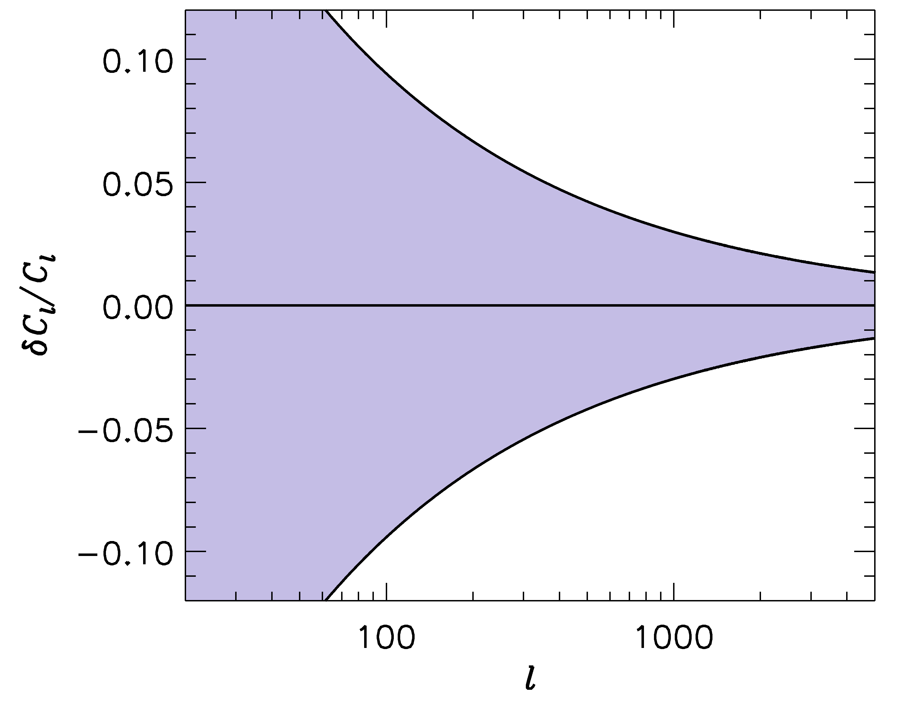
FUTURE SURVEYS LIKE LSST WILL PROBE THE POWER SPECTRUM
TO ~ 1-2 PERCENT PRECISION
-1
”LSST” ERROR BARS
WE SHOULD BE ABLE TO CALCULATE THE POWER SPECTRUM
TO AT LEAST THE SAME PRECISION!

Slide 39
IN ORDER TO CALCULATE THE POWER SPECTRUM TO 1%
ON THESE SCALES, A LARGE NUMBER OF EFFECTS MUST
BE TAKEN INTO ACCOUNT
BARYONIC PHYSICS – STAR FORMATION, SN FEEDBACK,…..
NEUTRINOS, EVEN WITH NORMAL HIERARCHY
NON-LINEAR GRAVITY
……………………..

Slide 40
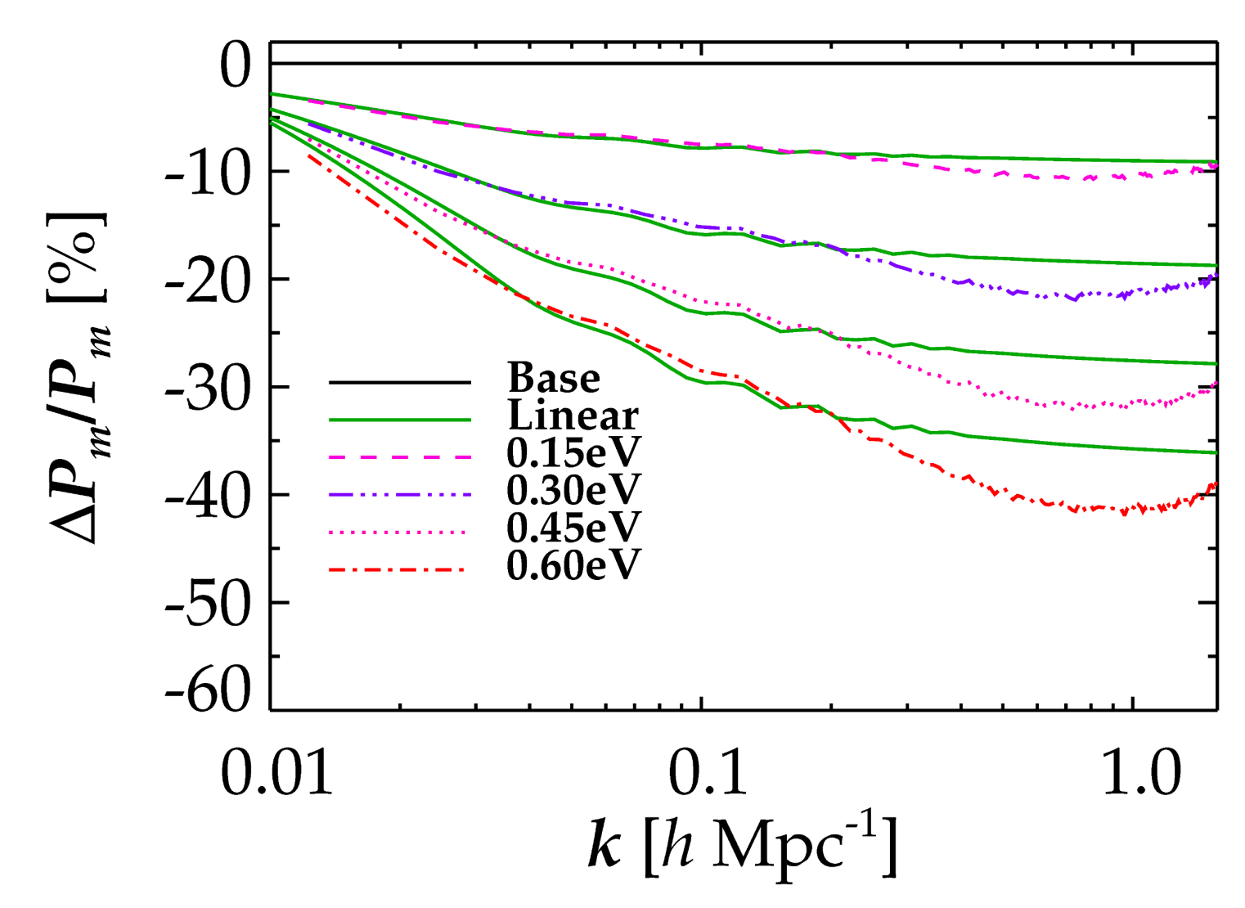
NON-LINEAR EVOLUTION PROVIDES AN ADDITIONAL AND VERY
CHARACTERISTIC SUPPRESSION OF FLUCTUATION POWER DUE TO
NEUTRINOS (COULD BE USED AS A SMOKING GUN SIGNATURE)
LINEAR THEORY
FULL NON-LINEAR
Brandbyge, STH, Haugbølle, Thomsen, arXiv:0802.3700 (JCAP)
Brandbyge & STH ’09, ’10 (JCAP), Viel, Haehnelt, Springel ’10

Slide 41
ANOTHER IMPORTANT ASPECT OF STRUCTURE FORMATION
WITH NEUTRINOS:
THE NUMBER OF BOUND OBJECTS (HALOS) AS WELL AS THEIR
PROPERTIES ARE CHANGED WHEN NEUTRINOS ARE INCLUDED

Slide 42
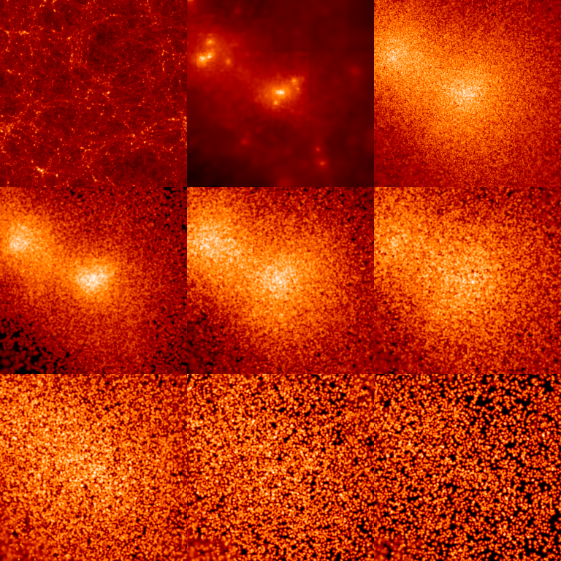
INDIVIDUAL HALO PROPERTIES
CDM
ν
512 h⁻¹ Mpc
0 < p/T < 1
1 < p/T < 2
2 < p/T < 3
3 < p/T < 4
4 < p/T < 5
5 < p/T < 6

Slide 43
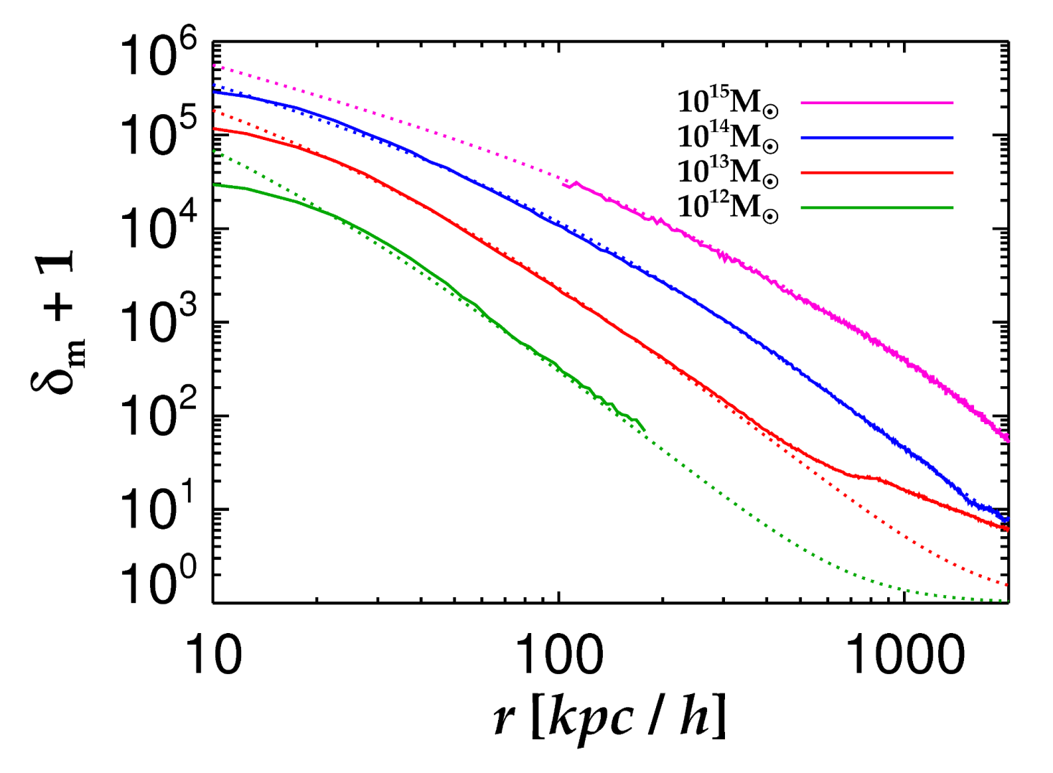
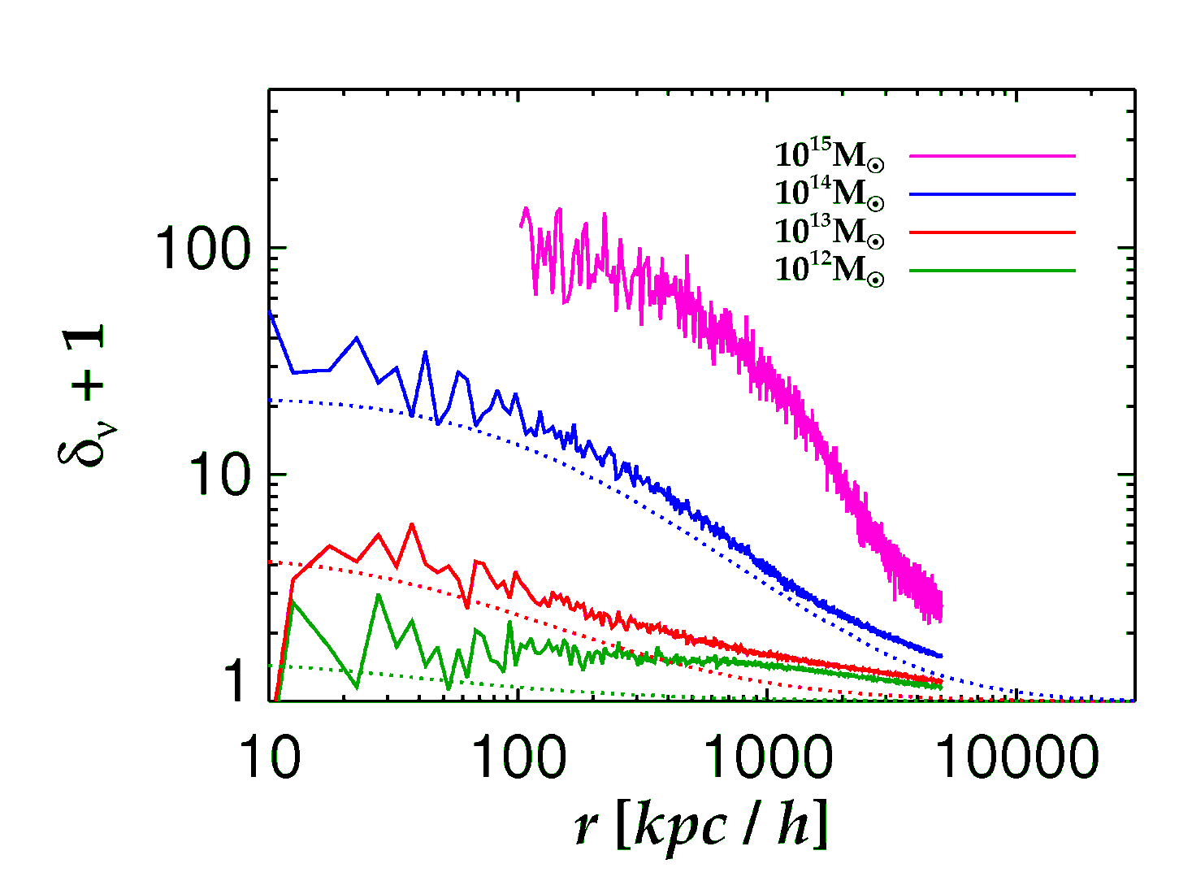
Brandbyge, STH, Haugboelle, Wong, arxiv:1004.4105
Neutrinos
Cold Dark Matter
See also Ringwald & Wong 2004

Slide 44
RECENTLY THERE HAS BEEN RENEWED INTEREST IN THE
POSSIBLE DETECTION OF THE COSMIC RELIC NEUTRINO BACKGROUND
THE MOST PROMISING POSSIBILITY IS TO USE NEUTRINO CAPTURE
FROM THE CνB (dating back to Weinberg ’62)
E.g.
ANY EXPERIMENT DESIGNED TO MEASURE THE BETA ENDPOINT
(E.G. KATRIN) CAN BE USED TO PROBE THE COSMIC NEUTRINO
BACKGROUND
PROBLEM: THE RATE IS TINY!!!
ANY EXPERIMENT OF THIS KIND WHICH MEASURED THE COSMIC
NEUTRINO BACKGROUND WILL AUTOMATICALLY PROVIDE AN
EXCELLENT MEASUREMENT OF THE NEUTRINO MASS

Slide 45
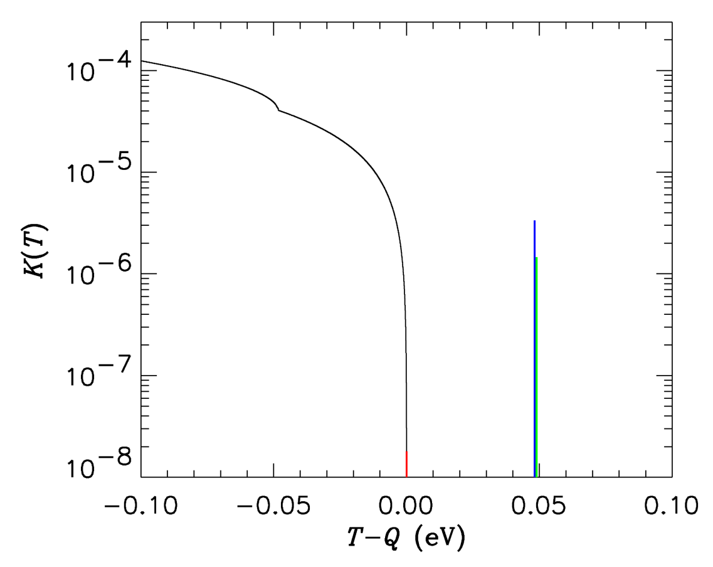
KURIE PLOT FOR TRITIUM – ASSUMES INVERTED HIERARCHY
AND Θ₁₃ CLOSE TO THE CURRENT UPPER BOUND
WITH INFINITELY GOOD ENERGY RESOLUTION THERE WILL BE
3 DISTINCT PEAKS FROM BACKGROUND ABSORPTION
AMPLITUDE OF EACH PROPORTIONAL TO

Slide 46
AND FINALLY: IN THE FAR DISTANT FUTURE (PERHAPS IN TIME
FOR THE 100th ANNIVERSARY) WE MIGHT BE OBSERVING THE
CνB ANISOTROPY
FOR SMALL MASSES IT CAN BE CALCULATED IN A WAY
SIMILAR TO THE PHOTON ANISOTROPY, WITH SOME
IMPORTANT DIFFERENCES:
AS SOON AS NEUTRINOS GO NON-RELATIVISTIC ALL HIGH l
MULTIPOLES ARE SUPPRESSED (ESSENTIALLY A GEOMETRIC
EFFECT)
GRAVITATIONAL LENSING IS MUCH MORE IMPORTANT THAN
FOR MASSLESS PARTICLES
STH & Brandbyge, arXiv:0910.4578 (JCAP)
(see also Michney, Caldwell astro-ph/0608303)

Slide 47
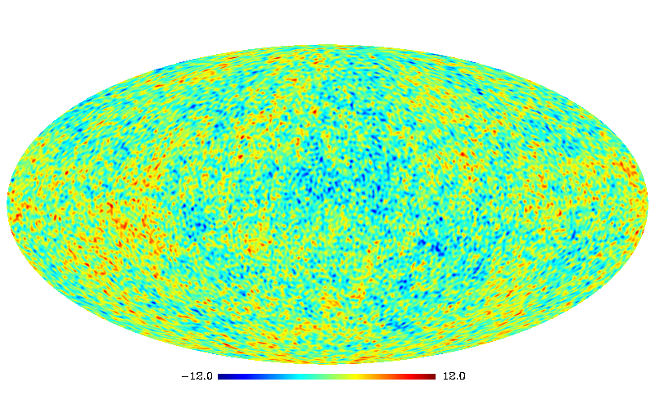
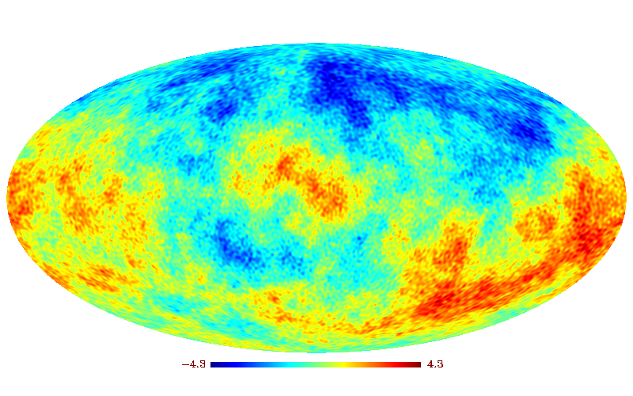
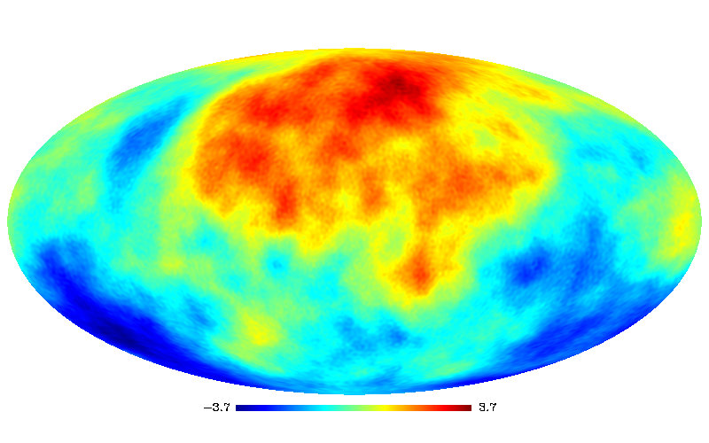
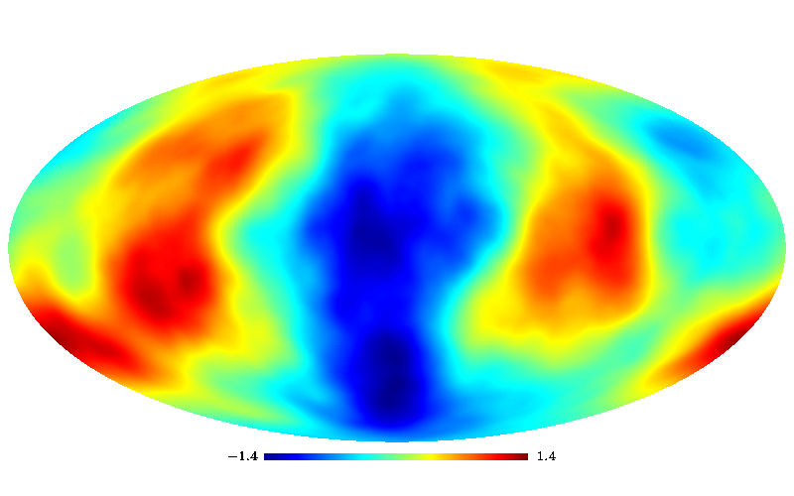
REALISATIONS OF THE CνB FOR DIFFERENT MASSES

Slide 48
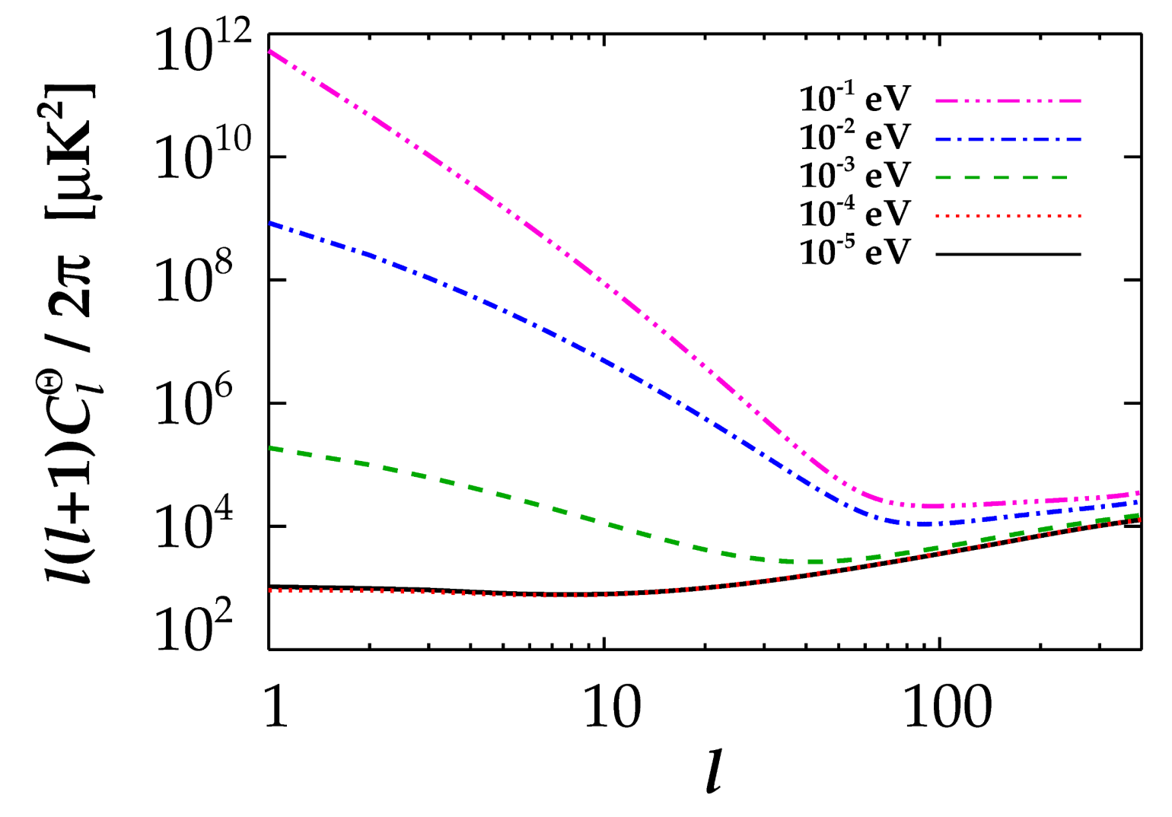
ANISOTROPY ~ O(1)
STH & Brandbyge, arXiv:0910.4578 (JCAP)

Slide 49
CONCLUSIONS
NEUTRINO PHYSICS IS PERHAPS THE PRIME EXAMPLE OF HOW
TO USE COSMOLOGY TO DO PARTICLE PHYSICS
THE BOUND ON NEUTRINO MASSES IS SIGNIFICANTLY
STRONGER THAN WHAT CAN BE OBTAINED FROM DIRECT
EXPERIMENTS, ALBEIT MUCH MORE MODEL DEPENDENT
COSMOLOGICAL DATA MIGHT ACTUALLY BE POINTING TO
PHYSICS BEYOND THE STANDARD MODEL IN THE FORM OF
STERILE NEUTRINOS

