Slide 1
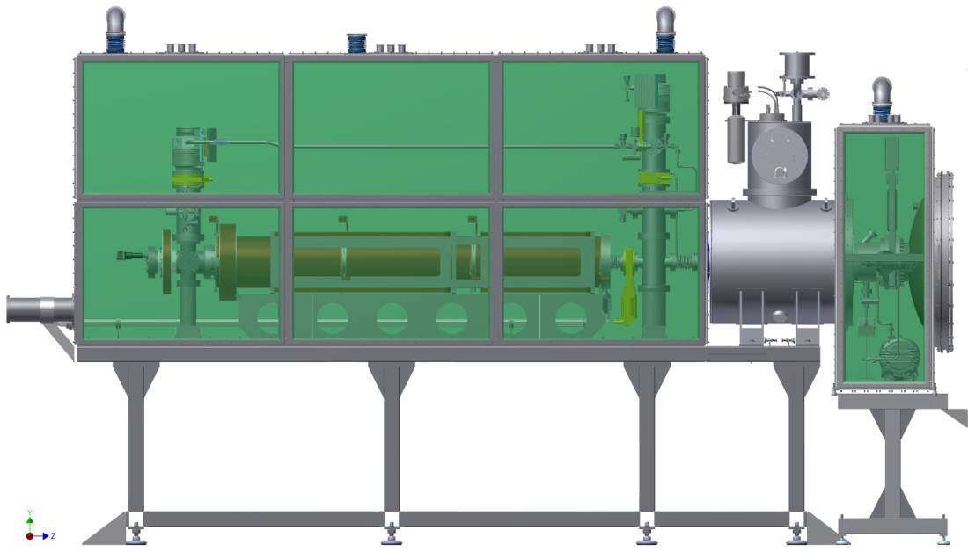
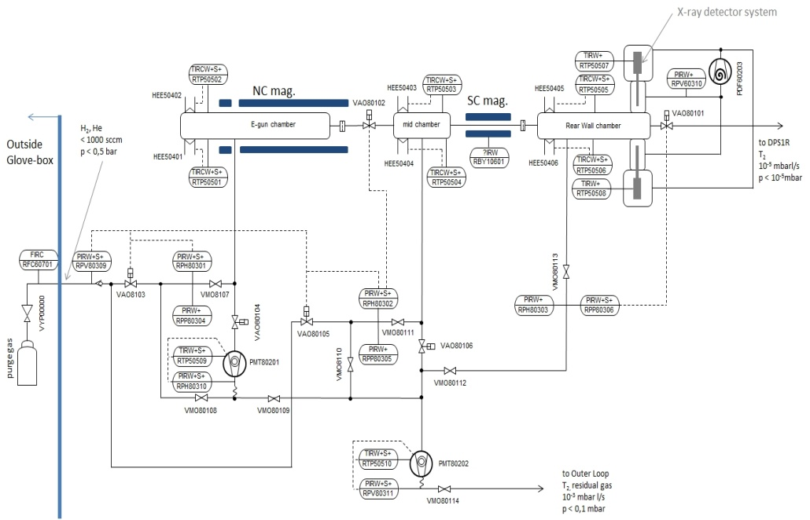
Design, development and test experiments for the Rearsection of KATRIN
GK Workshop
Bad Liebenzell, 30.9 - 2.10

Slide 2
Contents
Introduction to KATRIN
Rearsection functions and design
Electron gun design and electromagnetic simulations
E-gun beam detector
Rear Wall qualification and work function measurements
Summary

Slide 3
Contents
Introduction to KATRIN
Rearsection functions and design
Electron gun design and electromagnetic simulations
E-gun beam detector
Rear Wall qualification and work function measurements
Summary

Slide 4
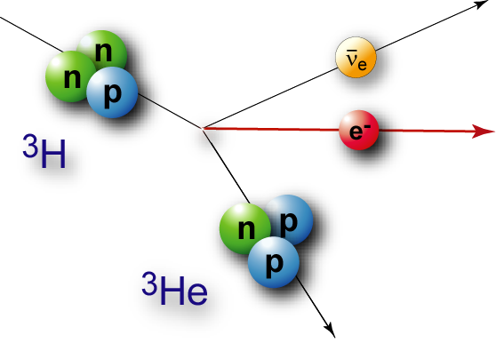
Introduction: KATRIN objective
Model independent neutrino mass from tritium β-decay kinematics
Sensitivity on m_{ν}: 0.2 eV
Only assumption: relativistic energy-momentum relation
³H:
E₀ = 18.6 keV
T_{1/2} = 12.3 y

Slide 5
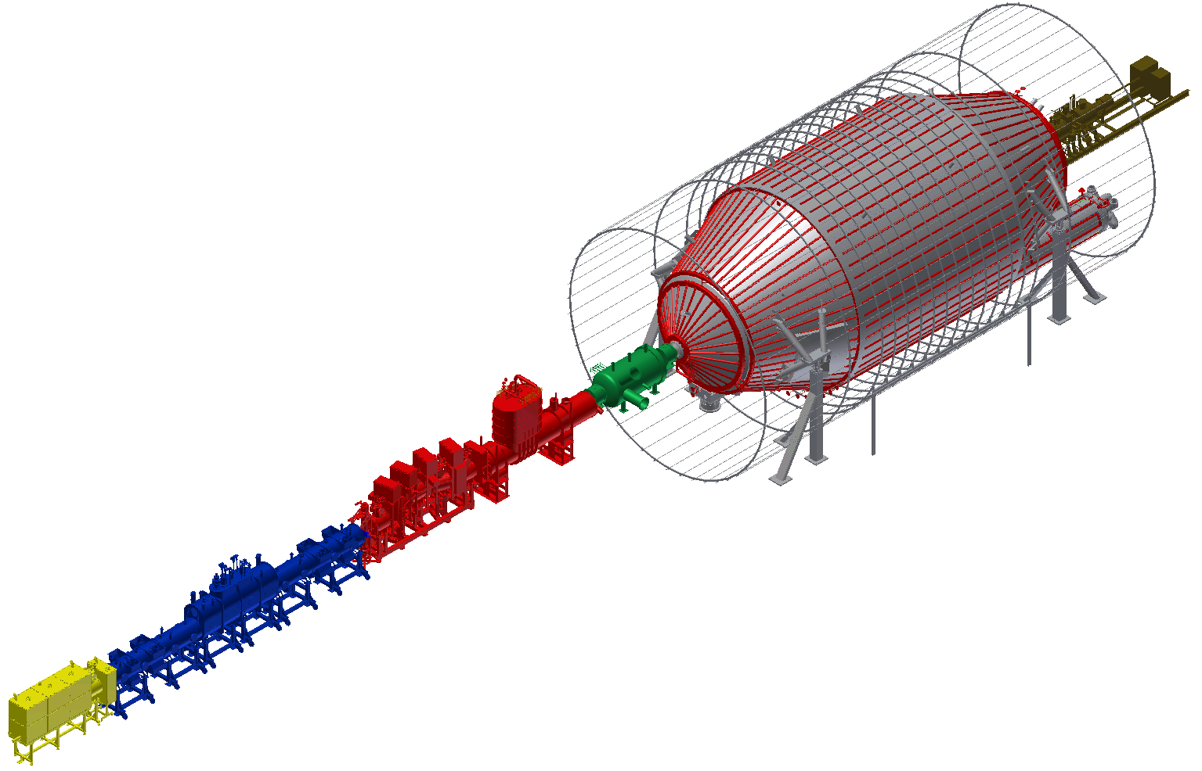
Introduction: KATRIN experimental setup
Main components:
WGTS: High-luminosity gaseous tritium source
DPS, CPS: Pumping sections
Two electrostatic retarding spectrometers (MAC-E-filters)
Main detector
CMS (connected to DPS1-R/WGTS)
Detector
CPS
DPS2
Pre- and main spectrometer
WGTS
DPS1-F
CMS
DPS1-R

Slide 6
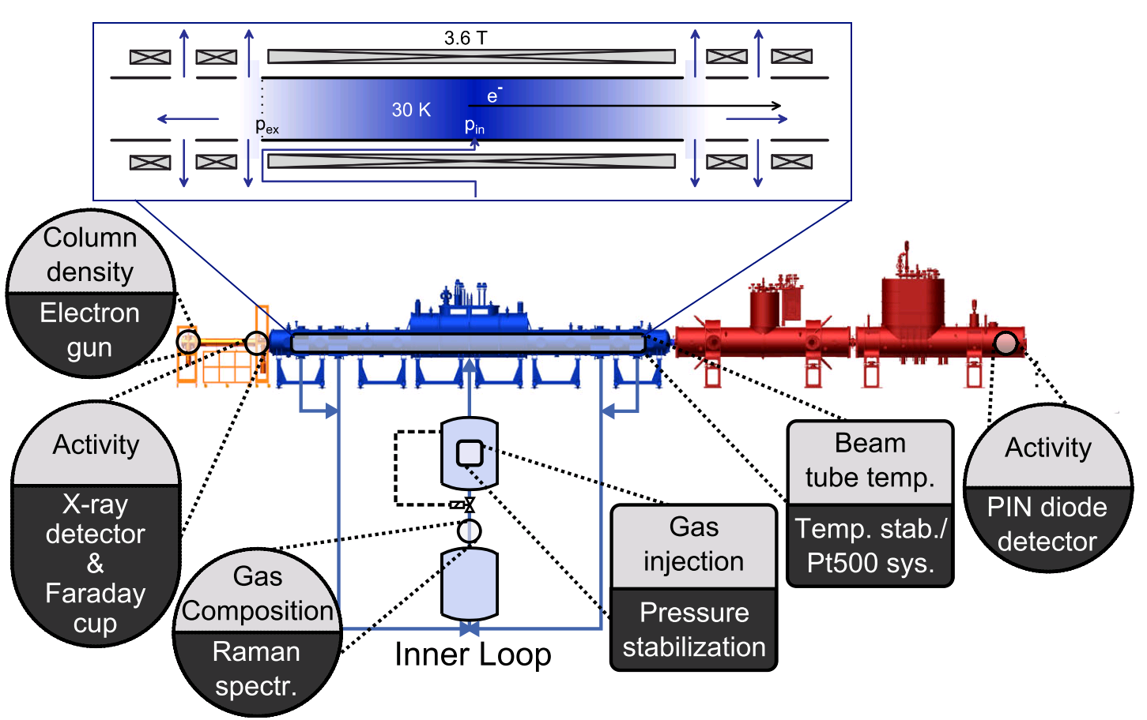
Source and transport section of KATRIN
STS: Tritium handling, control and monitoring
“Deliver” decay electrons but nothing else to the spectrometers

Slide 7
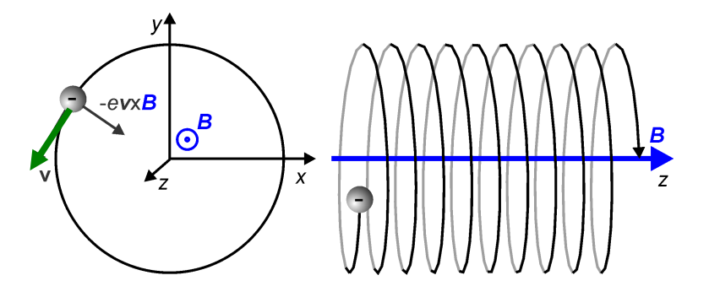
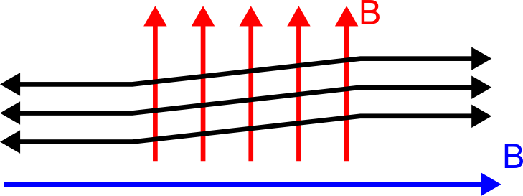
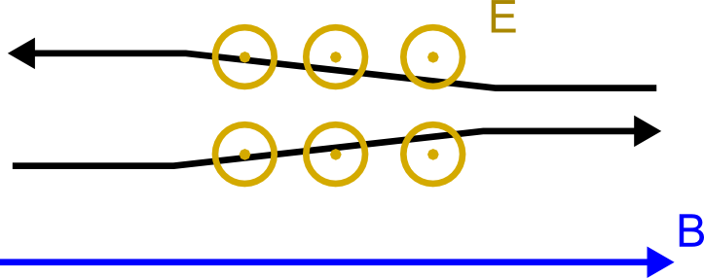
Electron guidance and track manipulation
B-Field: Cyclotron motion
Magnetic flux: Containment
Static E-Field: Acceleration
Adiabatic movement: Conservation of magnetic momentum µ = E_{T}/B
Magnetic dipole fields
B-Field and electric Field: E x B drift
e⁻
e⁻
e⁻
e⁻
B
B
-
-
-
-
e⁻
+
+
+
+
v
t

Slide 8
Electron guidance and track manipulation
B-Field: Cyclotron motion
Magnetic flux: Containment
Static E-Field: Acceleration
Adiabatic movement: Conservation of magnetic momentum µ = E_{T}/B
Magnetic dipole fields
B-Field and electric Field: E x B drift
e⁻
e⁻
e⁻
e⁻
B
B
-
-
-
-
e⁻
+
+
+
+
v
t

Slide 9
Electron guidance and track manipulation
B-Field: Cyclotron motion
Magnetic flux: Containment
Static E-Field: Acceleration
Adiabatic movement: Conservation of magnetic momentum µ = E_{T}/B
Magnetic dipole fields
B-Field and electric Field: E x B drift
e⁻
e⁻
e⁻
e⁻
B
B
-
-
-
-
e⁻
+
+
+
+
v
t

Slide 10
Contents
Introduction to KATRIN
Rearsection functions and design
Electron gun design and electromagnetic simulations
E-gun beam detector
Rear Wall qualification and work function measurements
Summary

Slide 11
Scheme of the Rearsection
2nd Containment
Rear Wall monitoring
TMP
TMP
Valves
Coils, Dipole Coils and Electrodes
Valve
Valve
Super-conducting Coil
Electron Gun
Diaphragm
Rear Wall
DPS-1R →
Rear Wall with stable plasma potential and monitoring
Valve, diaphragm and pumping for Tritium reduction at the electron gun
Electron Gun and electromagnetic design with axisymmetric (air-)coils, dipole coils and dipole electrodes leading electrons into DPS1-R
Containment for Tritium safety

Slide 12
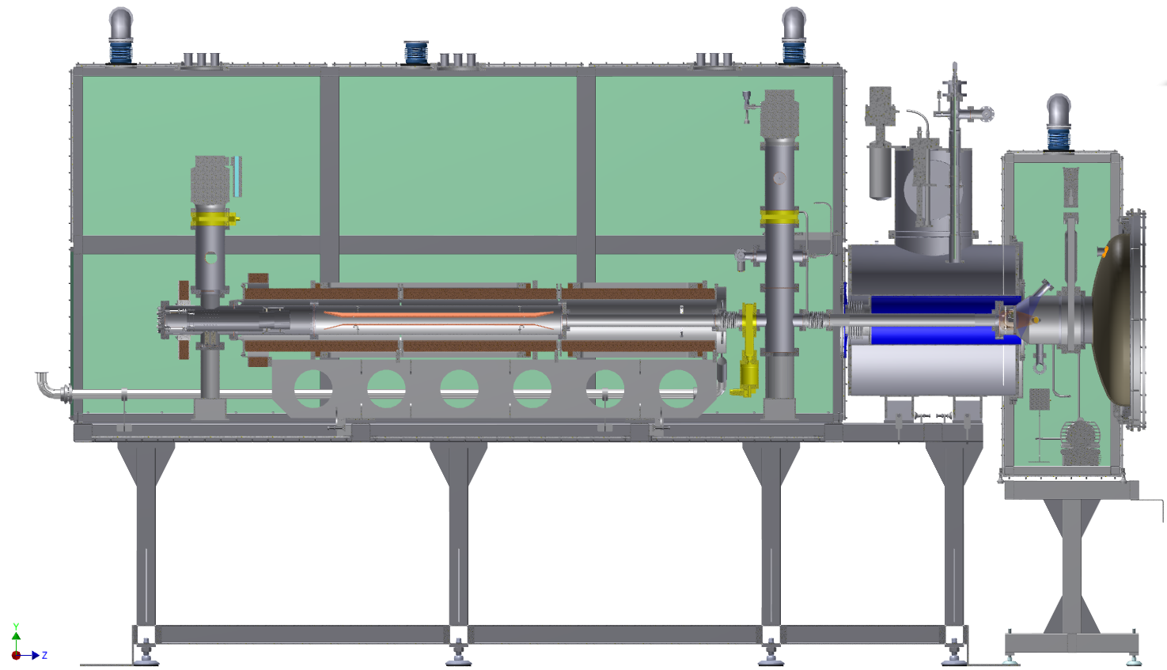
Rearsection technical design
Electron gun chamber
Transport section:
Solenoid, magnetic & electric dipoles
First chamber:
Pumping & sensors
RSCM
Rear Wall
& activity
monitoring

Slide 13
Rearsection vacuum scheme
Pressure monitoring and evacuation of each chamber individually possible
Fore line pressure for TMPs provided by the STS outer loop
Explicit purge gas connection and out baking for UHV

Slide 14
Contents
Introduction to KATRIN
Rearsection functions and design
Electron gun design and electromagnetic simulations
E-gun beam detector
Rear Wall qualification and work function measurements
Summary

Slide 15
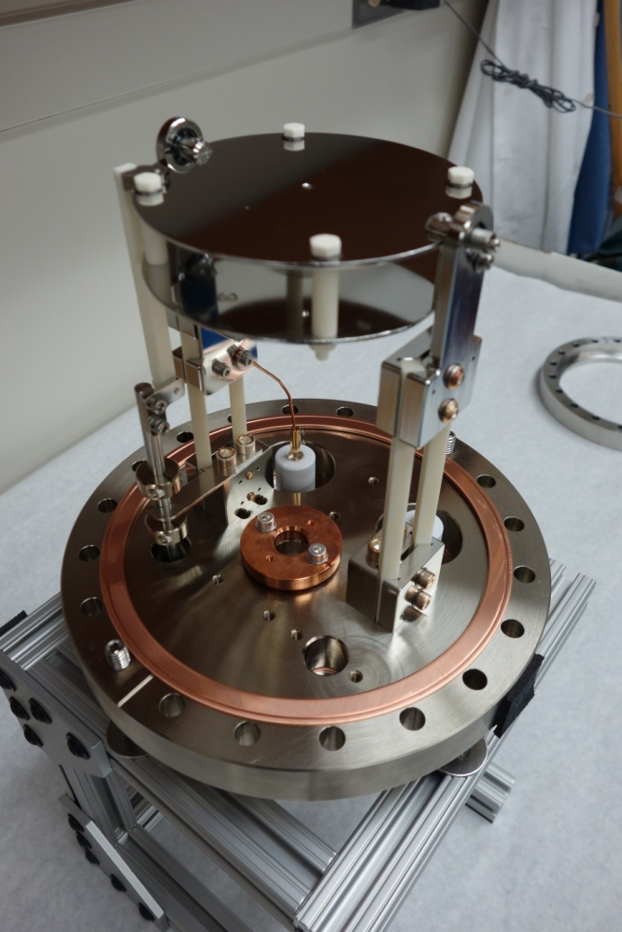
Electron gun mechanical design (1/2)
Features
High precision E-gun with adjustable angle+energy
Stepper motor + linear feed-through
HV cabling and insulation using off-the-shelf parts
Port for UV-light feed-in available
Ceramic bearings are used for turn-able plates

Slide 16
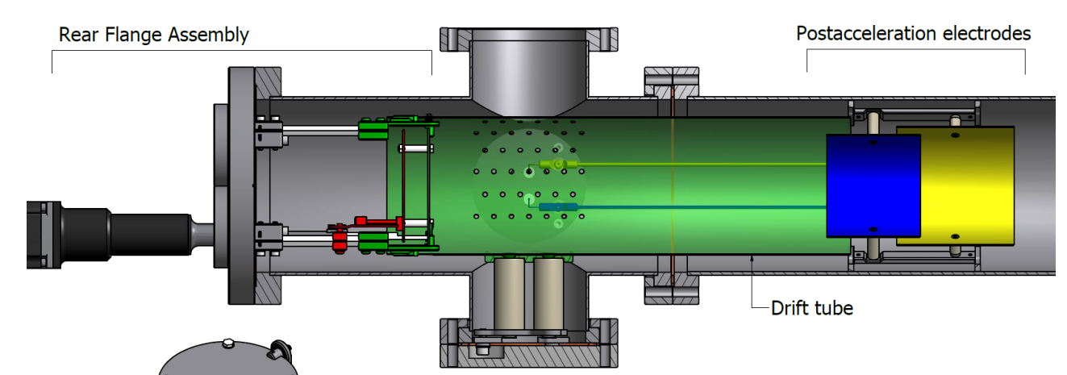
Electron gun mechanical design (2/2)
Flexible, modular design with special concern on alignment and HV
Prototype is currently machined and build at UCSB
All dimensions are results of simulations and optimizations with consideration of mechanical stringents

Slide 17
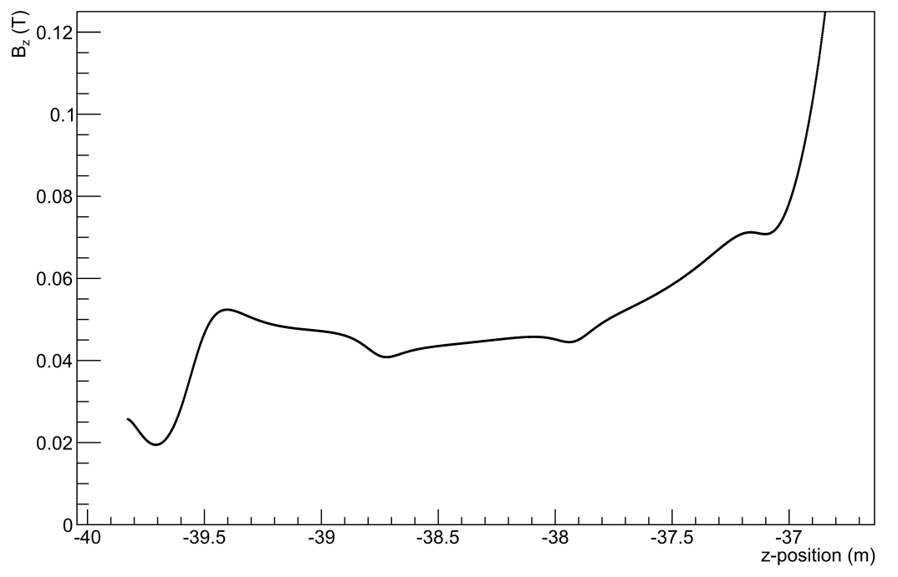
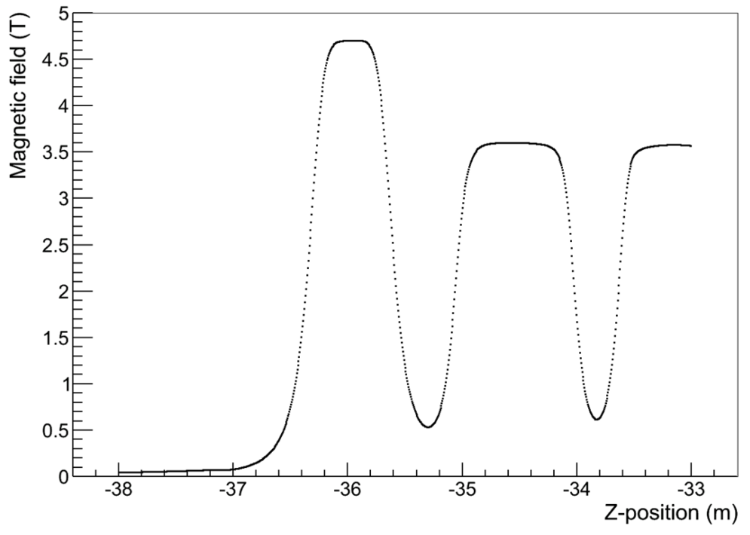
Electromagnetic transport: Solenoids

Slide 18
Electromagnetic transport: Dipole coils
E-Gun electrons shifted by electric and magnetic dipoles
Moveable offset aperture to block direct line of sight for T₂
Rear Wall hole must be closed during normal KATRIN measurements

Slide 19
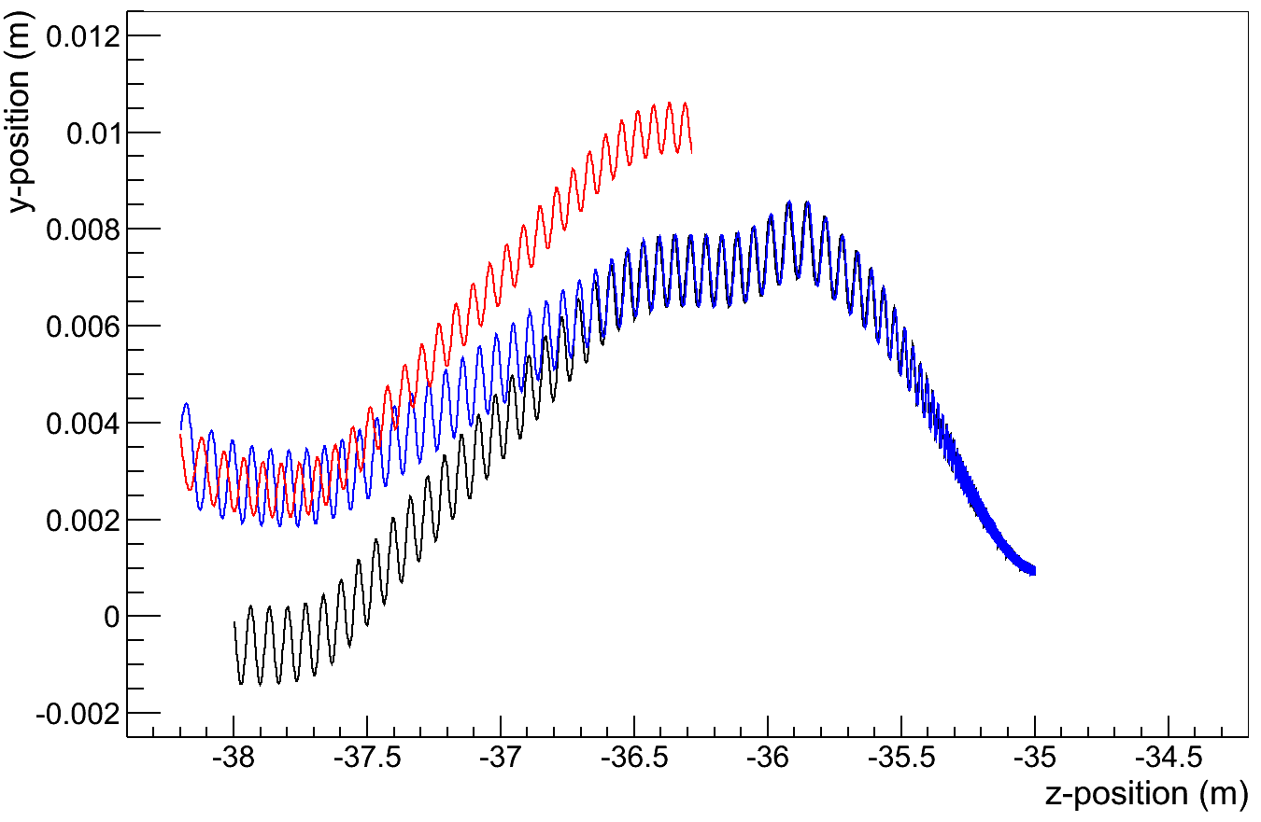
Electromagnetic transport: Dipole electrodes
Reflected electrons get significantly shifted in y-direction, even when reflected at the E-Gun they will certainly not pass the diaphragm again
Overall maximum adiabaticity violation in new design < 1 %

Slide 20
Contents
Introduction to KATRIN
Rearsection functions and design
Electron gun design and electromagnetic simulations
E-gun beam detector
Rear Wall qualification and work function measurements
Summary

Slide 21
Electron gun beam path – Beam tracker
To fire the electrons reliable through the small holes in aperture/Rear Wall a sensor is required
The electrons can be shifted up/downwards by dipole electrodes and in all directions by magnetic dipoles
Quadrant detectors with central holes in combination with a trans impedance amplifier can used as sensors

Slide 22
E-gun beam tracker build
Minimalistic electronics with 4 channel transimpedance amplifier
SMD, silver-palladium circuit print on a Al2O3 ceramic
Electronics proofed to be robust but still sensitive

Slide 23
E-gun beam tracker results (1/3)
Slow temperature dependent drift (leakage current)
Clear signal jumps when e-gun beam hits the detector

Slide 24
E-gun beam tracker results (2/3)
Used the dipole coils to „wipe“ over a detector pixel

Slide 25
E-gun beam tracker results (3/3)
Some dependence of voltage shift and primary electron energy visible – just as predicted by theory.

Slide 26
Contents
Introduction to KATRIN
Rearsection functions and design
Electron gun design and electromagnetic simulations
E-gun beam detector
Rear Wall qualification and work function measurements
Summary

Slide 27
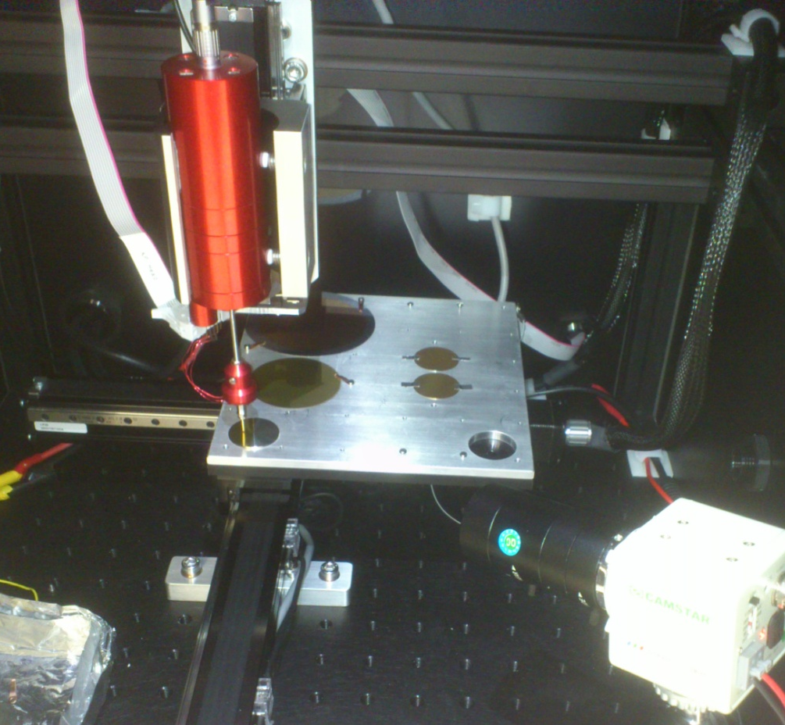
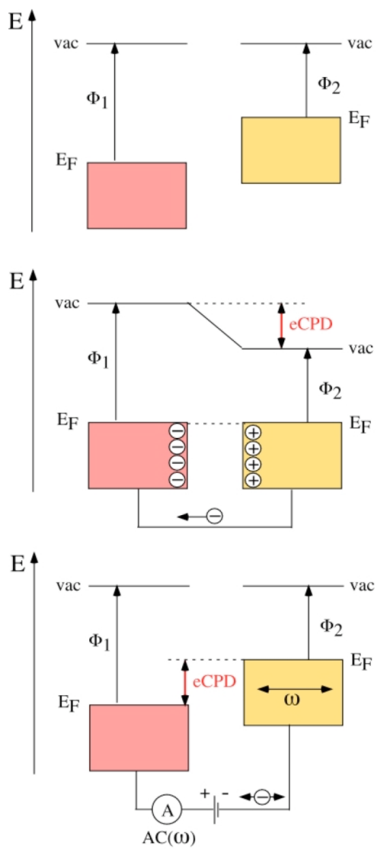
Work function measurement with a Kelvin Probe
Homogeneity and stability of work function of the Rear Wall important for KATRIN systematics
Measurement of different samples with a Kelvin probe available at University of Mainz
Kelvin probe can measure scan relative contact potential differences
Source: Dr. Schlaf

Slide 28
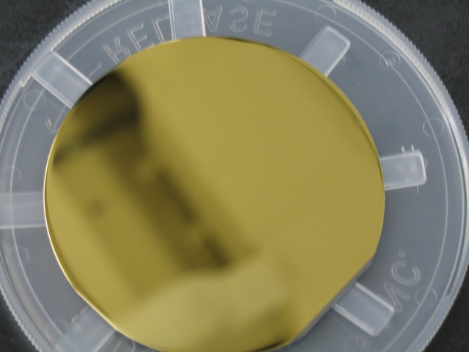
Work function measurements – Results (1/2)
Gold on a 3 inch Silicon wafer
Mean+RMS of Work Function data: 171 +/- 7 mV
Good homogeneity, but silicon is as substrate has disadvantages

Slide 29
Work function measurements – Results (2/2)
Gold on a beryllium window
Mean+RMS of Work Function data: -12 +/- 26 mV
Result not impressive but encouraging to try other metals as substrate

Slide 30
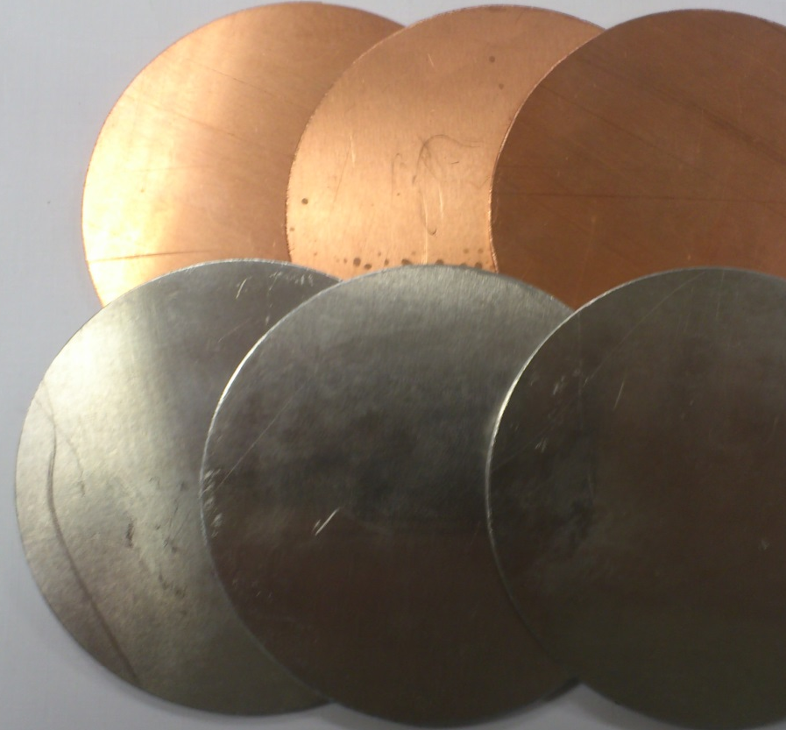
Rear Wall baseline & qualification strategy
The current, sophisticated, silicon-based Rear-Wall candidate has remaining risks
Plan to develop a baseline option by gold-coating a pure, appropriate metal
Different metals/coating methods foreseen
Different testing steps with a regular measurement of the work function in between
Testing procedure:
Cleaning/reproducibility
Outbaking
Tritium contamination

Slide 31
Contents
Introduction to KATRIN
Rearsection functions and design
Electron gun design and electromagnetic simulations
E-gun beam detector
Rear Wall qualification and work function measurements
Summary

Slide 32
Summary of the Rearsection status
Development of the Rearsection at UCSB got significantly supported with design development and test experiments.
The mechanical design ultimately needed step-by-step checks and development of the electromagnetic design.
Functionality of a quadrant detector based E-gun beam tracker has been proofed. Integration of 2 beam trackers is planned.
The number of Rear Wall candidates characterized by the Kelvin probe increases steadily. It is the first obstacle in a list of qualification tests. Current favorite is gold evaporated on stainless steel.
Thanks for your Attention

